Slide 1

ConJac: Large Steps in
Dynamic Simulation
Nicholas Weidner¹, Theodore Kim², Shinjiro Sueda¹
Texas A&M University, Yale University

Slide 2
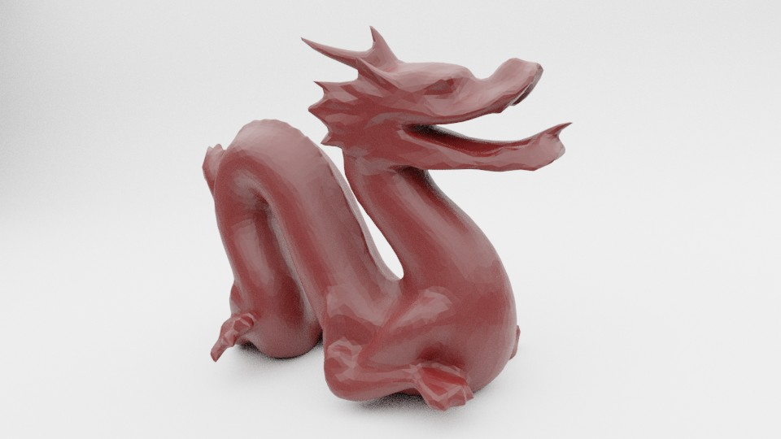
Dynamic Simulation
Pull
Pull
Gravity
Pulling a dragon
Notes:
Let’s look at this soft body dragon
It’s a tetrahedral mesh placed on a flat floor
To introduce some dynamic motion, lets introduce a gravitational force
And some pull and release forces to pull part of the dragon head and body and introduce some motion

Slide 3
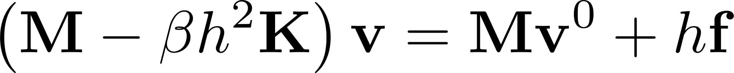
Dynamic Simulation
Pull
Linearly Implicit time stepping
Mass
Stiffness
Pull
Velocity
Step size
Forces
Gravity
Large Steps in Cloth Simulation
[Baraff and Witkin 1998]
Vanilla
Pulling a dragon
Notes:
To simulate this setup, there are a lot of different integration schemes we could choose from
Commonly used in graphics is the linearly implicit time stepping scheme
Popularized from Baraff and Witkin in 98
Just to highlight what we’re looking at, we have our mass, our implicit stiffness, our velocities, step size, and forces
This beta term is not usually written into most formulation
Think of it as a dial for the amount of implicitness we want
If we turn it down to 0, we end up with a full explicit integration scheme
Also upping this beta results in more and more quasistaticness in our result
From this point on, let’s refer to this as our vanilla formulation

Slide 4
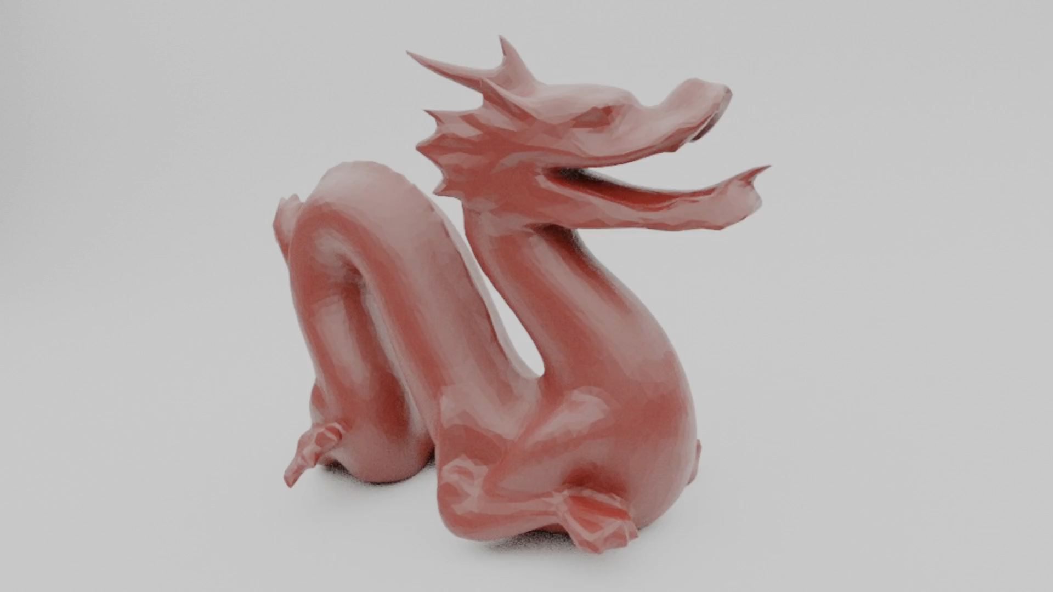
Dynamic Simulation
Vanilla h=5e-3
Notes:
Looking at our vanilla sim in action
It’s stable with some nice motion, but it’s not that dynamic
In order to increase our dynamic motion let’s reduce the time step we use

Slide 5

Dynamic Simulation
Vanilla h=2e-3
Notes:
Now we see more dynamic motion in our scene before settling
But to achieve this we had to reduce our timestep by a factor of 2.5 , which takes 2.5 the computation time of the previous example
Efficiency is a big thing in computer graphics, though
There has been a lot of research in the area of making these simulations faster, but there is usually a draw back that comes with previous approaches

Slide 6
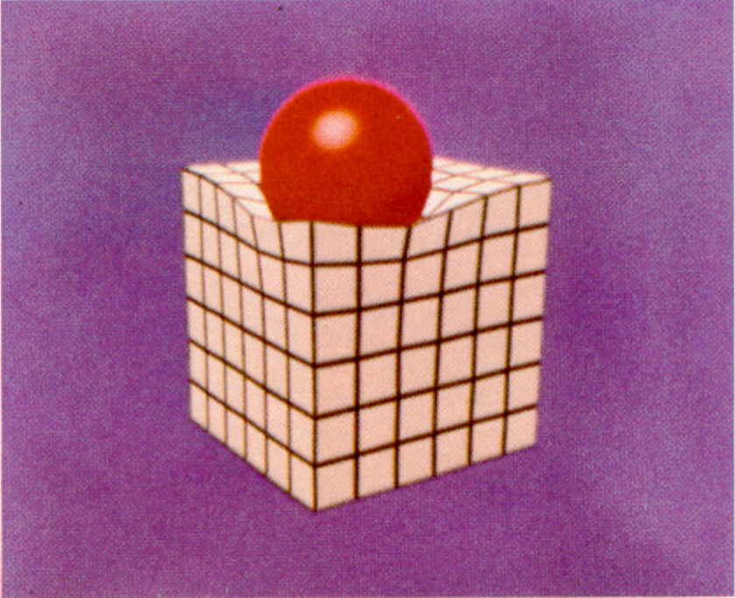
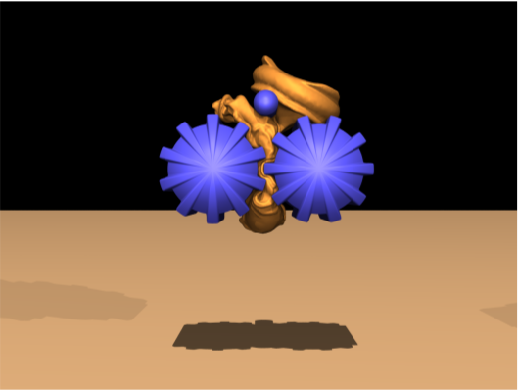
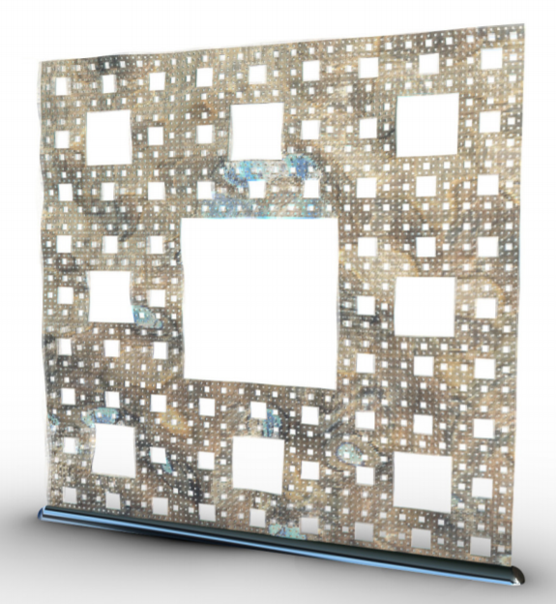
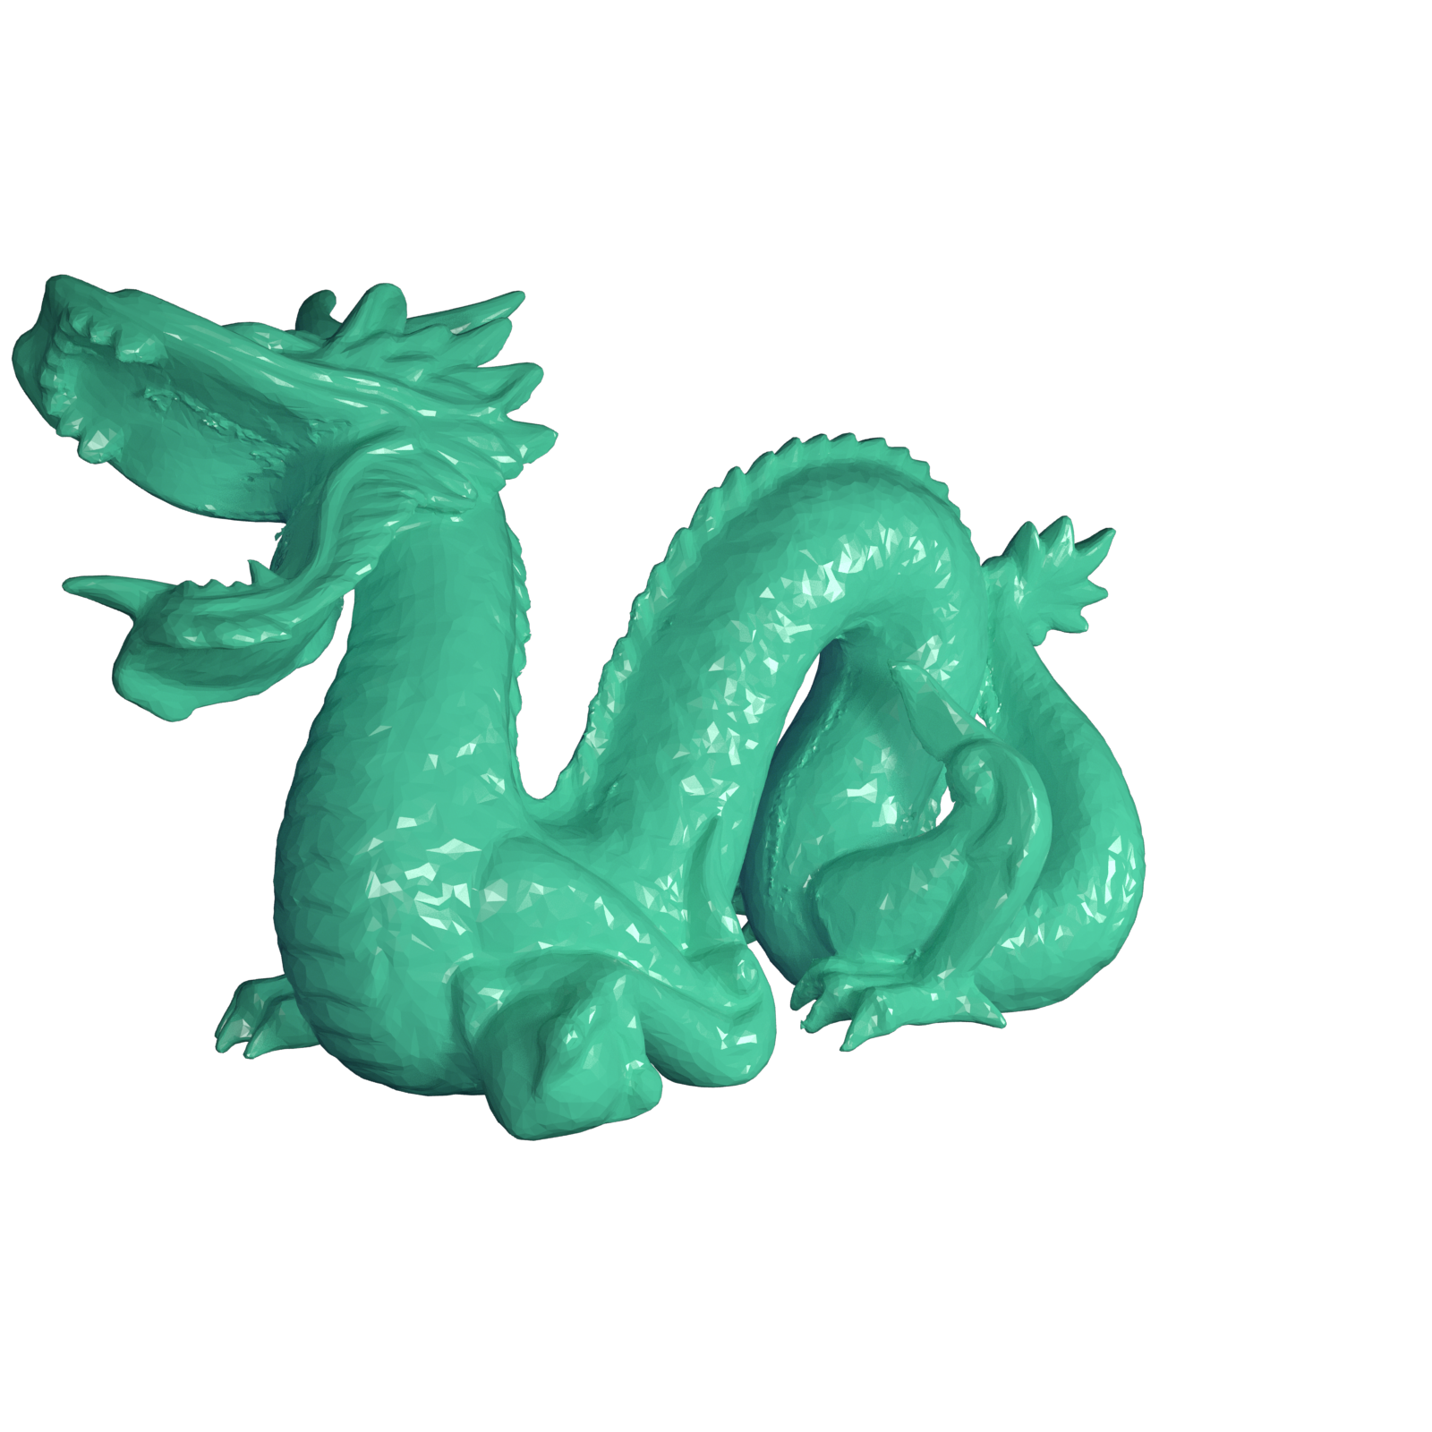


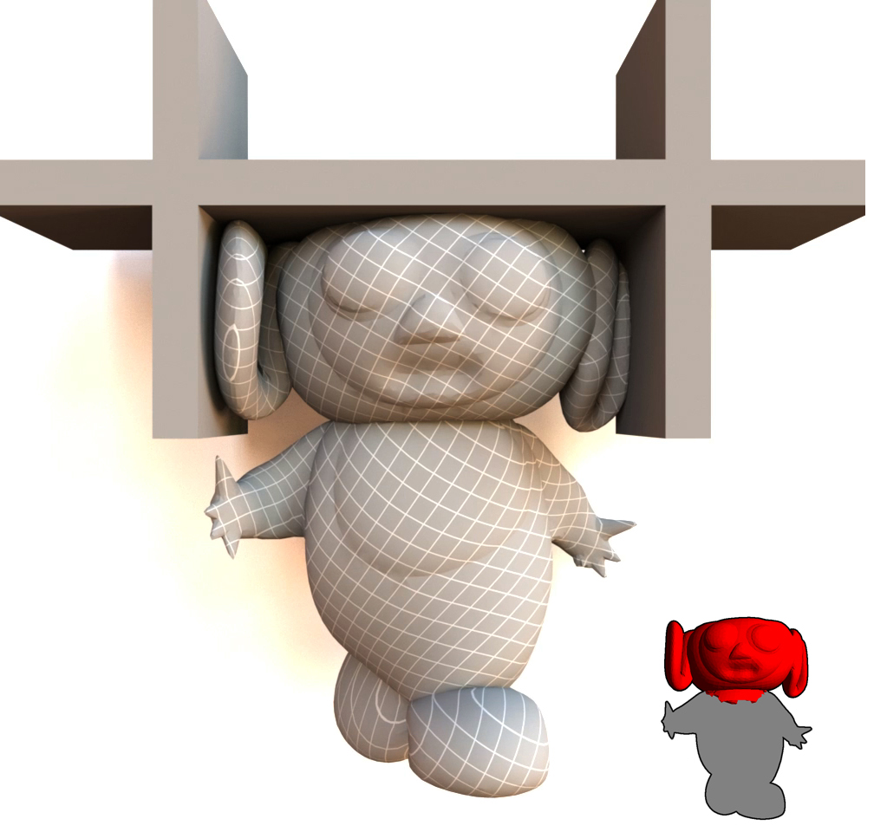
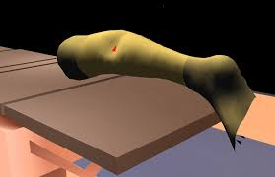
Related Work CANNOT Satisfy:
Dynamic motion at large timesteps
Same static configuration
Complex nonlinear material support
  Anisotropic
  Heterogeneous
No precomputation
  Topological changes
Fully two-way coupled simulation using existing frameworks
  Rigid bodies
[Terzopoulos et al. 1987]
[Baraff and Witkin 1998]
[Bro-Nielson and Cotin 1996]
[An et al. 2008]
[Barbic and James 2005]
[Choi and Ko 2005]
[Pan et al. 2015]
[Pentland and Williams 1989]
[Teng et al. 2015]
[Xian et al. 2019]
[Muller et al. 2007]
[Bouaziz et al. 2014]
[Narain et al. 2016]
[Zhang et al. 2019
[Mitchell et al. 2016]
[Kim and James 2011]
[Barbic and Zhao 2011]
…
Notes:
Looking across a wide breadth of related works
We’ve already mentioned that dynamic motion at large timesteps often get damped out
There are also methods out there that focus on getting results fast by other means, but these often sacrifice a proper static configuration when the motion settles down
Many laternative methods also only support linear materials, meaning they cannot support complex nonlinear materials such as anisotropic and heterogenous materials
Some methods also require a precomputation step which makes features such as topological changes impossible
Finally not every method can support two way coupled simulations with existing frameworks
This allows for the introduce of rigid body mechanics into scenes
Many previous methods can succeed at a number of these together, but none have yet been able to handle all of them at once
NEXT

Slide 7
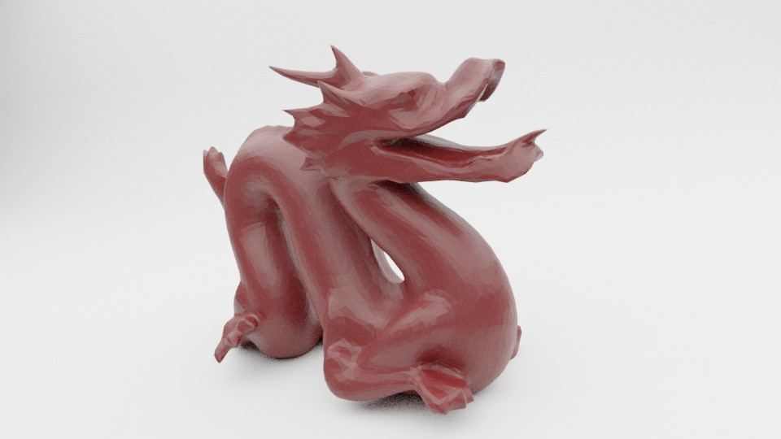
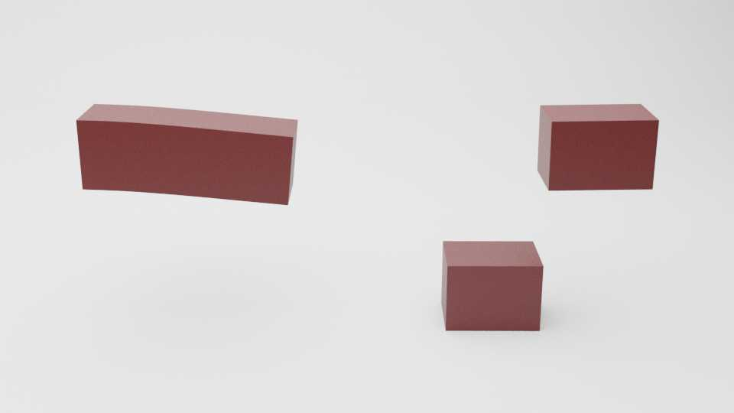
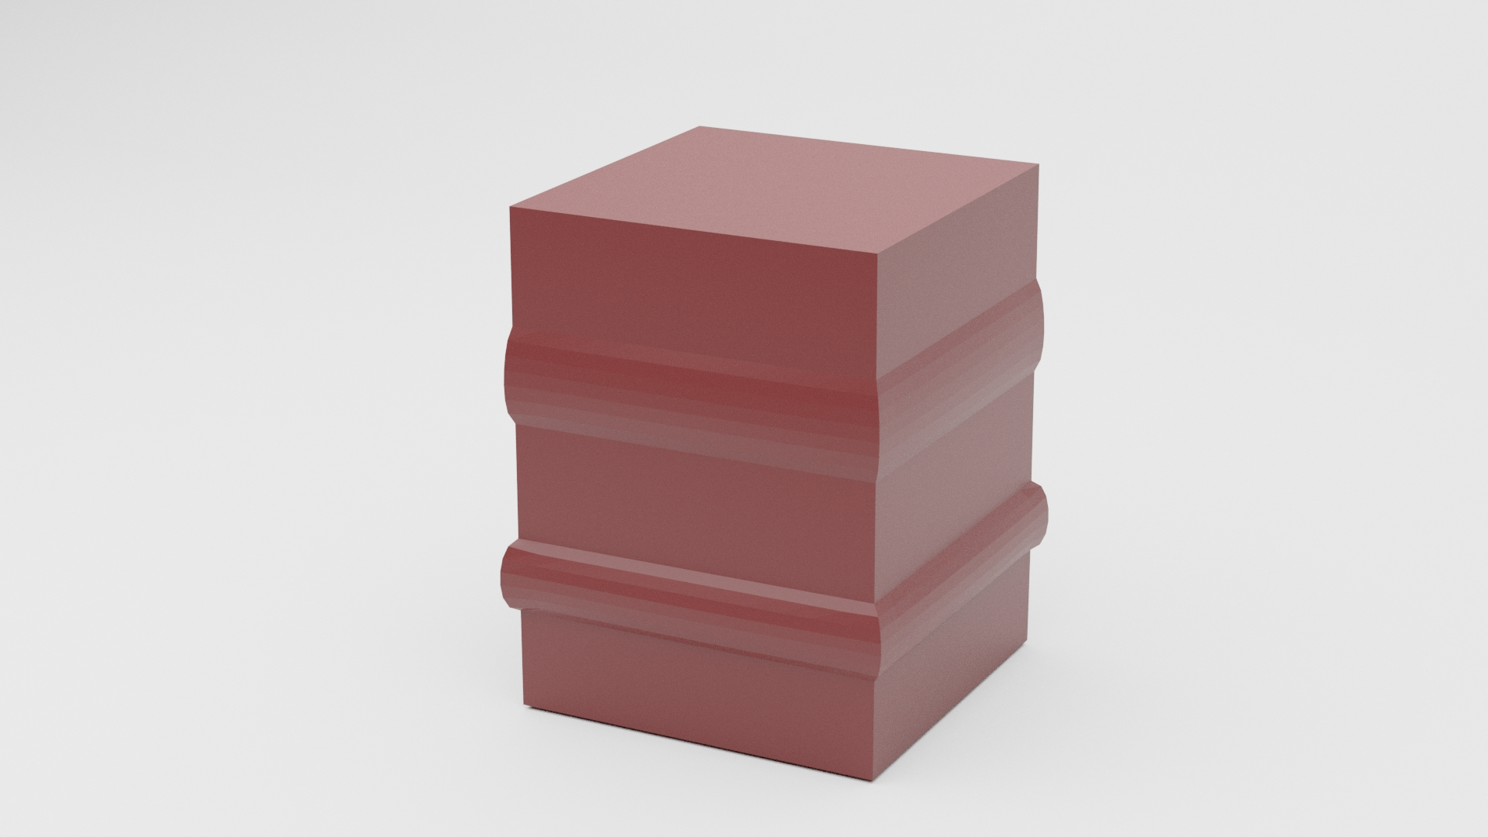
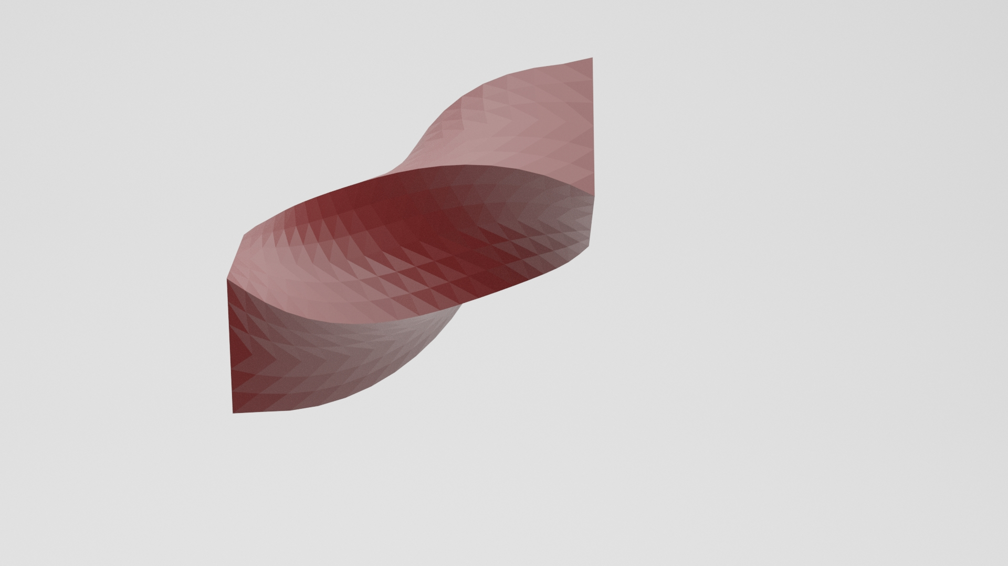
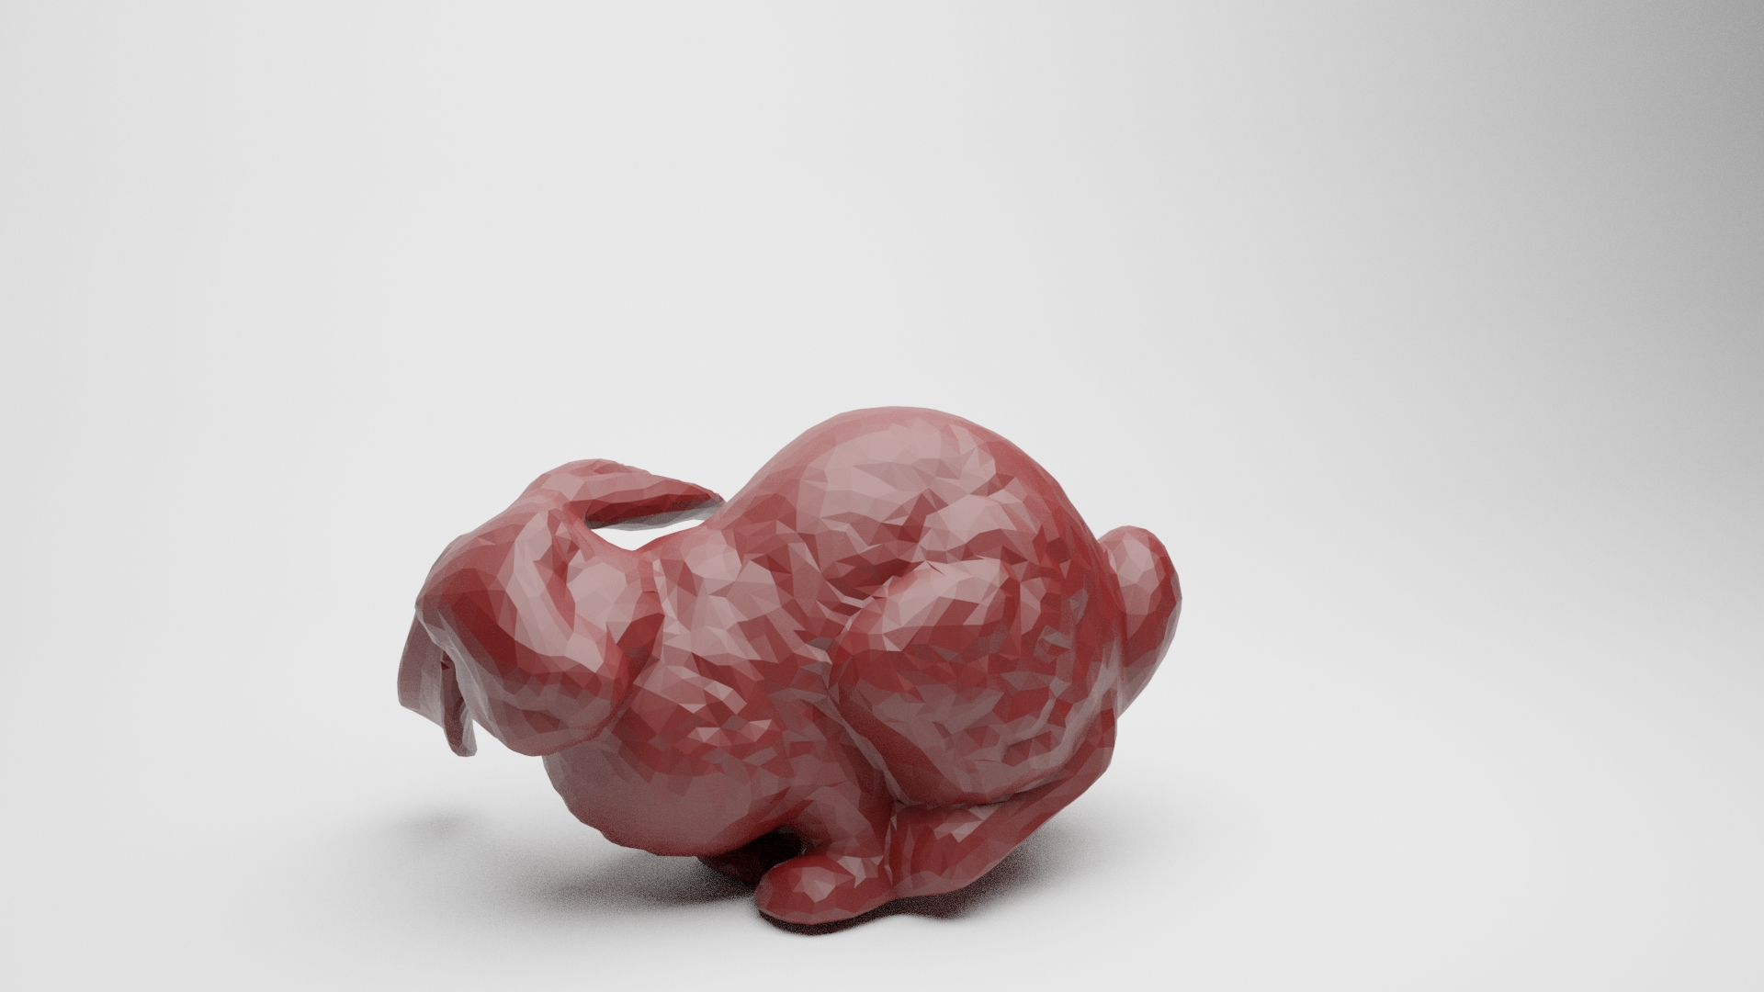
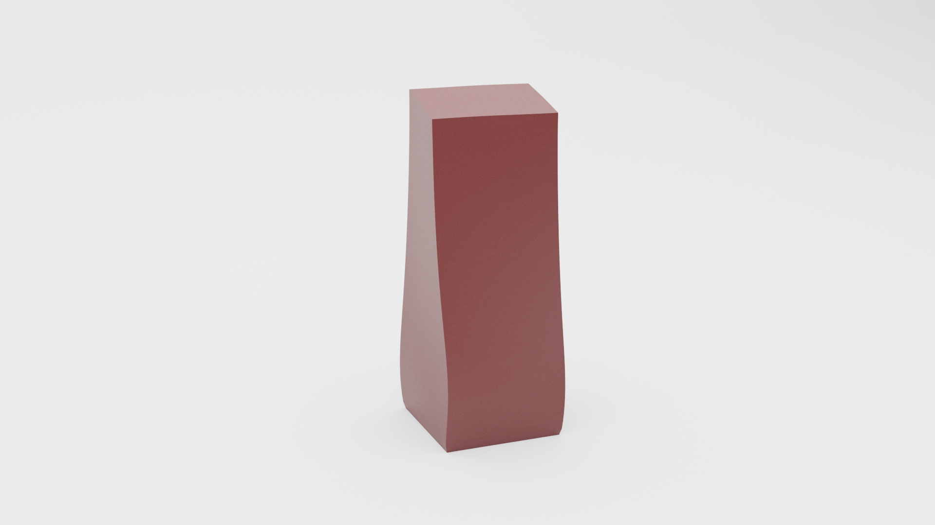
ConJac CAN Satisfy:
[Weidner et al. 2020]
Same static configuration
Complex nonlinear material support
  Anisotropic
  Heterogeneous
No precomputation
  Topological changes
Dynamic motion at large timesteps
Fully two-way coupled simulation using existing frameworks
  Rigid bodies
Notes:
This brings us to our work which we call ConJac, which can satisfy all 5 of these requirements with a single formulation

Slide 8
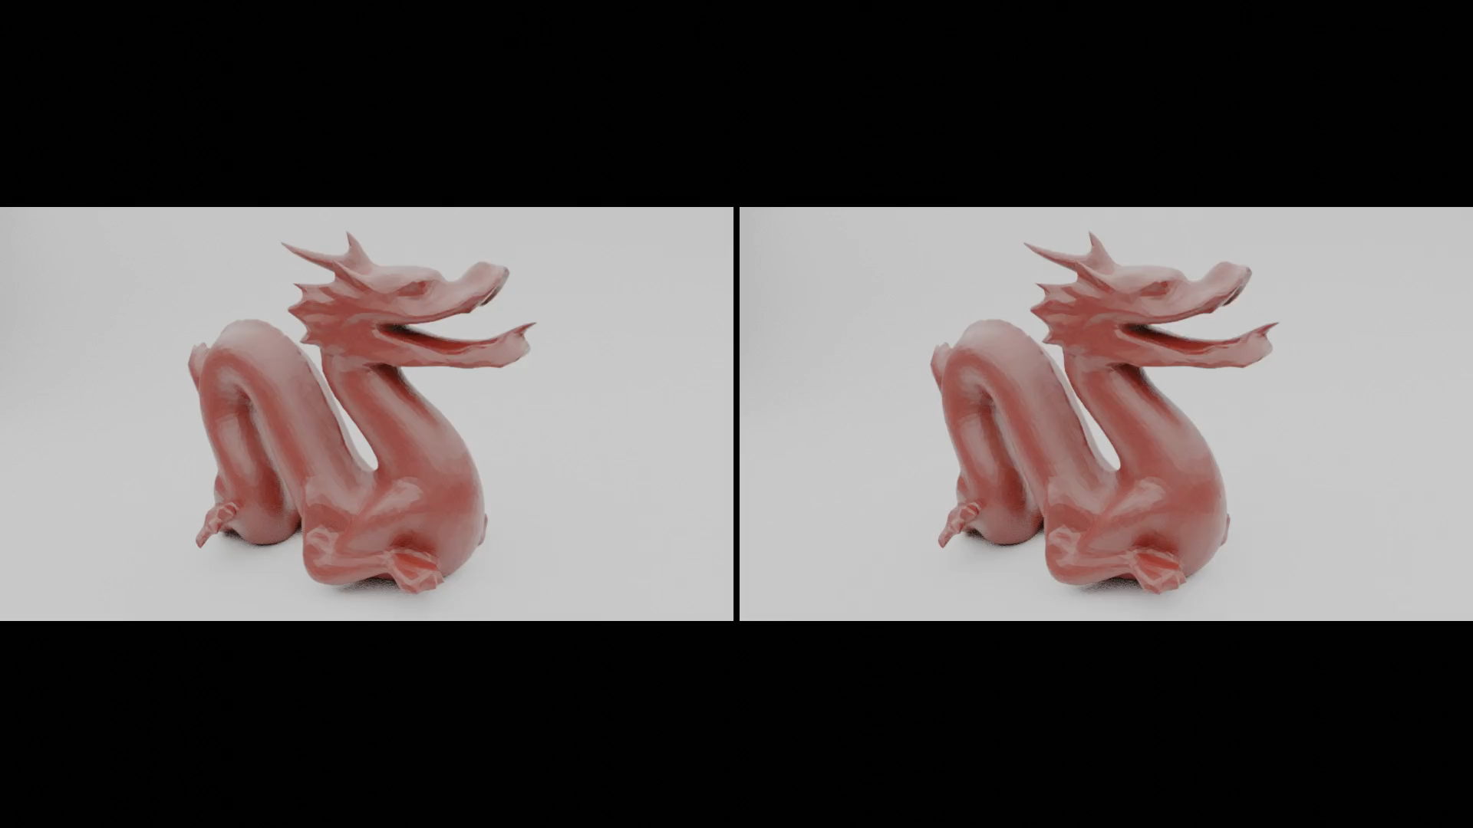
Vanilla ConJac
h=5e-3 h=5e-3
Notes:
This is the same dragon simulation using our ConJac method and using the same h as the original Vanilla simulation showed, but with significantly more dynamics
Let me get into how we went about this

Slide 9
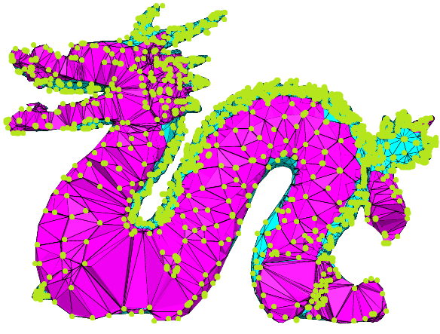
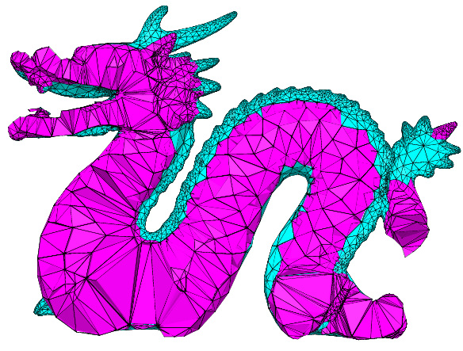
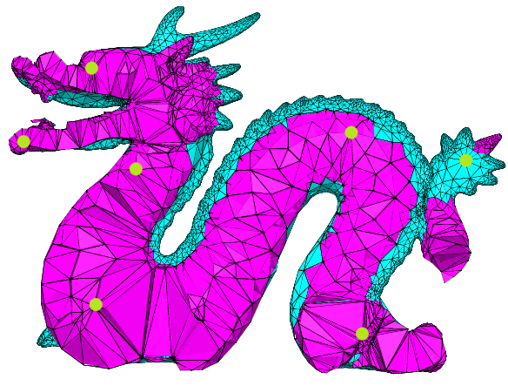
Condensation
All Degrees of Freedom (DOFs)
Reduced Degrees of Freedom (DOFs)
Notes:
We built our idea off of work done in Condensation
Condensation deals with taking a simulation that works on an entire set of a bodies degrees of freedom
And reducing that set down to a subset that maps onto the overall problem
Previous condensation work primarily dealt with reducing the DOFs at the position level, though, and they couldn’t satisfy all of our requirements
So instead, our work takes the approach of reducing our problem at the velocity level

Slide 10
ConJac Dynamic Simulation
Fixed Node
1 Dimensional Nodes
Quasistatic Node
Dynamic Node
Notes:
To explain our ConJac method lets start by looking at a simple spring chain of nodes
We’ll have a fixed node at the top
What we call a quasistatic node in the middle
And finally what we call a dynamic node at the bottom
Let’s also confine this to 1 dimension, so these nodes can only move up and down, assume all of our masses to be equal, and assume a zero rest length spring condition

Slide 11
ConJac Dynamic Simulation
Fixed Node
Spring Force
Gravitational Force
Quasistatic Node
Dynamic Node
Notes:
Each of these two springs has an equal spring force keeping the system balanced
Once we introduce gravity we end up with an imbalance on our quasistatic nodes
If we introduce another assumption that the net forces on our quasistatic node are 0…

Slide 12
ConJac Dynamic Simulation
Fixed Node
Spring Force
Gravitational Force
0
Quasistatic Node
Dynamic Node
Notes:
Then we are able to calculate a new rest state for our system
Because we’ve made these assumption about our quasistatic nodes,
based on the position and velocity of our dynamic node
it’s possible to calculate the position and velocity of our quasistatic node
This translates to any number of quasistatic nodes we introduce in the middle

Slide 13
ConJac Dynamic Simulation
Fixed Node
Spring Force
Gravitational Force
Quasistatic Node
0
Quasistatic Node
Quasistatic Node
Dynamic Node
Notes:
We could have 3 quasistatic nodes, or any amount more
In any case this single dynamic node encodes all the information about the other nodes in our setup

Slide 14
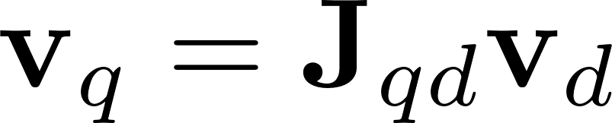
ConJac Dynamic Simulation
Fixed Node
Quasistatic Node
Quasistatic
Velocity
Dynamic
Velocity
Quasistatic Node
Condensation
Jacobian
(ConJac)
Quasistatic Node
Dynamic Node
Notes:
What we want to formalize here is a linear mapping between our
Dynamic velocities
And our quasistatic velocities
We also want this to be for any volumetric solid composed of an arbitrary nonlinear material
We call this mapping the condensation jacobian or ConJac

Slide 15
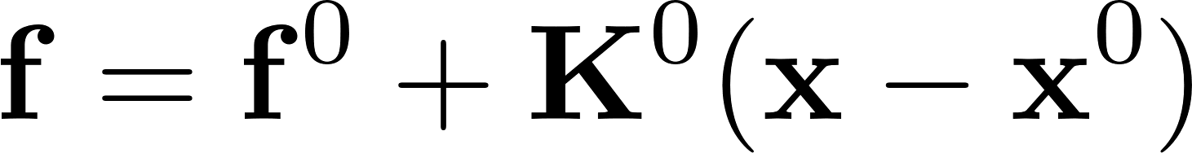
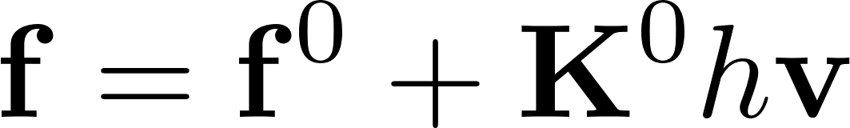
ConJac Dynamic Simulation
Fixed
Quasistatic
Quasistatic
Quasistatic
Dynamic
Notes:
Lets us derive this Jacobian mapping that makes this work
The implicit force approximation popularized by Baraff and Witkin
Uses the current force, stiffness, and positions
Lets take this a rewrite our change in positions as our next velocity with regards to a time step

Slide 16
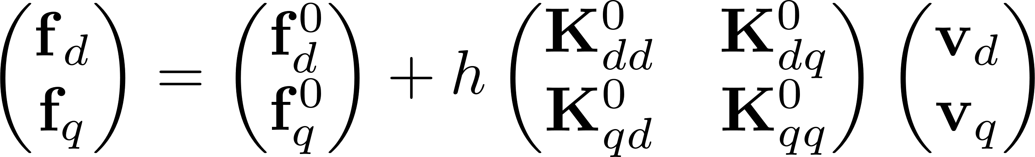
ConJac Dynamic Simulation
Fixed
Quasistatic
Quasistatic
Quasistatic
Dynamic
[Bro-Nielson and Cotin 1996]
Notes:
From this we can follow previous condensation work to split this up into a partition of the dynamic and quasistatic quantities
We can see our quasistatic partitions noted here in green
This bottom row is the forces on our quasistatic nodes, and if we look independently at this…

Slide 17
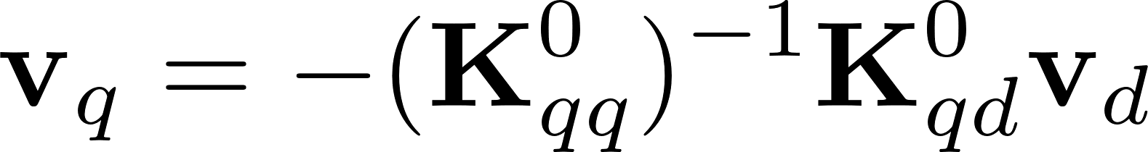
ConJac Dynamic Simulation
Fixed
Quasistatic
Quasistatic
Quasistatic
Dynamic
Notes:
We can apply our zero net force assumption to rearrange our equation into this
Comparing this new equation to our original formulation goal, we see a definition for our Jacobian term

Slide 18
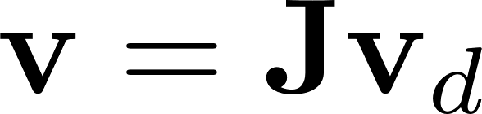
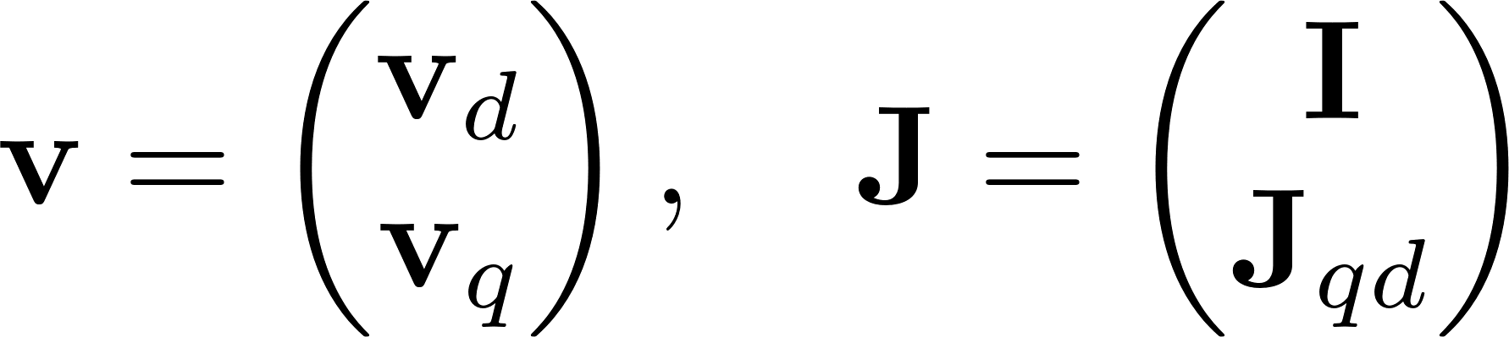
ConJac Dynamic Simulation
Vanilla
Fixed
ConJac
Quasistatic
Quasistatic
Quasistatic
Dynamic
Notes:
Let us circle back to our vanilla equation of motion
Now lets take this jacobian mapping we’ve just derived, and expand it to include our dynamic and quasistatic DOFs
In other words our mapping MAPS our quasistatic velocities but passes through our dynamic velocities untouched with an identity
This augments our equation of motion into a new ConJac equation of motion
If we think about what this new equation of motion means for our computation, we’ve reduced our entire solve on the velocities down to the number of dynamic DOFs
For example in our spring case, this Jacobian has reduced down a 4 DOF solve in the vanilla case to a 1 DOF solve in the ConJac case
There is one more very important point to cover, though

Slide 19
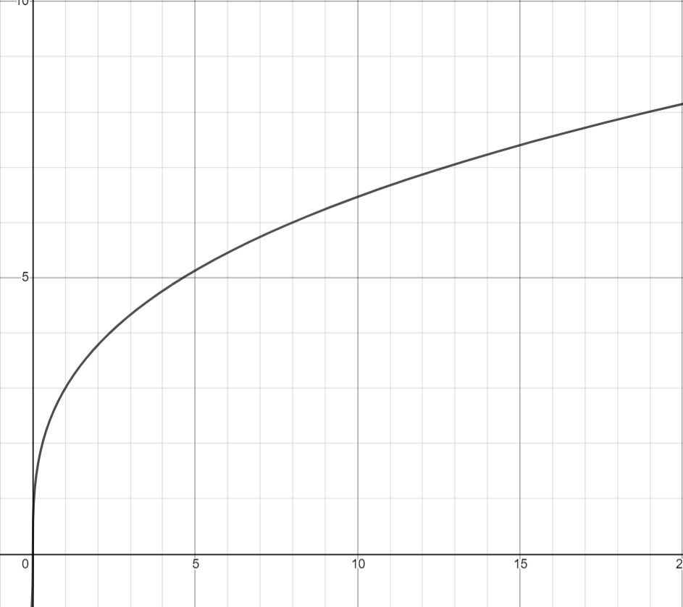
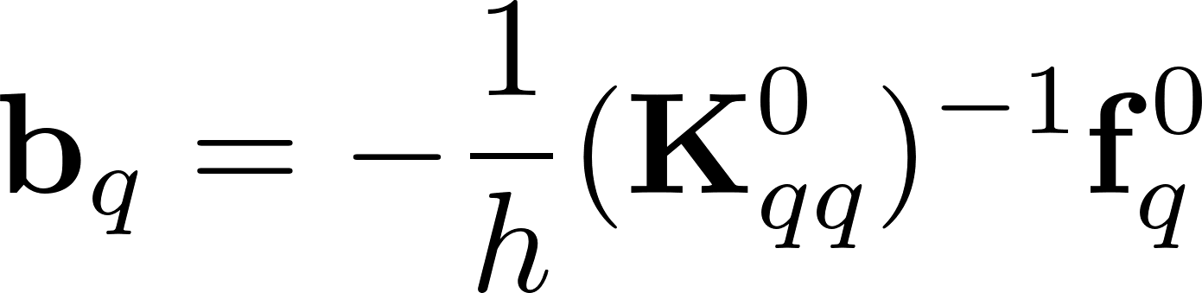
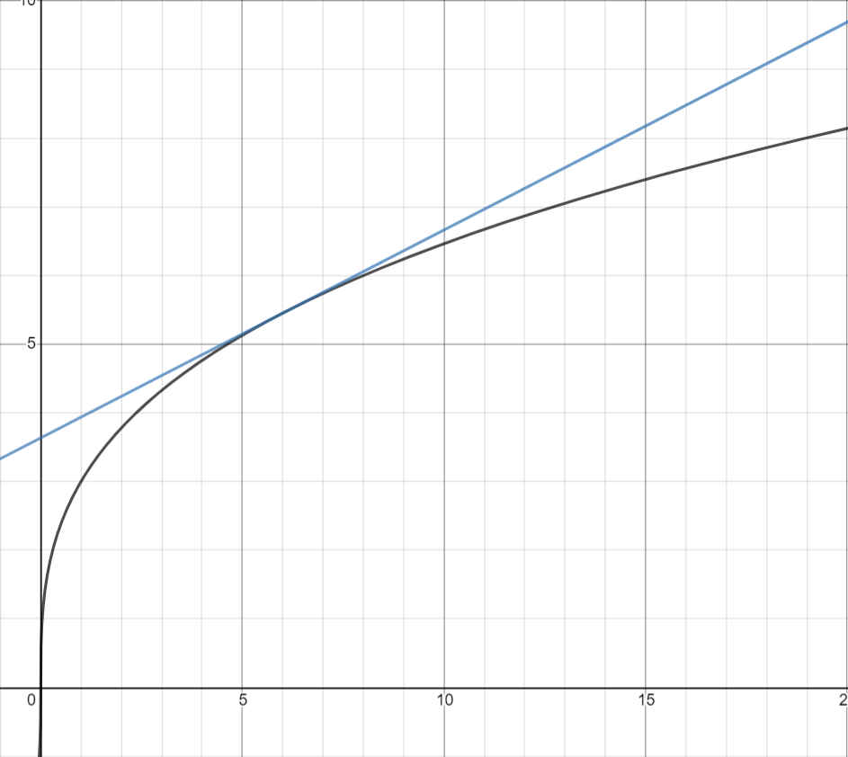
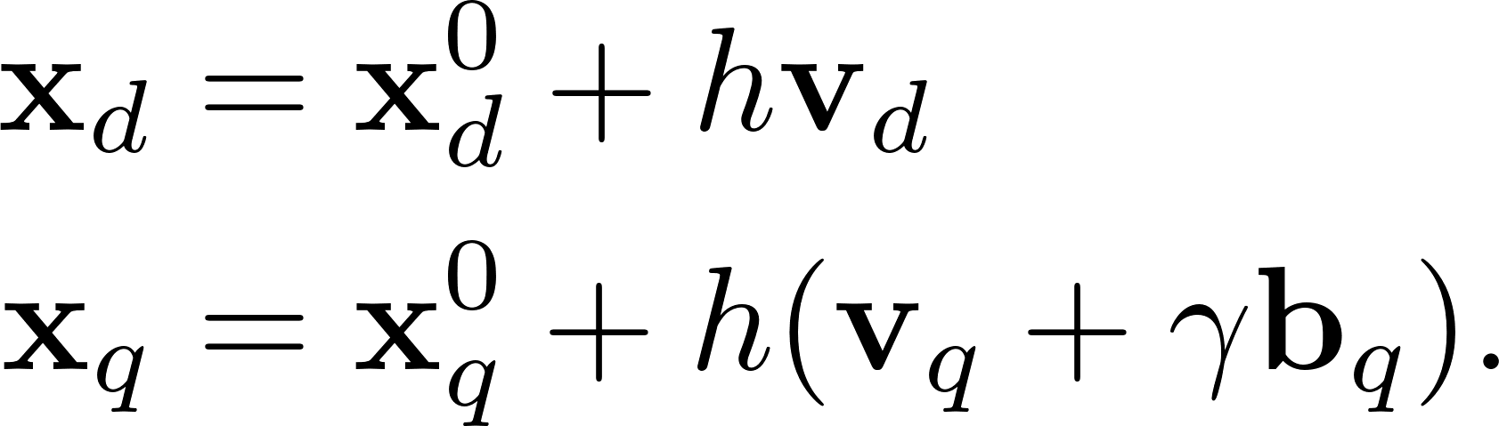
ConJac Dynamic Simulation
Nonlinear Material Force
Force
c.f. [Baumgarte 1972]
Position
Notes:
Let us examine the force plot of a nonlinear material force at some point in time
As mentioned we are making a linear approximation of out forces
Applying our condensation at the velocity level means after taking a timestep we have introduced non zero values into our scene
So alongside the Jacobian we derive this stabilization term b
This baumgarte like stabilization term is applied at the position level
It is also controlled by a strength tuning gamma term to give us control over it’s effect

Slide 20
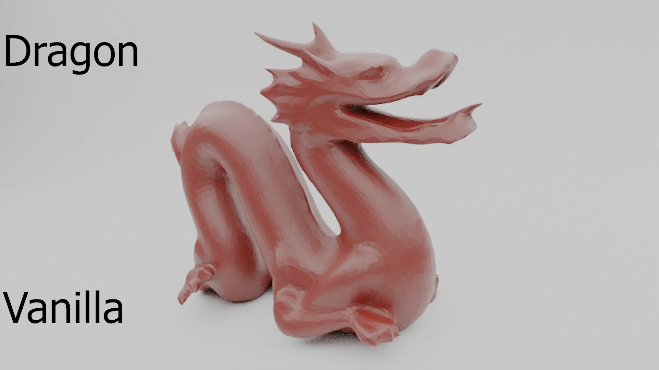
Dynamic Deformations
Notes:
Now lets go back to our comparison results
We see here again the vanilla dragon with much of it’s dynamics numerically damped out of the system

Slide 21
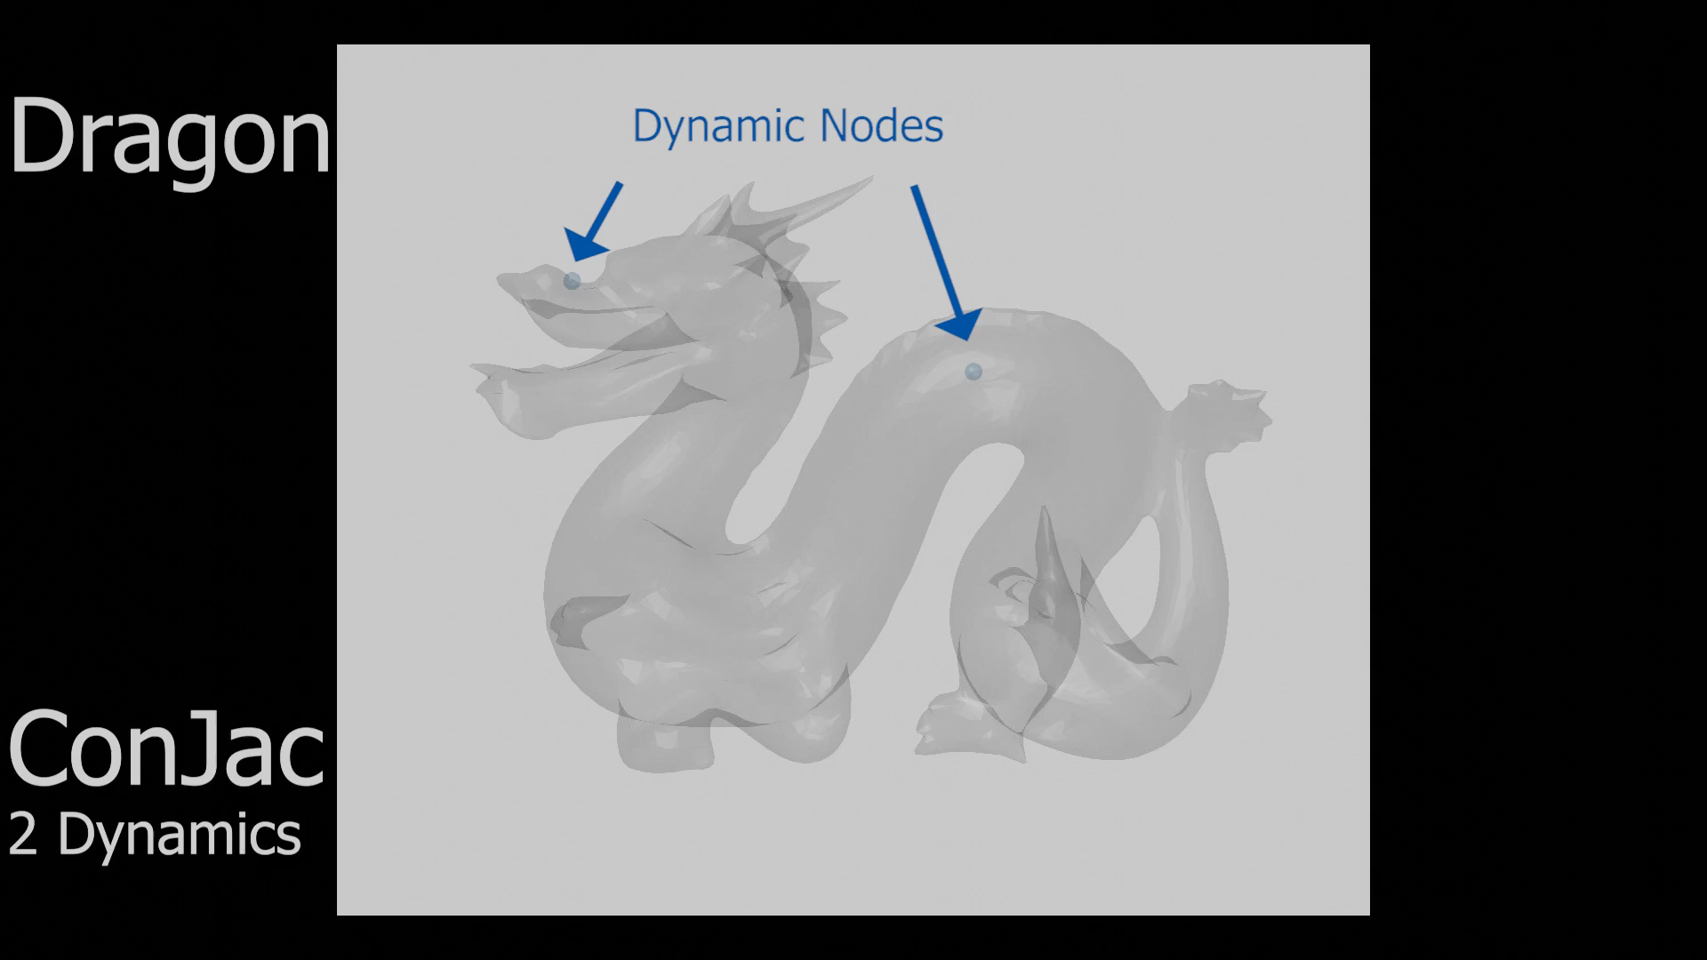
Show dynamic nodes
Notes:
Here we have the setup for our conjac dragon
This setup includes two dynamic nodes positioned around the areas of our pull forces
One in the head, and one in the back body

Slide 22
Vanilla ConJac (2 Dynamics)
h=5e-3 h=5e-3
Notes:
Looking again at this 2 dynamic node case comparison, we see how much more dynamic the motion is after the pull forces are released
To clarify this Dragon mesh has about 10k nodes, and the overall system has been reduced down to only 2
One obvious question you might have is how does this number of dynamic nodes effect our results

Slide 23
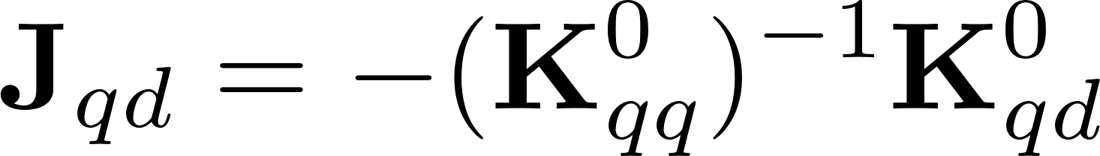
Dragon Wallclock Time
Notes:
From a performance perspective we can see that as we increase the number of dynamic nodes in our mesh
The wallclock time increase comes from time spent solving
Now I’ve mentioned how the reduction creates a much smaller system to solve for overall, but if you remember from our Jacobian formulation
This setup involves a number of back solves increasing in size with respect to our dynamic nodes
This obviously takes more and more time to compute
And we see that this produces a linear increase in cost to our overall simulation, but what about visual results

Slide 24
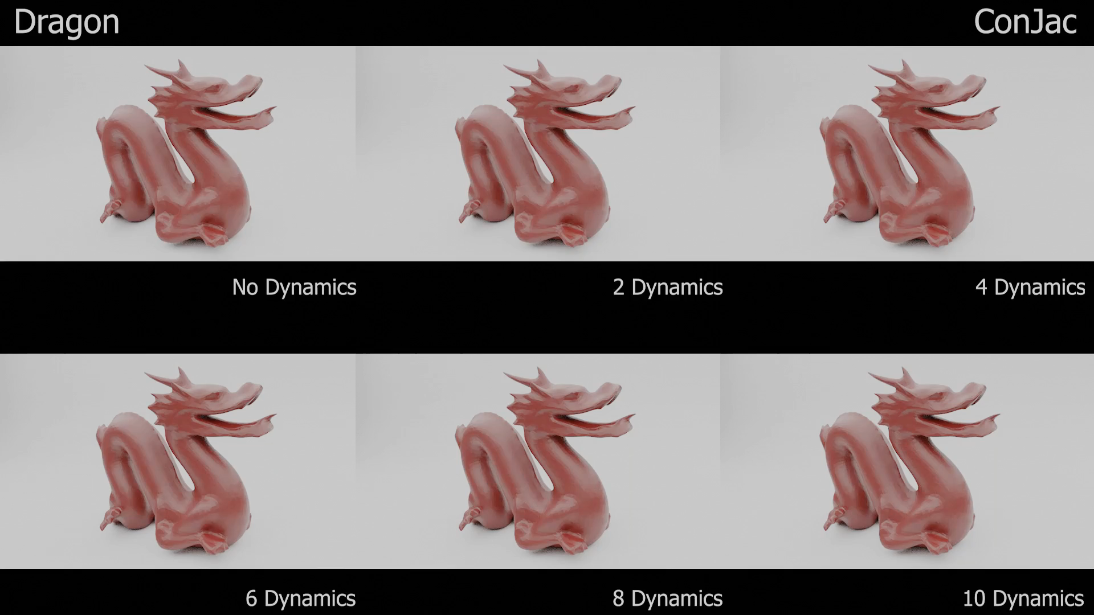
Notes:
Here we see that as we increase our number of dynamic nodes, we do get an increase in dynamics, but it is not as severe as one might have guessed
We can actually obtain a high level of dynamic behavior with only two dynamic nodes on 10k node mesh
For another comparison with vanilla, though, let’s look closer at our 6 dynamic node case

Slide 25
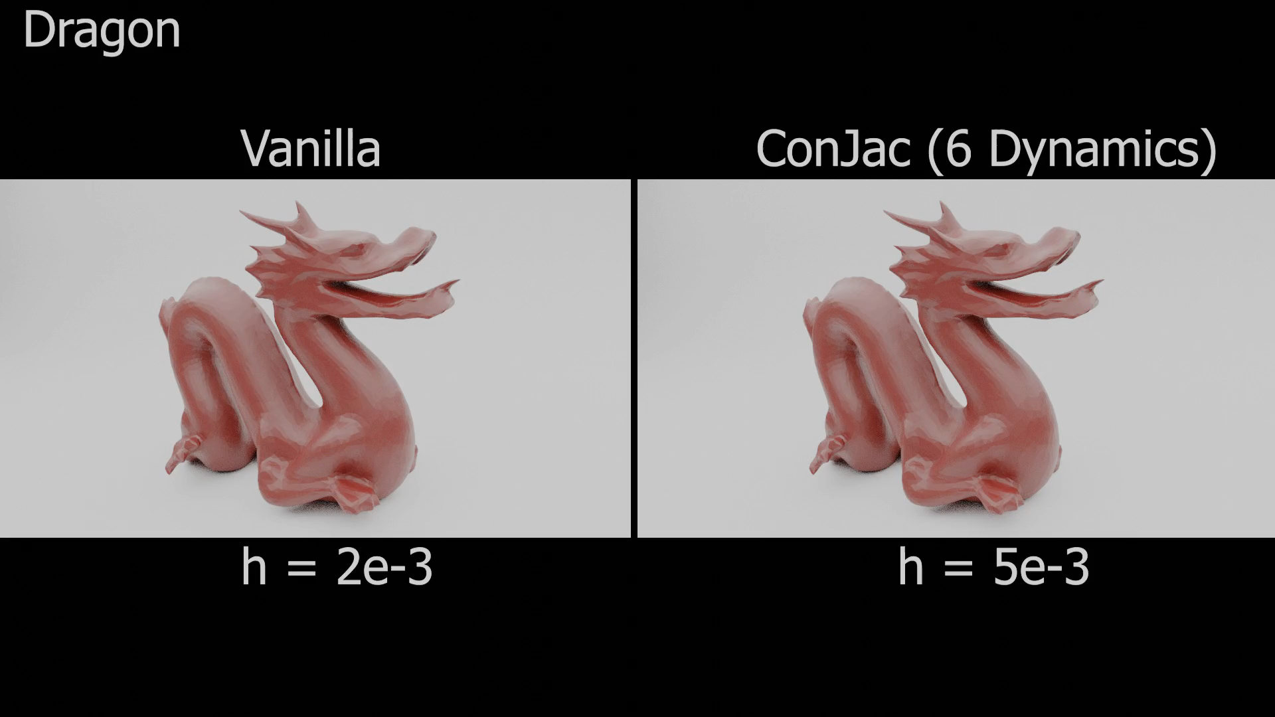
2x Faster!
Notes:
Here we have the 6 dynamic node dragon side by side with a small time step vanilla sim
The dynamics are very close by comparison but even though Vanilla can solve an individual step faster
ConJac ends up simulating this dynamic 2x faster overall
With that being said, let’s quickly run through all of the robust features ConJac is still able to handle

Slide 26
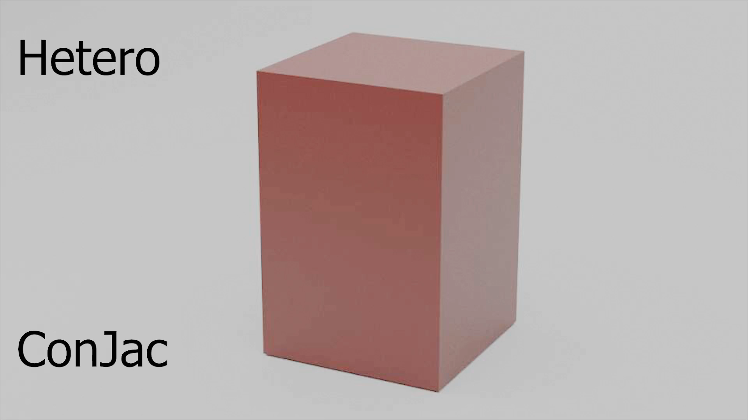
Only 1
Dynamic node!
Notes:
We wanted support for complex nonlinear materials and we see here a heterogeneous box with a mixture of stiffnesses under gravity
This simulation also runs using only a single dynamic node!

Slide 27
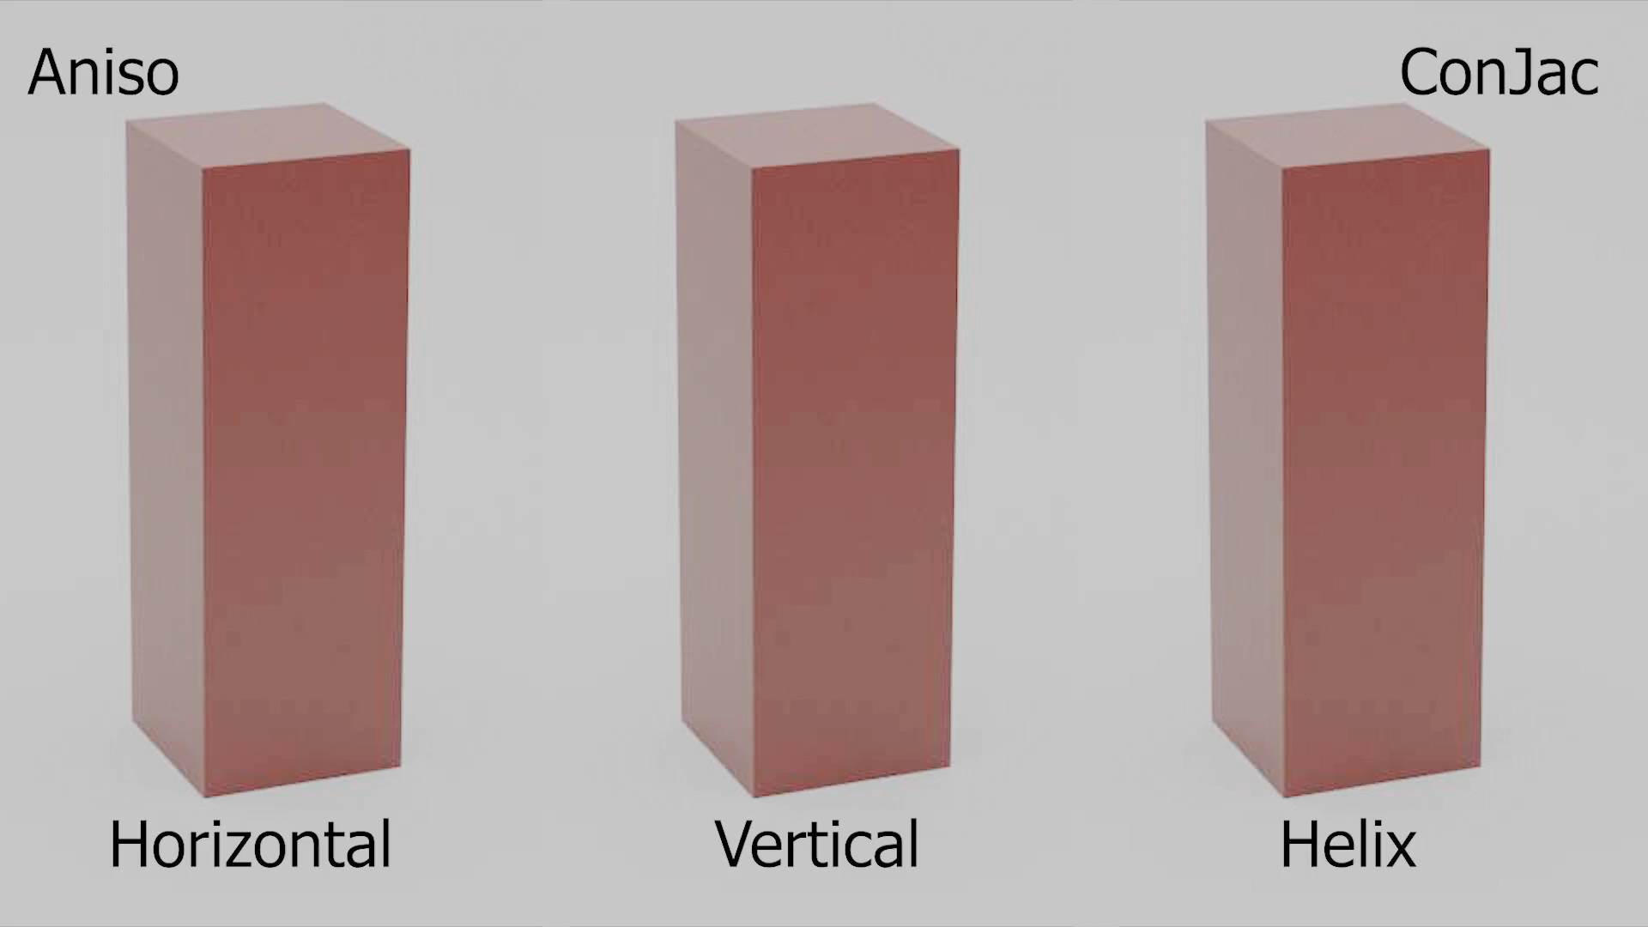
Only 1
Dynamic node!
Only 1
Dynamic node!
Only 1
Dynamic node!
Notes:
ConJac also support anisotropic materials as seen by these bars with varying anisotropic fiber directions under gravity
Each of these is also achieved using only a single dynamic node!

Slide 28
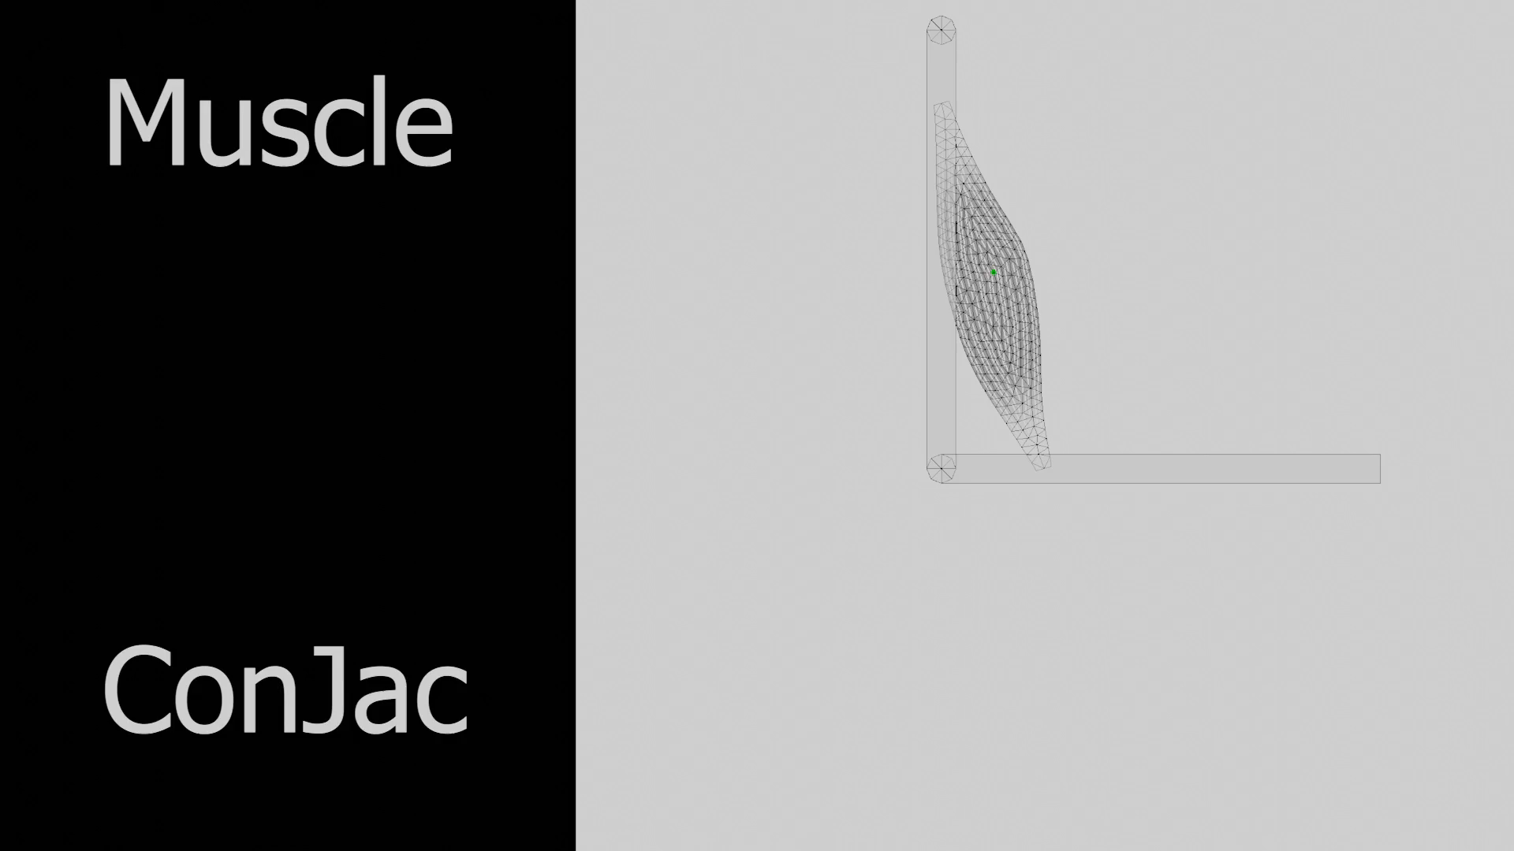
Notes:
We achieve support for two-way coupled simulation in this muscle simulation where this muscle is driven by a single dynamic node in the center
And connected to rigid body bones at the ends

Slide 29
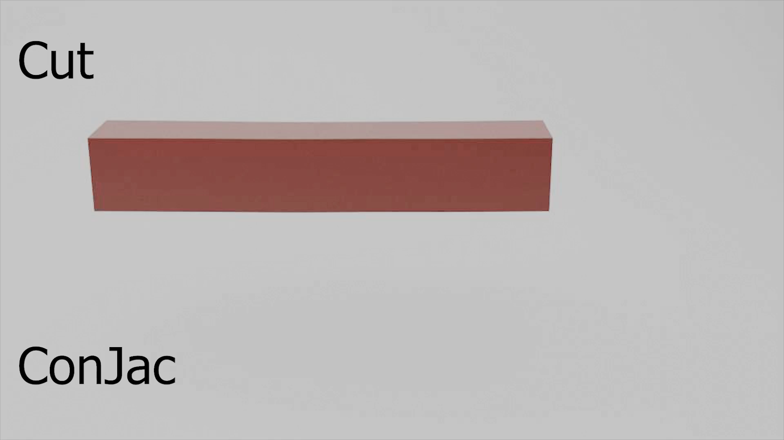
Notes:
Because we didn’t require any precomputation in our ConJac formulation, we can support topological changes such as cutting in this scene
You’ll also notice one of these cut pieces doesn’t have a quasistatic node in it at the end, yet it gracefully degrades into a purely quasistatic model

Slide 30
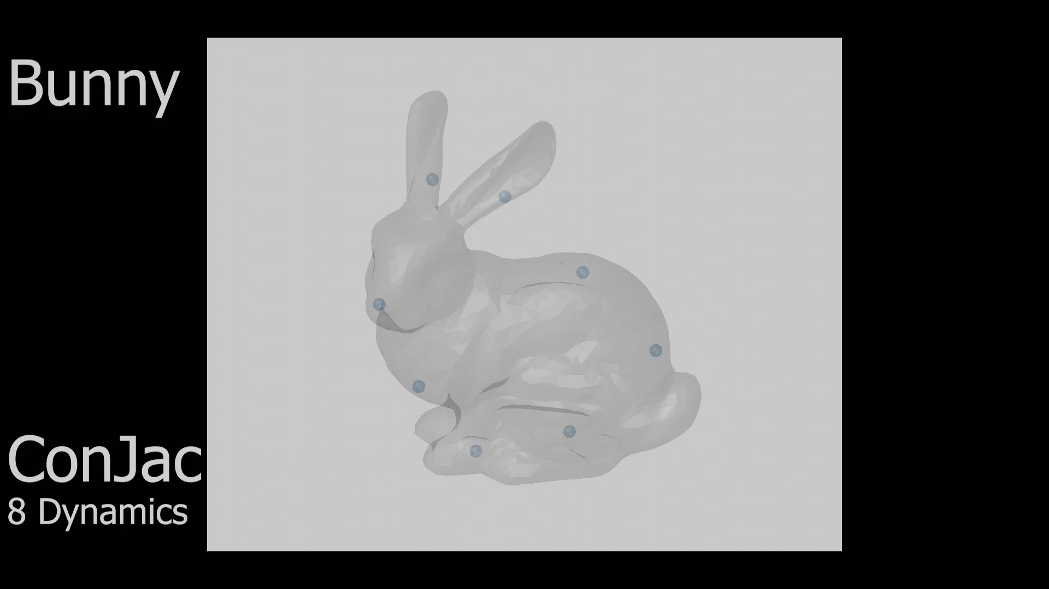
Notes:
As a final example, here we have a number of dynamic nodes scattered around a bunny mesh

Slide 31
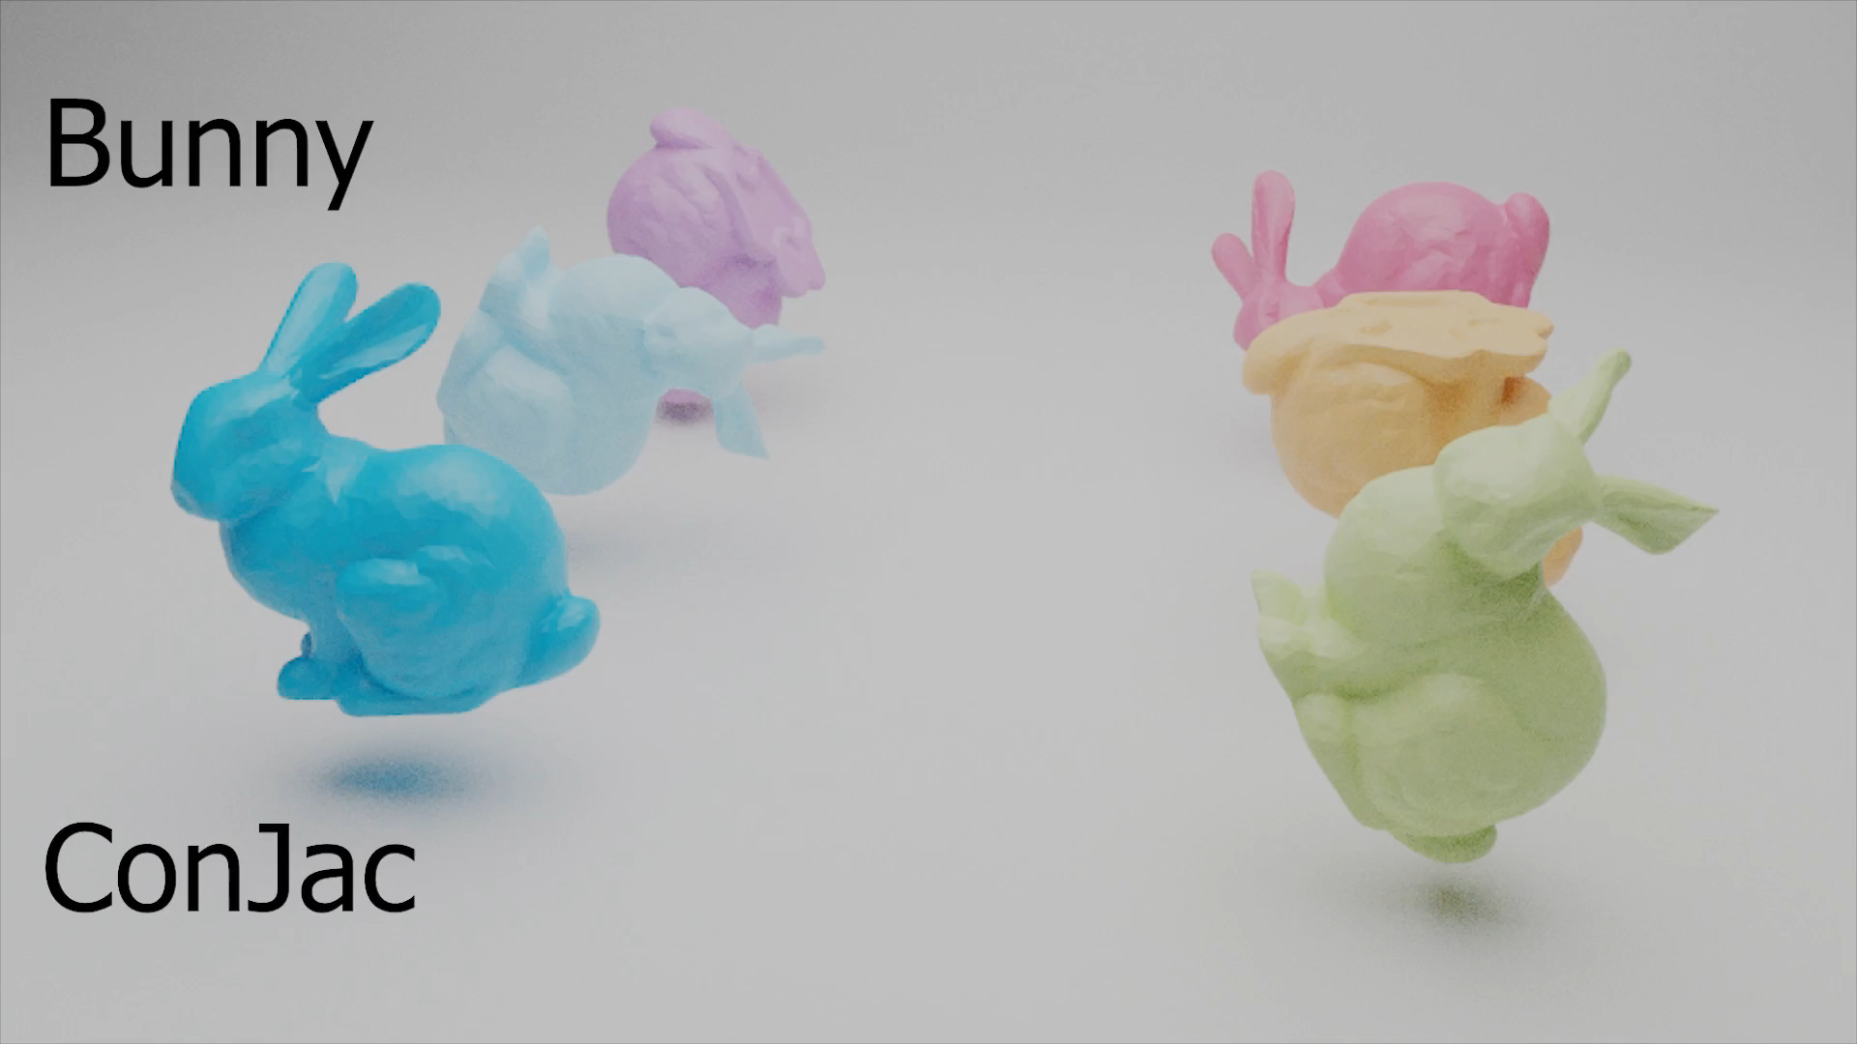
Notes:
Even the introduction of contact and frictional forces results in a high degree of local dynamic motion around the areas of dynamic nodes

Slide 32
Summary
Same static configuration
Complex nonlinear material support
  Anisotropic
  Heterogeneous
No precomputation
  Topological changes
Dynamic motion at large timesteps
Fully two-way coupled simulation using existing frameworks
  Rigid bodies
Notes:
In conclusion we’ve succeeded in achieving all of the features we set out to support
We can produce the proper static configuration while supporting nonlinear materials and without introducing any precomputation step
The dynamics of motion are retained even at large timesteps
And we successfully integrated ConJac with other frameworks

Slide 33
Limitations
Closely placed dynamic nodes
Artifacts with large motion
More dynamic nodes increases computation
...
Notes:
I don’t have much time left but just covering some of the limitations
There are obvious issues with dynamic node placement as well some artifacts when the motion is to extreme
There is also the fact that the simulation slows with additional nodes but we think there are some interesting avenues to pursue pertaining to domain decompositions and the like

Slide 34

Thank You!
Questions?

