Slide 1
Closest Point Turbulence for Liquid Surfaces
Theodore Kim, Nils Thuerey, Jerry Tessendorf
ACM Transactions on Graphics, 2013
Notes:
So far, everything we’ve looked at has been single phase turbulence, i.e. smoke or fire simulations. In all these simulations, we’ve assumed that we have air, and some particulate floating around in it.
A really obvious next question to ask is, what multi-phase simulations, where there is both an air phase and a water phase? These are also a staple of visual effects, but suffer from similar problems.
You can meticulously manipulate a simulation at low resolution, but when you bump the resolution up, the motion changes entirely. Can we apply the same philosophy that we used for single phase simulations? Can we use some sort of simple model to add turbulent detail to a simulation, but in a way that doesn’t ruin all the previous design work? (show PhysBAM resolutions)

Slide 2
100³ Houdini simulation
Notes:
Here’s a Houdini simulation, at 100^3. This demo is courtesy of Jeff Lait at Side Effects Software

Slide 3
8x up-res, 100³ Houdini simulation
Notes:
Here’s our result, which we used to up-res the original 100^3 simulation. There’s a lot more detail here.

Slide 4
8x up-res Original

Slide 5
Outline
Previous Works
The Closest Point Method
3D iWave
Additional Extensions
Results

Slide 6
Outline
Previous Works
The Closest Point Method
3D iWave
Additional Extensions
Results

Slide 7
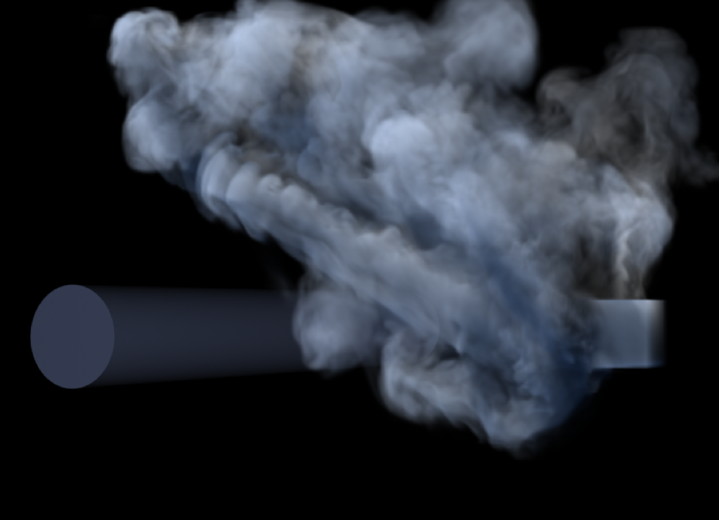
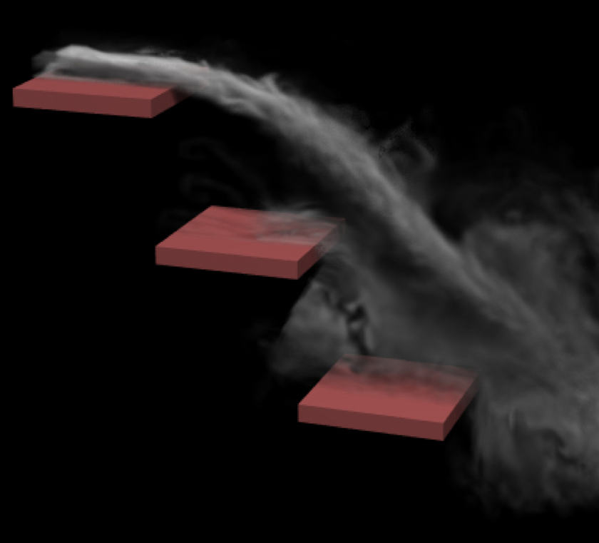
Smoke Up-Res
[Nielsen et al. 2009]
[Kim et al. 2008]
[Huang et al. 2011]
[Yuan et al. 2011]
Notes:
There’s been a whole bunch of work looking at how to up-res smoke simulations, including our own. It’s become a pretty standard tool in visual effects, so it’s natural to ask if they can be generalized to liquids as well

Slide 8
[Narain et al. 2008]
Notes:
It turns out that you can’t really apply the same techniques to liquid simulation. Here’s some work from 2008 that tried to use just do some velocity field upres, and it doesn’t quite look right. Why is this? It’s actually not that easy a question to answer.

Slide 9
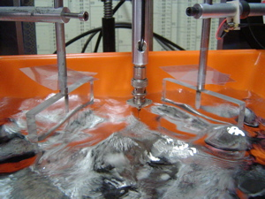
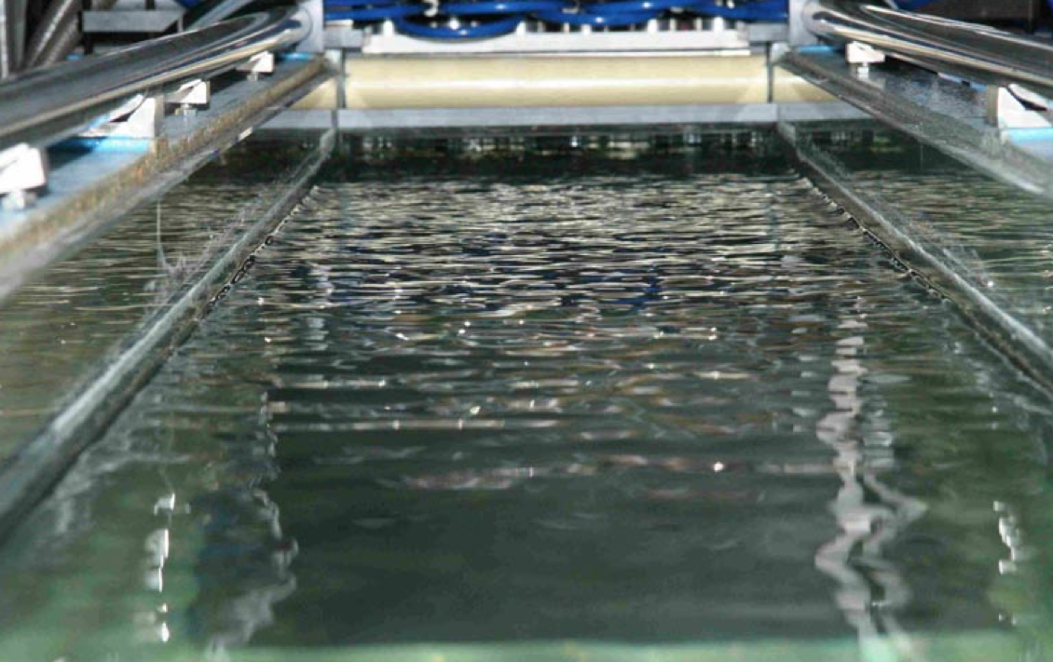
[Falcon 2010]
[Savelsberg and van de Water 2008]
Notes:
Let’s take a step back and took a look at some of the larger fluids literature. There’s all sorts of lab measurements and findings surrounding surface wave dynamics. Here are just two of the setups from two groups in Europe. The one of the right is actually the one we’re interested in.

Slide 10
Surface waves travel much faster than the underlying water
Notes:
There’s a lot of interesting stuff in this paper, but I’ll give a gross one sentence summary here – they measured the waves across the surface of a liquid to be moving very fast. Much faster than the velocities in the underlying fluid.
So, it’s not just a problem of capturing high resolution fluid velocity fields. You need to do something more.

Slide 11
Free Surface Turbulence
Kolmogorov spectrum:
Kolmogorov-Zakharov spectrum:
A.k.a. “wave” or “weak” turbulence
[Zakharov 1968]
Notes:
This makes sense, because it has been known for a long time that the velocity energy spectrum of a single fluid is not the same as the surface gradient spectrum of a free surface. There’s even two different names for it. In the single phase case we have Kolmogorov turbulence, and for a fluid, we have a Kolmogorov-Zakharov spectrum. You can see that the exponents for the two are not the same. The free surface case is acutally much steeper.

Slide 12
Free Surface Turbulence
The approach
Low resolution simulation initiates waves
Run a wave simulation on the liquid surface
All purely Eulerian
Notes:
What we can draw from this is that an algorithm similar to our previous one should be possible. We can run a separate wave simulation the surface of the liquid, with the waves initiated using the low-resolution simulation.
Once we’re set in this, another question immediately presents itself. How do you run a wave simulation on a surface that is rapidly changing and deforming? In the time that’s left, this is the main problem that we’ll look at.

Slide 13
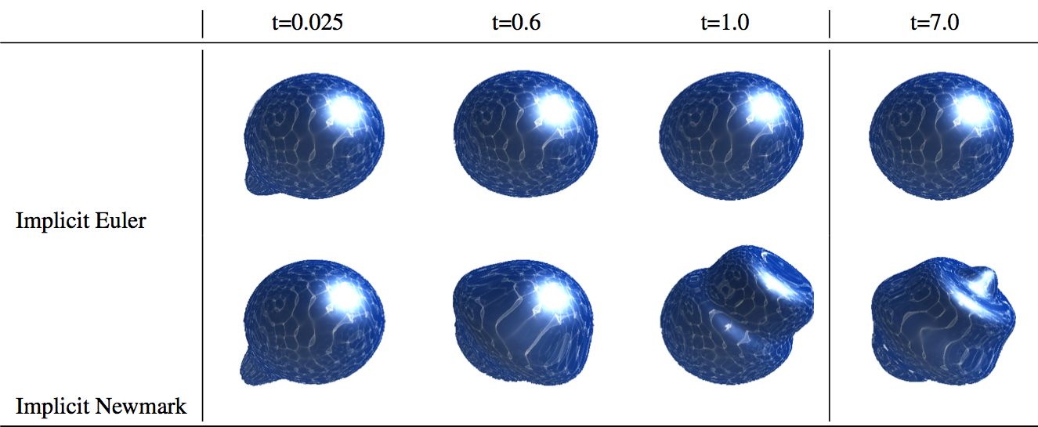
Surface Simulation
[Angst et al. 2008]
Notes:
There’s always the hard way. The surface of the liquid can be represented as a triangle mesh, and we can simulate the wave equation on the triangle mesh. This works okay if your mesh connectivity is fixed, and was done by Angst et al in 2008, which actually included my colleague Nils.

Slide 14
Surface Simulation
[Bojsen-Hansen et al. 2012]
Notes:
It is possible to do this, as was shown by (Wojtan paper). It’s not always easy though, and if you want to use some other equation for wave motion, not just the wave equation, it’s not clear how to do things.

Slide 15
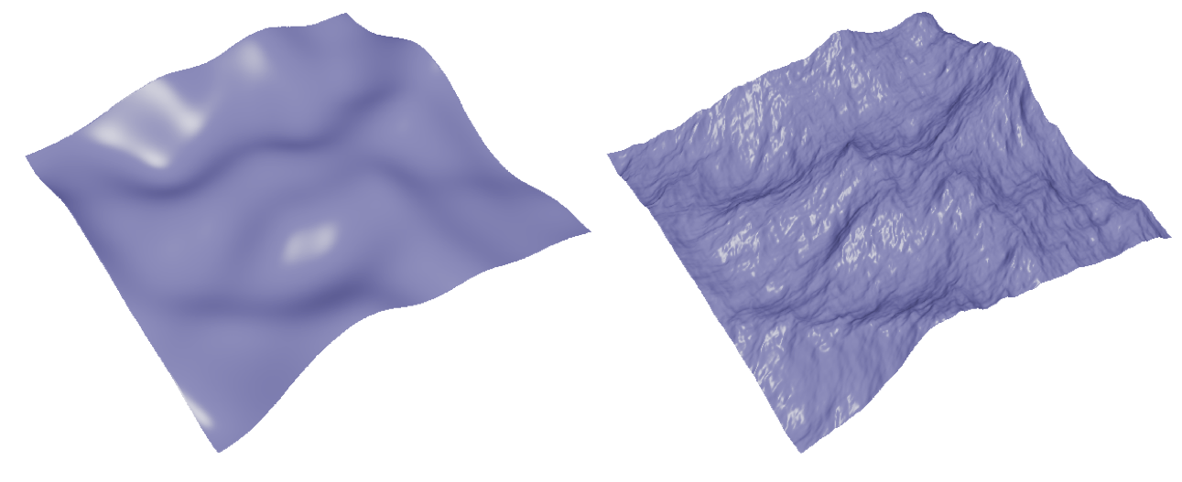
Surface Simulation
[Nielsen et al. 2012]
Notes:
This is again on a Lagrangian mesh, and it’s not that clear how to apply it on a surface with artbitrary topology

Slide 16
Outline
Previous Works
The Closest Point Method
3D iWave
Additional Extensions
Results

Slide 17
Closest Point Method
A simple embedding method
[Ruuth and Merriman, 2008]
[Macdonald and Ruuth 2008]
[Macdonald and Ruuth 2009]
[Macdonald, Brandman and Ruuth 2011]
Notes:
Instead we’re going to use an elegant new embedding method called the closest point method that doesn’t use need any sort of fancy mesh tracking strategy. I’ll introduce the general idea first, and then we’ll go into how it doesn’t do quite what we want it to, so we need to invent some new pieces.

Slide 18
2D Wave Equation
Notes:
Let’s start with something really simple, a 2D wave equation simulation. Here’s the wave equation. We can use any time integration scheme we want for the time derivative, the important part is the Laplacian here.

Slide 19
2D Wave Equation
Notes:
Let’s start with something really simple, a 2D wave equation simulation. Here’s the wave equation. We can use any time integration scheme we want for the time derivative, the important part is the Laplacian here.

Slide 20
2D Wave Equation
Notes:
Let’s start with something really simple, a 2D wave equation simulation. Here’s the wave equation. We can use any time integration scheme we want for the time derivative, the important part is the Laplacian here.

Slide 21
2D Wave Equation
 | 1
1 | -4 | 1
 | 1
Notes:
If we simulate things on a flat plane, discretizing the Laplaican is really easy. We get the standard 5 point star, and we apply it everywhere over the domain.

Slide 22
2D Wave Equation
 | 1
1 | -4 | 1
 | 1
Notes:
If we simulate things on a flat plane, discretizing the Laplaican is really easy. We get the standard 5 point star, and we apply it everywhere over the domain.

Slide 23
Notes:
Here’s a central bump we inserted into the center, and it propagates outwards from the middle. (displaced plane sim)

Slide 24
Notes:
The wave equation does in fact deal with height displacements, but for the time being it’s more helpful to think of the height as a scalar, so it’s just this ink propagating outwards, like we can see here. It’s the same simulation, just a different visualization. (scalar plane sim)

Slide 25
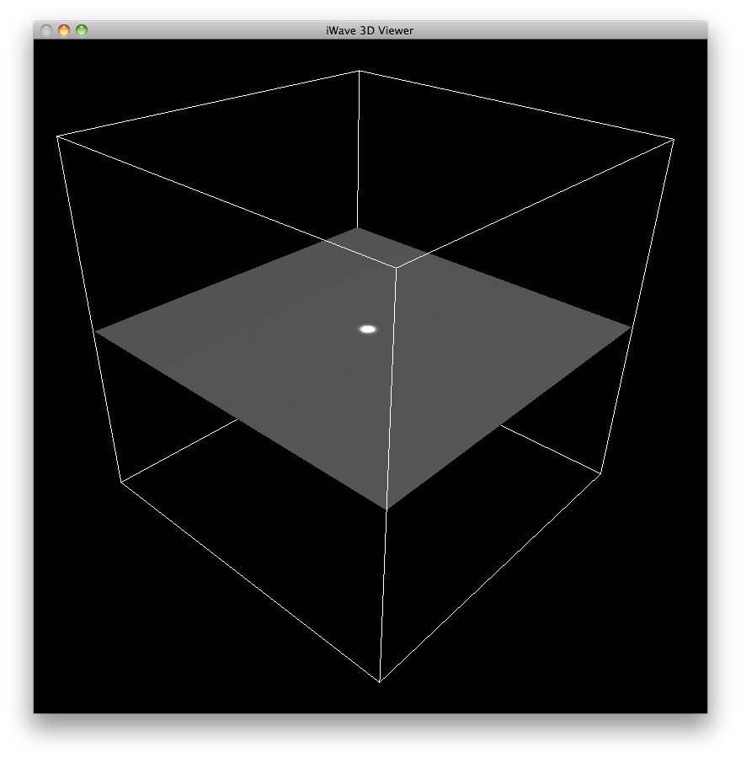
Notes:
Now we’re going to do something that may seem strange at first, but I promise will lead somewhere. Let’s take our 2D simulation data and build its extension field.
First we’ll embed the 2D surface into a 3D volume.

Slide 26
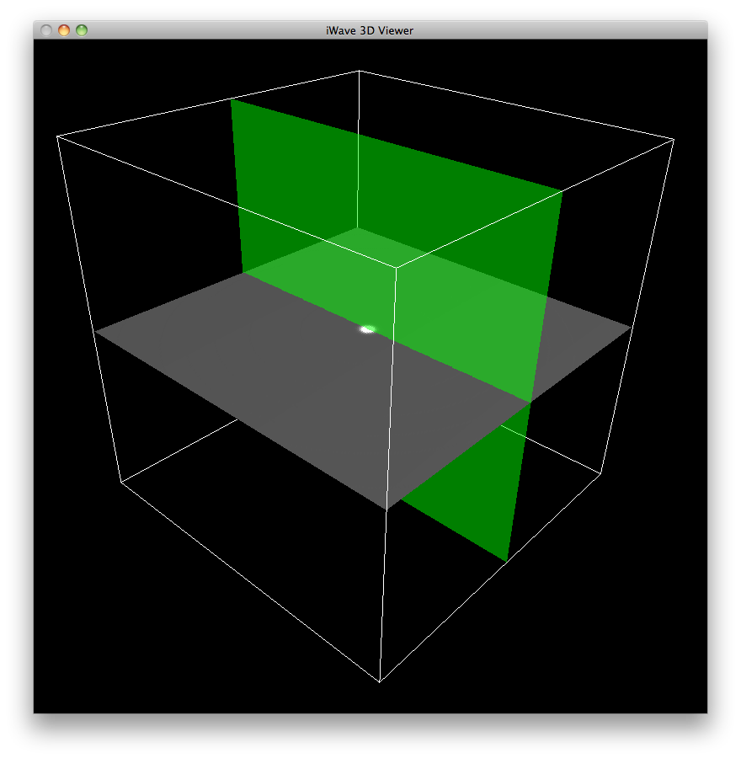
Notes:
We take a vertical slice through the middle here

Slide 27
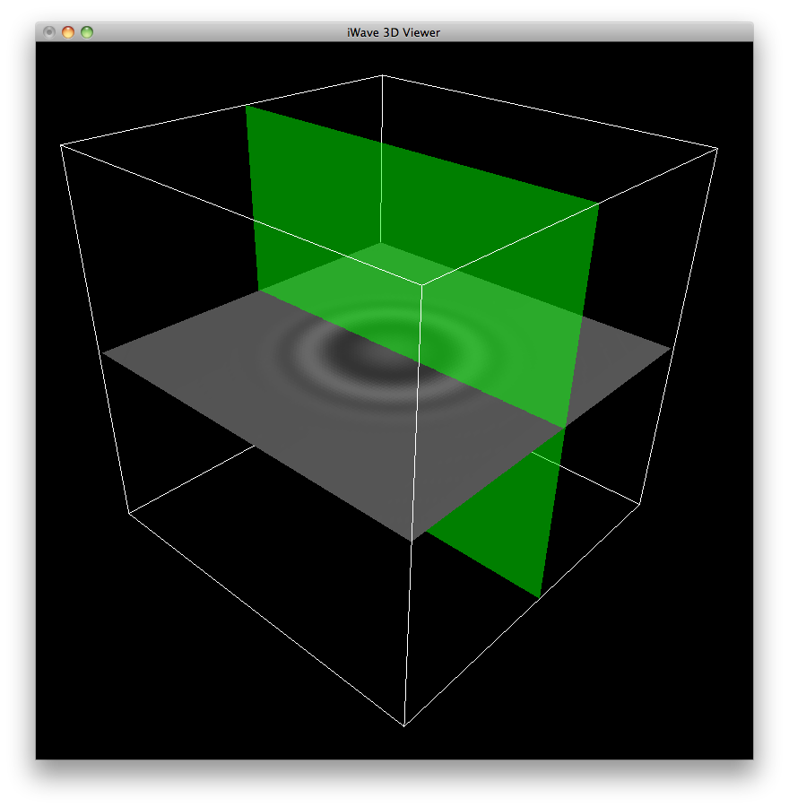
Notes:
Actually things are a little clearer to illustrate if the plane information is a little more substantial, so let’s take a slice after the waves have developed a little bit

Slide 28
Notes:
We take a vertical slice through the middle here, and we can see that the scalar data only lives on one thin line. (thin line)

Slide 29
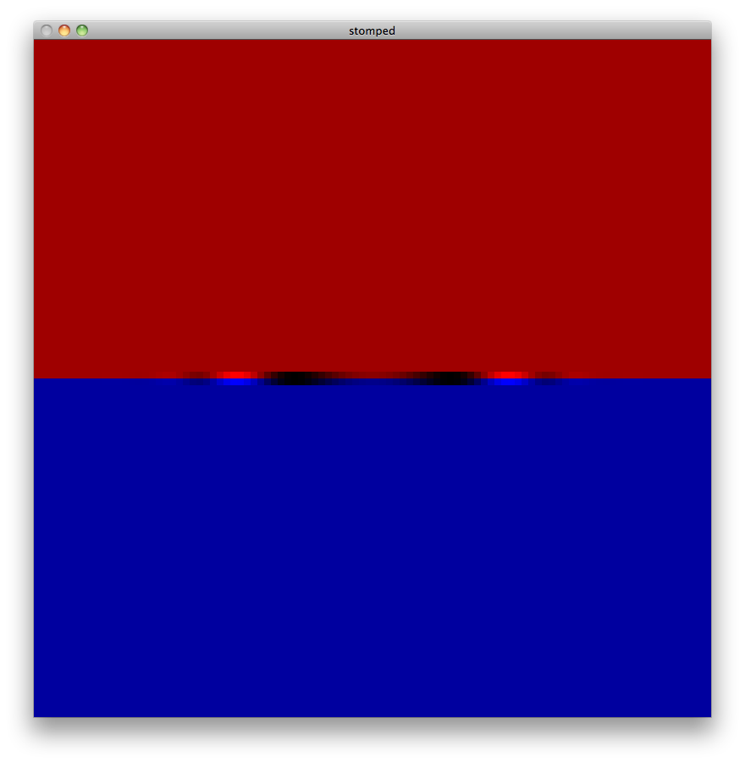
Notes:
It’s a little clearer to see if we color in the air as red and the water as blue. Now we see the scalars only live on the surface at the moment.

Slide 30
Notes:
Let’s extend the scalars in the normal directions

Slide 31
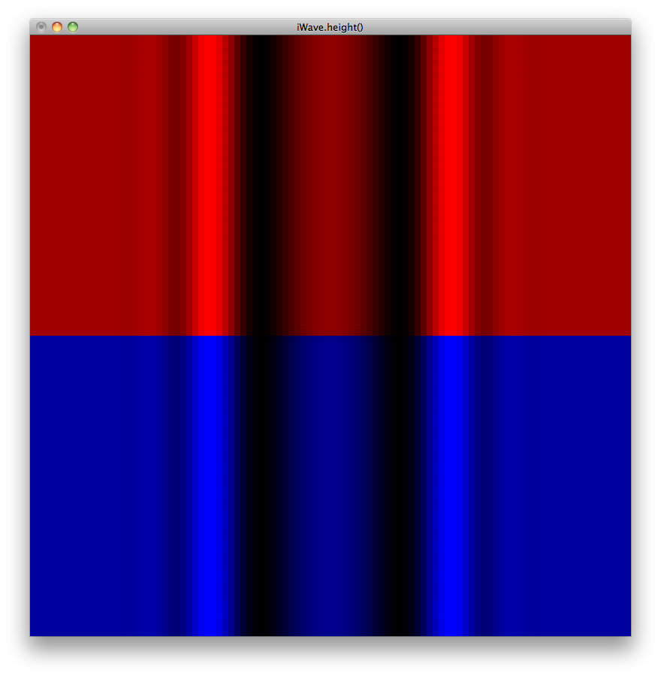
Notes:
Let’s extend the scalars in the normal directions.
What we have now is the extension field of the original surface field, so there’s now a scalar defined at every position in 3D space that corresponds to some quantity on the surface.

Slide 32
 | 1
1 | -4 | 1
 | 1
Notes:
So instead of using the 2D Laplacian in the 2D plane to evolve the wave equation

Slide 33
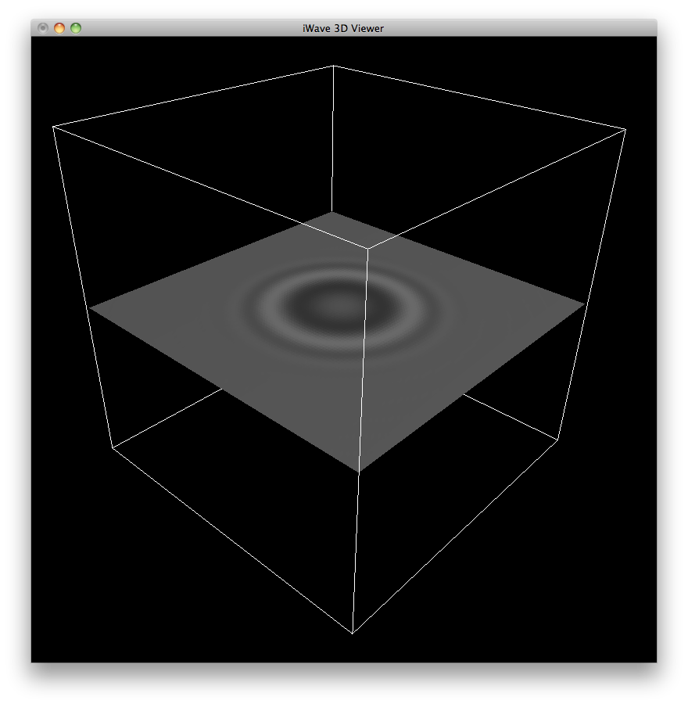
1
1
-6
1
1
Notes:
We’re going to use the 3D Laplacian throughout all space. So the 3D Laplacian looks very similar to the 2D version,

Slide 34
1
1
1
-6
1
1
1
Notes:
But we stick two more neighbors onto the stencil to account for the third dimension.

Slide 35
1
1
1
-6
1
1
1
After each step,
re-extend
Notes:
We’re going to go ahead and integrate this just like a 3D simulation, but with the key difference that after each timestep, we’re going to rebuild the extension field. So, we’ll re-propagate out all quantities from the surface.
So we do that, and here’s what we get:

Slide 36
Notes:
Actually, we get back the exact same simulation (show scalar plane sim)
Why did this happen? It seems like we’re not simulating the 2D wave equation anymore, but some weird and arbitrary 3D problem now.

Slide 37
Notes:
Let’s take a closer look at what’s going on. (zoom in on some grid cells)

Slide 38
1
1
1
-6
1
1
1
Notes:
So we’re applying the 3D Laplacian throughout space here

Slide 39
1
-2
1
1
-2
1
1
-2
1
Notes:
Which is in fact the sum of a 1D stencil in three directions

Slide 40
1
-2
1
1
-2
1
1
-2
1
1
-2
1
Notes:
Now if we apply the 1D stencil that goes in the extension direction

Slide 41
1
-2
1
1
-2
0
1
1
-2
1
1
-2
1
Notes:
But remember that everything in this direction is a duplicate of the same value, so the convolution actually works out to zero.

Slide 42
0
1
1
-2
0
1
-4
1
1
1
0
Notes:
Which means that effectively, the stencil being used is really just the 2D stencil, but oriented in the tangent directions.
So really because we constructed things this way, nothing new happens in the z direction, and we’re still using exactly the 2D Laplacian, and simulating the 2D wave equation.

Slide 43
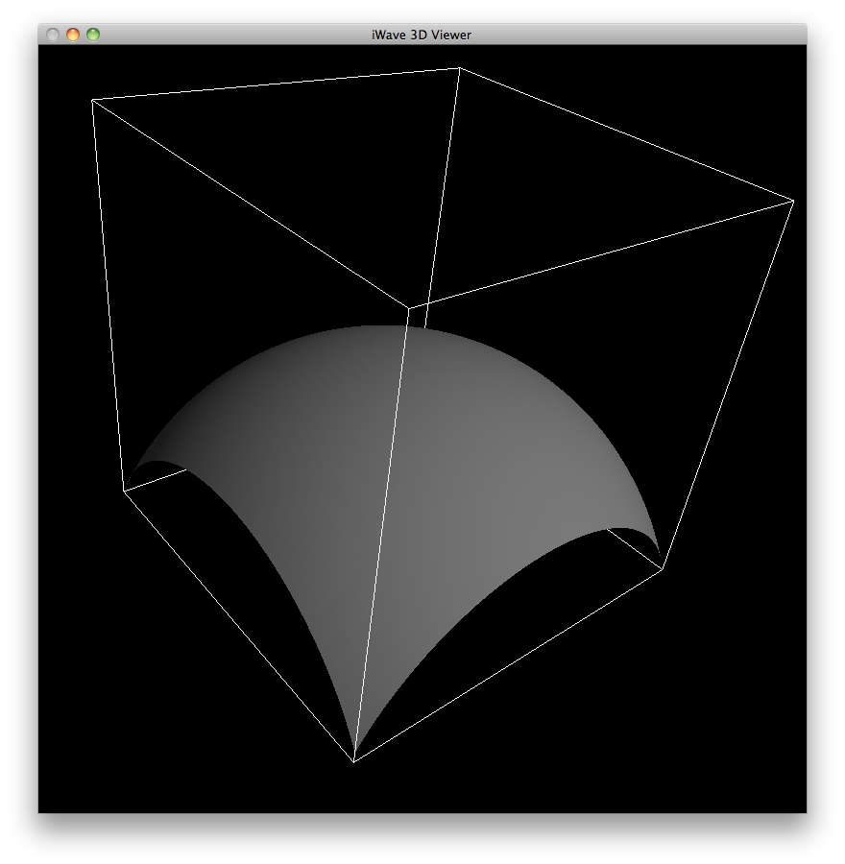
Notes:
So far this has been a pointless exercise. We’ve devised a more expensive way of simulating something we already know how to simulate.
But, this method is actually not constrained to planes. Let’s do a curved surface instead

Slide 44
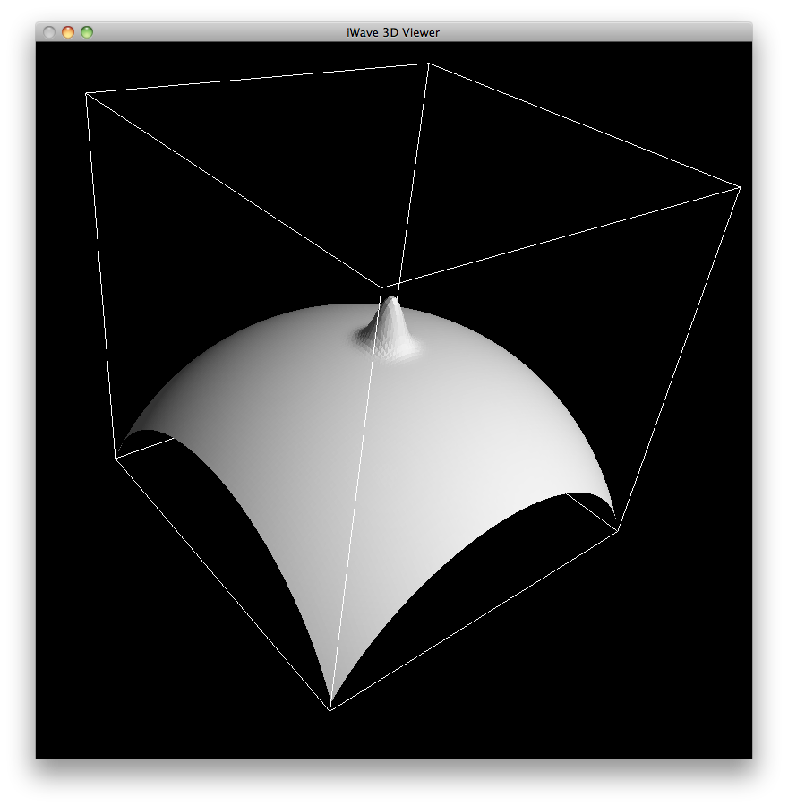
Notes:
We’ll insert a bump into the middle

Slide 45
Notes:
But like before, let’s visualize it as a scalar

Slide 46
Notes:
If we run this method on it, we get the wave equation on a curved surface!

Slide 47
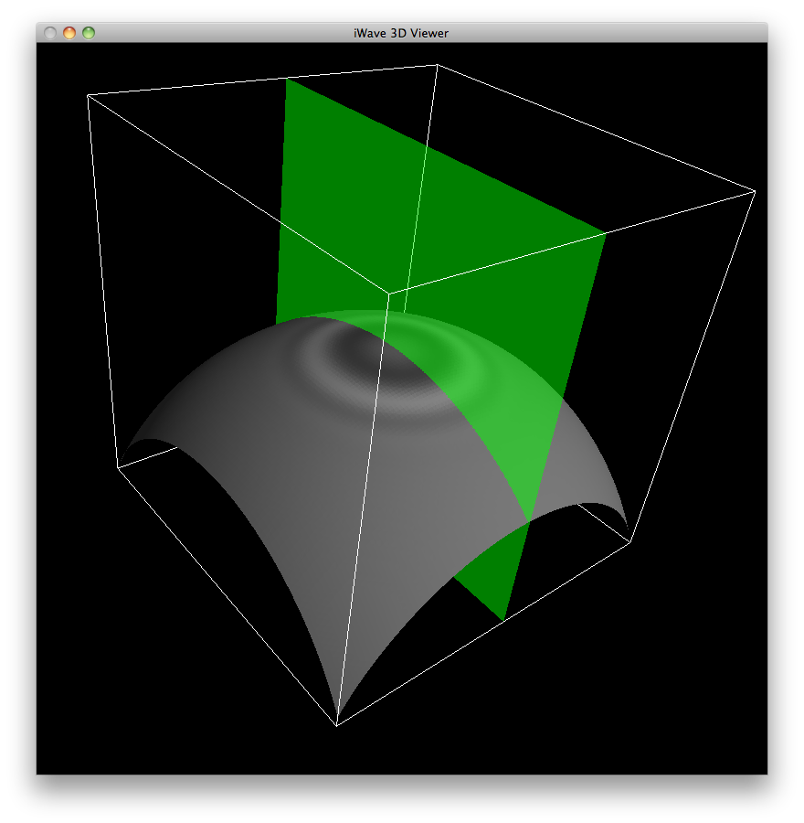
Notes:
We compute the extension field for this as well, which is slightly trickier, but it is possible.
Here if we take a slice out of the middle

Slide 48
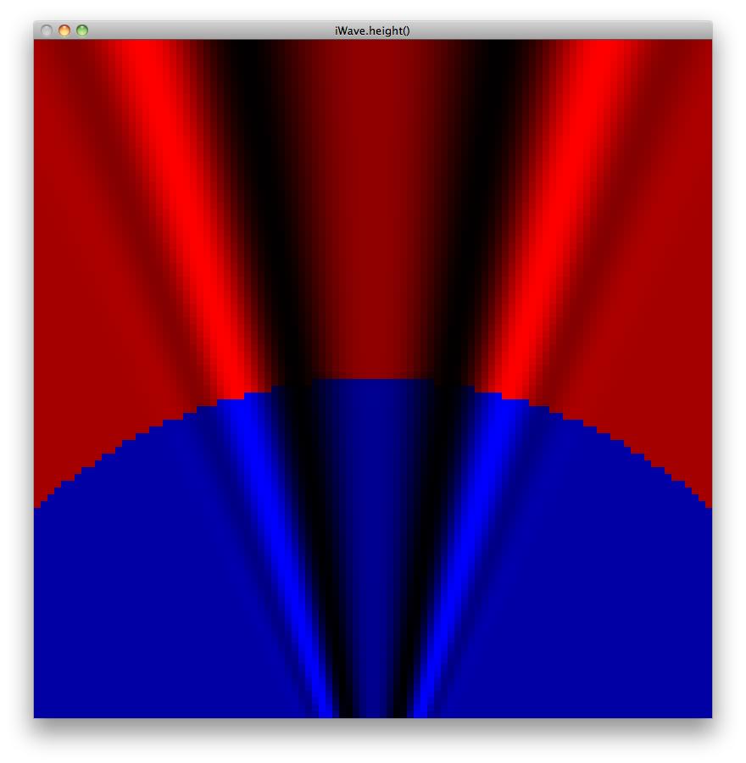
Notes:
Then we get an extension field that looks like this. More complex than the one we saw before, but it makes sense. All the surface quantities have been extneded in the normal direction.
We actually develop a fast way of computing this field in our paper, but I’m going to skip over that part so we can get at a more interesting result.

Slide 49
Outline
Previous Works
The Closest Point Method
3D iWave
Additional Extensions
Results

Slide 50
Closest Point Method
Works well for
Laplacian: Gradient:
1
1
1
1
1
-6
1
-1
0
1
1
-1
1
-1
Notes:
This is called the closest point method (show citations), and nothing I’ve shown is novel, it’s been developed by others over the past few years. But, it is a really slick method of performing simulations on surfaces, and we’d like to use it for our purposes.
The main problem is that almost all of the previous work shows that it works great for the one operator we’ve just shown, the Laplacian, and maybe something simpler, like the gradient. What if we want to simulate with something more complex?

Slide 51
iWave Equation
[Tessendorf 2004]
Notes:
In particular, instead of the classic wave equation, we’re interested in using the iWave method, a more sophisticated method that has been used extensively in production

Slide 55
iWave Equation:
Wave Equation:
Notes:
You’ll notice that the wave equation and the iwave equation look very similar, except that the iWave equation has a radical over the Laplacian. This is called a fractional derivative, and it both makes the waves more interesting and makes the simulation more complex.

Slide 56
Fractional Laplacian
Scaled sum of Bessel functions:
Notes:
Instead of the simple Laplacian, which we’ll show with colors here (show shaded Laplacian), the fractional Lapalcian discretizes into a scaled sum of Bessel functions of the first kind (show the Bessels, show them sum to a kernel).

Slide 57
Fractional Laplacian
Scaled sum of Bessel functions:
Notes:
Instead of the simple Laplacian, which we’ll show with colors here (show shaded Laplacian), the fractional Lapalcian discretizes into a scaled sum of Bessel functions of the first kind (show the Bessels, show them sum to a kernel).

Slide 58
Fractional Laplacian
Scaled sum of Bessel functions:
Notes:
Instead of the simple Laplacian, which we’ll show with colors here (show shaded Laplacian), the fractional Lapalcian discretizes into a scaled sum of Bessel functions of the first kind (show the Bessels, show them sum to a kernel).

Slide 59
Fractional Laplacian
Scaled sum of Bessel functions:
Notes:
Instead of the simple Laplacian, which we’ll show with colors here (show shaded Laplacian), the fractional Lapalcian discretizes into a scaled sum of Bessel functions of the first kind (show the Bessels, show them sum to a kernel).

Slide 60
Fractional Laplacian
Scaled sum of Bessel functions:
… =
Notes:
Instead of the simple Laplacian, which we’ll show with colors here (show shaded Laplacian), the fractional Lapalcian discretizes into a scaled sum of Bessel functions of the first kind (show the Bessels, show them sum to a kernel).

Slide 61
 | 1
1 | -4 | 1
 | 1
1
1
1
-6
1
1
1
???
Notes:
Now we have a problem. Before we had an obvious generalization from the 2D to 3D Laplacian, but what should we convert the Bessel function into?

Slide 62
1
-2
1
1
-2
0
1
1
-2
1
1
-2
1
Notes:
Now we actually get to our own contribution. Remember before, when we looked why the 3D Laplacian worked? (show the 3 directions again) It was because things cancelled out in the normal direction. There’s another way to look at this.

Slide 63
1
1
1
1
-6
1
1
-4
1
1
1
1
Notes:
You can also say that it works because when you take the projection of the 3D Laplacian in the normal direction, you retrieve the 2D Laplacian.

Slide 64
This is an Abel transform
1
1
1
1
-6
1
1
-4
1
1
1
1
Notes:
You can also say that it works because when you take the projection of the 3D Laplacian in the normal direction, you retrieve the 2D Laplacian.

Slide 65
Abel Transform
1
1
1
1
-6
1
1
-4
1
1
1
1
Notes:
There’s a more formal name for this operation – when you project a spherical function onto a plane, it’s taking the function’s Abel transform.

Slide 66
Inverse Abel Transform
1
1
1
1
-6
1
1
-4
1
1
1
1
Notes:
There’s also the opposite operation. If you have some flat 2D function, and you want to expand it out into 3D, can should take its inverse Abel transform.
This shows up in medical imaging, because you have quantities that show up on the photographic plane, so there are numerical methods for computing this inverse transform.

Slide 67
Inverse Abel Transform
???
Notes:
We are more fortunate than that however. Fortunately the expression for the iWave kernel can be transformed symboically.

Slide 68
Inverse Abel Transform
Notes:
The J0 Bessel function, which is at the center of the iWave kernel, has a known analytic inverse Abel transform, which is the sinc function.
With this knowledge in hand, we can now build a 3D iwave kernel in the same way as the 2D kernel (show the 3D summation).

Slide 69
Inverse Abel Transform
Notes:
The structure becomes a little more visible if we look at the individual Bessel functions that constitute the kernel

Slide 70
Inverse Abel Transform
Notes:
The structure becomes a little more visible if we look at the individual Bessel functions that constitute the kernel

Slide 71
Inverse Abel Transform
Notes:
The structure becomes a little more visible if we look at the individual Bessel functions that constitute the kernel

Slide 72
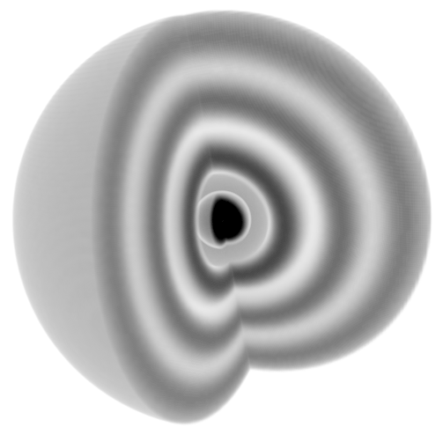
Inverse Abel Transform
Notes:
The structure becomes a little more visible if we look at the individual Bessel functions that constitute the kernel

Slide 73
Inverse Abel Transform
Notes:
The structure becomes a little more visible if we look at the individual Bessel functions that constitute the kernel

Slide 74
Finding
Any 2D operator can be applied to the Closest Point Method by taking its inverse Abel transform

Slide 75
Outline
Previous Works
The Closest Point Method
3D iWave
Additional Extensions
Results

Slide 76
Turbulence Seeding

Slide 78
Extension Field
Notes:
Here’s the side by side. On the left, you see that the strategy smears everything out. In the middle, we have the opposite problem and it keeps things artificially sharp. On the right, we strike a nice balance between the two.

Slide 79
Advection
Notes:
The last piece is that you do indeed have to perform advection in order to have the waves move along with the flow. You actually do have to be careful about how you do this if you want it to be efficient but still use higher order advection methods like MacCormack advection. I will only note this, and refer you to the paper for more details.

Slide 80
Outline
Previous Works
The Closest Point Method
3D iWave
Additional Extensions
Results

Slide 81
100³ Houdini simulation, 00:12 per frame
Notes:
For now, let’s just look at some results.
Here’s the paddle example that we saw before, which took 24 seconds a frame

Slide 82
200³ Houdini simulation, 03:44 per frame
Notes:
And here’s the brute force solution again. This took a lot more time, 3:44 a frame.

Slide 83
4x up-res, 00:58 per frame

Slide 84
8x up-res, 05:29 per frame

Slide 85
Notes:
But, we look at them side by side, and clearly the 8x gets more detail.

Slide 86
Performance Per Frame
 | Houdini, Direct | Our Algorithm
100³ | 00:24 | N/A
200³ | 03:44 | 00:12
400³ | 38:00 | 00:58
800³ | N/A | 05:29
1000³ | N/A | 11:12
12-core, 2.66 Ghz Intel Xeon
Notes:
Here’s the performance per frame. Note that our algorithm initially actually runs faster than the original simulation. So, if you want to goose a little more performance out of your simulation at little extra cost, you can apply our method.

Slide 87
100² x 50 simulation, 00:18 per frame
Notes:
Our method is fairly agnostic to the source of the sim, so we also tried with a PhysBAM simulation. Here’s the original, clearly it looks pretty viscous, and took 18 seconds per frame.

Slide 88
8x up-res, 02:48 per frame
Notes:
Here’s the 8x upres, which took 2:48 per frame.

Slide 89
Notes:
So you can see what’s new form our sim, here’s a split screen again.

Slide 90
100³ simulation, 01:52 per frame
Notes:
Finally, here’s the default PhysBAM sim, with not obstacles.

Slide 91
8x upres, 03:15 per frame
Notes:
And here it is with 8x upres. It takes about 3 minutes per frame.

Slide 92
Notes:
Here’s the split screen.

Slide 93
Performance Per Frame
 | Dam Break | Pouring
Original Simulation | 00:18 | 01:52
2x Upres | 00:06 | 00:07
4x Upres | 00:21 | 00:34
8x Upres | 02:48 | 03:15
12-core, 2.66 Ghz Intel Xeon
Notes:
So here’s the original PhysBAM running times

Slide 94
Performance Per Frame
 | Dam Break | Pouring
Original Simulation | 00:18 | 01:52
2x Upres | 00:06 | 00:07
4x Upres | 00:21 | 00:34
8x Upres | 02:48 | 03:15
12-core, 2.66 Ghz Intel Xeon
Notes:
And you actually have to go up a few upres levels before your running time even starts exceeding them. So, it’s pretty efficient.

Slide 95
Conclusions
Up-res liquids with a surface simulation
The Closest Point Method (CPM) is simple, robust Eulerian method
Adapt 2D stencils for CPM using the inverse Abel transform
More details in paper
Turbulence seeding
Frozen core extension

Slide 96
Future Work
Implicit CPM integrator?
Up-res FLIP liquids?
What other operators can we apply?

Slide 97
Acknowledgements
NSERC Discovery, “Many-Core Physically Based Simulation”
NSF CAREER, “Enabling Efficient Non-Linearities in Biomechanical Simulations”
Side Effects Software, especially Jeff Lait
Notes:
And it defintely wouldn’t have happened without the following funding sources, and a very nice equipment donation from Side Effects, the makers of Houdini

Slide 98
Thank You
Source: http://www.mat.ucsb.edu/~kim/CPT/source.html
Notes:
So far, everything we’ve looked at has been single phase turbulence, i.e. smoke or fire simulations. In all these simulations, we’ve assumed that we have air, and some particulate floating around in it.
A really obvious next question to ask is, what multi-phase simulations, where there is both an air phase and a water phase? These are also a staple of visual effects, but suffer from similar problems.
You can meticulously manipulate a simulation at low resolution, but when you bump the resolution up, the motion changes entirely. Can we apply the same philosophy that we used for single phase simulations? Can we use some sort of simple model to add turbulent detail to a simulation, but in a way that doesn’t ruin all the previous design work? (show PhysBAM resolutions)

Slide 99
Notes:
You can get lots of different looks out of this method, for example you can control how persistent the surface waves are using the damping parameters.

Slide 100
8x up-res, classic wave equation

Slide 102
Performance Per Frame
 | Houdini, Direct | Our Algorithm
100³ | 00:24 | N/A
200³ | 03:44 | 00:12
400³ | 38:00 | 00:58
800³ | N/A | 05:29
1000³ | N/A | 11:12
Notes:
So, to summarize the performance numbers, on the left here is the performance of the direct commercial solver.

Slide 103
Performance Per Frame
 | Houdini, Direct | Our Algorithm
100³ | 00:24 | N/A
200³ | 03:44 | 00:12
400³ | 38:00 | 00:58
800³ | N/A | 05:29
1000³ | N/A | 11:12
Notes:
So, to summarize the performance numbers, on the left here is the performance of the direct commercial solver. The scaling isn’t great. In fact, we had to stop simulating past 400 cubed, because it ran for over a week.

Slide 104
Performance Per Frame
 | Houdini, Direct | Our Algorithm
100³ | 00:24 | N/A
200³ | 03:44 | 00:12
400³ | 38:00 | 00:58
800³ | N/A | 05:29
1000³ | N/A | 11:12
Notes:
By contrast, our solver initially runs faster than the original solver.

Slide 105
Performance Per Frame
 | Houdini, Direct | Our Algorithm
100³ | 00:24 | N/A
200³ | 03:44 | 00:12
400³ | 38:00 | 00:58
800³ | N/A | 05:29
1000³ | N/A | 11:12
Notes:
By contrast, our solver initially runs faster than the original solver

Slide 106
Performance Per Frame
 | Houdini, Direct | Our Algorithm
100³ | 00:24 | N/A
200³ | 03:44 | 00:12
400³ | 38:00 | 00:58
800³ | N/A | 05:29
1000³ | N/A | 11:12
Notes:
And the detail tends to max out at around 5 minutes per frame, which is still a tractable running time.

Slide 107
Performance Per Frame
 | Dam Break | Pouring
Original Simulation | 00:18 | 01:52
2x Upres | 00:06 | 00:07
4x Upres | 00:21 | 00:34
8x Upres | 02:48 | 03:15
Notes:
We see something similar with the other two examples.

Slide 108
Performance Per Frame
 | Dam Break | Pouring
Original Simulation | 00:18 | 01:52
2x Upres | 00:06 | 00:07
4x Upres | 00:21 | 00:34
8x Upres | 02:48 | 03:15
Notes:
So here’s the original PhysBAM running times

Slide 109
Performance Per Frame
 | Dam Break | Pouring
Original Simulation | 00:18 | 01:52
2x Upres | 00:06 | 00:07
4x Upres | 00:21 | 00:34
8x Upres | 02:48 | 03:15
Notes:
And you actually have to go up a few upres levels before your running time even starts exceeding them. So, it’s pretty efficient.

Slide 110
[Nielsen and Bridson 2011]
Notes:
You could take a different approach entirely and re-simulate just a layer of liquid on top of what was already simulated, as was done here (Brisdon and Nielsen). This approach has been quite successful, and has been used in production, particularly in the adventures of tin tin from last year
This isn’t quite what we want though. This will still break the silhouette of the liquid, and so some work still needs to be redone.

Slide 111
8x up-res Original
Notes:
But, we look at them side by side, and clearly the 8x gets more detail.

Slide 112
2x up-res, 00:12 per frame
Notes:
Here’s our upres by a factor of 2. It’s very fast, 12 seconds a frame, faster than even the original simulation, and you can already see some nice detail start to emerge.

Slide 113
10x up-res, 11:12 per frame

Slide 114
10x up-res 8x up-res

Slide 115
Extension Field
Conventional Extension
Notes:
Second, how do we compute the extension field? There’s a definite right way and wrong way to do this. Here’s what happens if you compute the extension field the conventional way. It works, but there’s a bunch of artifacts at the top.

Slide 116
Extension Field
Extend once
Notes:
One tempting thing to do, especially if speed is a concern, is to only compute the extension field once at the beginning and then let things chug along. You’ll get something this way too, and it’ll be a little crisper, but some pretty obvious artifacts show up eventually.

Slide 117
Extension Field
Frozen core extension
Notes:
We devised a different strategy that we refer to as a “frozen core” variant, and its gives the results right here. There’s some transient blocky behavior, but overall no artifacts persist over time.

