Slide 1
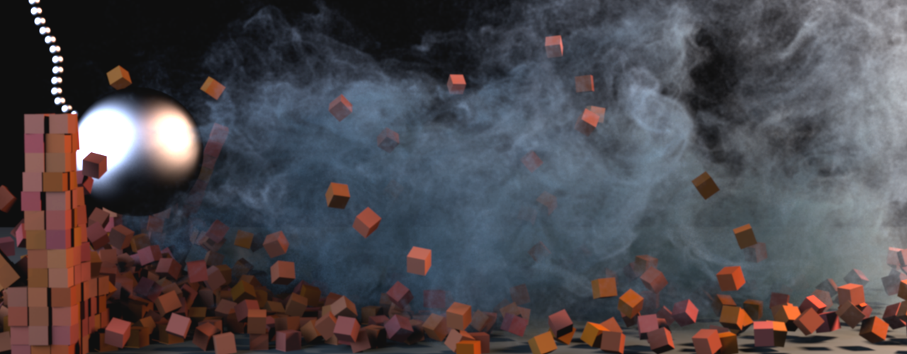
Subspace Fluid Re-Simulation
Theodore Kim and John Delaney
University of California, Santa Barbara
Notes:
Good morning everybody, and thank you for coming to my talk. I’m Theodore Kim from the University of California, Santa Barbara, and I’ll be talking about subspace fluid re-simulation.

Slide 2
200 x 266 x 200 simulation, 7 hours 2 minutes
Notes:
What do I mean by re-simulation? Let’s say we have this plume of smoke here that we took 7 hours to simulate. A lot of times you simulated something, but you want to tweak one parameter just a little bit. Do you really need to run a whole new simulation?
We already computed something that’s very similar to what we want; can we leverage all that work we did to make things go a little faster the next time around?

Slide 3
Notes:
This is what our paper addresses. On the middle and the right, we tweaked the vorticity confinement constant, and got results back 30 times faster. If you just measure the speed of the solver itself, it came back over 1700 times faster.

Slide 4
Outline
Previous Work
Subspace Basics
The Cubature Approach
Other Features
Results
Discussion and Conclusions
Notes:
Okay, that’s the broad picture, now let’s back up a bit.
First I’m going to give some context in relation to previous work, then go into the subspace approach. In its basic form, the subspace approach can’t do this, so I show how we apply the cubature approach to it.
I’ll wrap up by briefly mentioning some other features and with some results and discussion.

Slide 5
Outline
Previous Work
Subspace Basics
The Cubature Approach
Other Features
Results
Discussion and Conclusions
Notes:
Let’s get started with some context

Slide 6
Fluid Simulation
[Foster and Metaxas 1997]
[Stam 1999]
Semi-Lagrangian Advection
Implicit Integration
Notes:
If you’re doing grid based simulation, you’re doing some variant on semi-Lagrangian advection and implicit integration. It’s so standard it may seem strange that I’m mentioning it here, but it will in fact come up later on.

Slide 7
Vortex Methods
Adaptive Methods
[Losasso et al. 2004]
[Ando et al. 2013]
[Brochu et al. 2012]
[Pfaff et al. 2012]
Turbulence Methods
Viscosity Methods
[Kim et al. 2008]
[Schechter and Bridson 2008]
[Narain et al. 2008]
[Mullen et al. 2009]
Notes:
There’s been a lot of work that tries to make Stable Fluids and related algorithms faster. There’s classic approaches like octree methods, and other approaches, like synthetic turbulence methods, viscosity methods, and vortex methods.

Slide 8
Subspace Methods
[Barbic and James 2005]
[Pentland and Williams 1989]
[Harmon and Zorin 2013]
[Kim and James 2011]
Notes:
We’ll be looking at a different method here, subspace methods. These methods have been popular in solid mechanics, and the work goes back to the 1980s. They’re appealing because if done right you can get gigantic speedups, like 1000x or 1 million times speedups.
A lot of work has been done in solid mechanics, as you can see here.

Slide 9
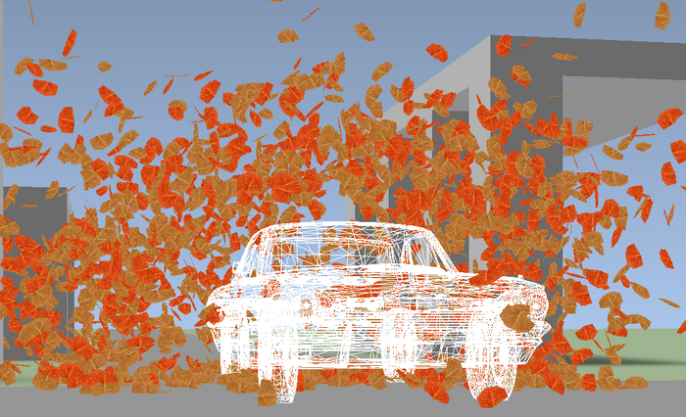
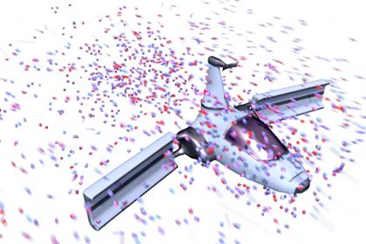
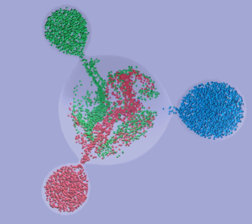
Subspace Methods
[Treuille et al. 2006]
[Wicke et al. 2009]
[Stanton et al. 2013]
Notes:
Treuille and co-workers pioneered their use for fluid mechanics back in 2006, and they’ve done some great follow-up work since then.
Once again though we’re looking at the re-simulation problem, which as it turns out is different from that addressed by this previous work.

Slide 10
[Treuille et al. 2006]
Notes:
It’s instructive to take a closer look at this particular work in the context of our problem.

Slide 11
Notes:
Here we have a pretty simple example – a rising plume. We implemented the 2006 paper, and when we re-run the same simulation with the exact same settings, this is the result we got. What gives?

Slide 12
Notes:
We implemented the 2006 paper, and when we re-run the same simulation with the exact same settings, this is the result we get. What gives?

Slide 13
Outline
Previous Work
Subspace Basics
The Cubature Approach
Other Features
Results
Discussion and Conclusions
Notes:
Let’s take a closer look at what goes on under the good in these subspace algorithms

Slide 14
Diffusion
Notes:
Diffusion is a good example, since everybody’s familiar with that. We can write diffusion down as a single matrix D

Slide 15
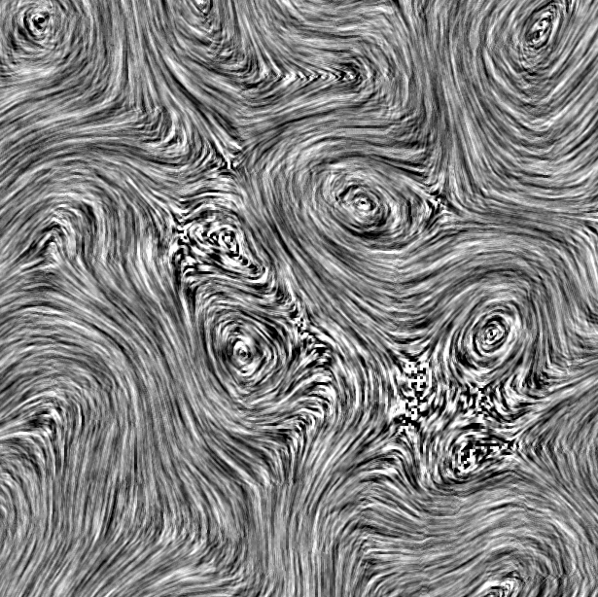
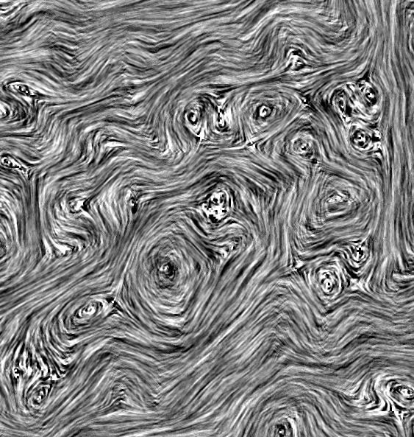
Diffusion
Notes:
Now accelerating this step using subspace methods is straightforward. Say you have a basis matrix U, and each column of U is a different velocity field. For the time being, let’s say that U is a pretty good basis, i.e. linear combinations of these columns actually yield a wide variety of interesting velocity fields. There are only r columns, and r is a lot, lot smaller than N.

Slide 16
Notes:
We can project the matrix V by doing a pre and post multiply here.

Slide 17
Stable Fluids
Diffusion
Projection
Advection ???
Notes:
So, we can apply standard subspace methods to the diffusion and projection stages of Stable Fluids no problem. Implicit integration works out of the box.
What about advection?

Slide 18
Semi-Lagrangian
Advection
Diffusion
???
Notes:
Remember, the whole reason this worked was because we could write the diffusion operation down as a matrix.
What’s the matrix for semi-Lagrangian advection?

Slide 19
Semi-Lagrangian
Advection
Diffusion
???
Notes:
Remember, advection is non-linear so it’s impossible to write is an a linear matrix.

Slide 20
Finite Difference Advection
[Treuille et al. 2006]
A
Notes:
We could go in a different direction
In the 2006 paper, Instead of semi-Lagrangian advection, they used finite differences. In this case, you still can’t write it as a matrix, but you can write it as a 3rd order tensor

Slide 21
Finite Difference Advection
[Treuille et al. 2006]
A
~
A
U^{T}
U
Notes:
Being careful to do it in the extra dimension as well. So once again, you get a tiny matrix you can re-use at runtime and run the advection stage thousands of times faster than before.

Slide 22
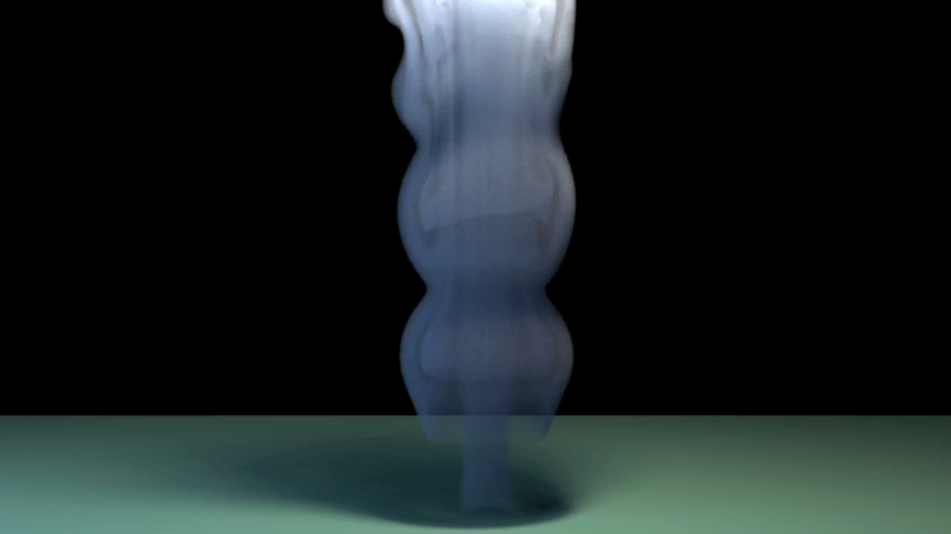
Finite differences,
not Semi-Lagrangian
Exponential,
not implicit
Notes:
Now it makes sense why the method isn’t so good at re-simulation. It doesn’t use semi-Lagrangian advection, it uses finite differences.
So really, it’s a totally different integrator! There’s no reason to expect it to give the same results back!

Slide 23
Semi-Lagrangian
Advection
???
Notes:
So we’re left with the same question. What’s the matrix for semi-Lagrangian advection? Or rather, what’s the tensor?

Slide 24
Semi-Lagrangian
Advection
???
[Stanton et al. 2013]
Enables ÷ and √
Notes:
The Stanton paper this year describes new operators you can capture, such as division and the square root.
We actually looked at operations like this too, but semi-Lagrangian methods don’t fit here either.

Slide 25
Semi-Lagrangian
Advection
Finite Difference
Advection
1
-1
1
-1
Notes:
The problem is that semi-Largangian methods aren’t reducible to a static stencil. Any cell can look at any other cell, and which cells it does changes every timestep. It’s impossible to encode this in a one-time tensor.
Clearly a different approach is needed.

Slide 26
Outline
Previous Work
Subspace Basics
The Cubature Approach
Other Features
Results
Discussion and Conclusions
Notes:
That’s where we come in– the cubature approach.

Slide 27
Optimizing Cubature for Efficient Integration of Subspace Deformations [An et al.] 2008
Notes:
The cubature approach is from this paper in 2008 which I helped out with. So far it’s only ever been used for solid mechanics, but we’ll show how to use it for fluids.

Slide 28
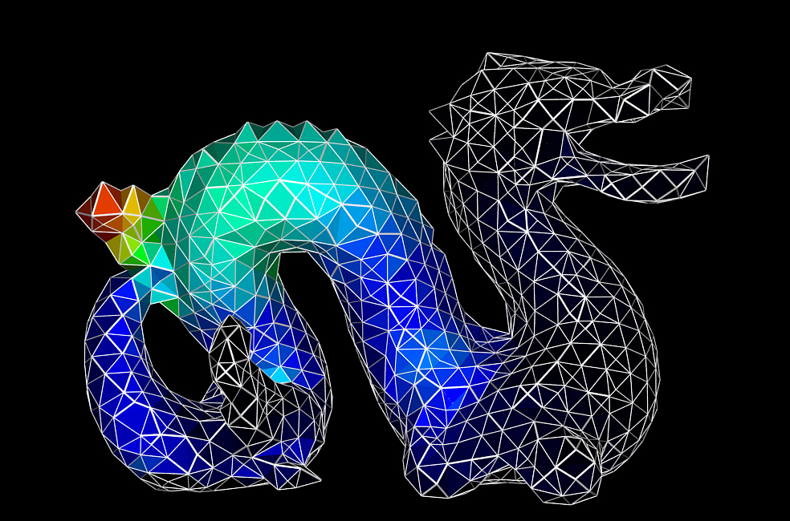
The Cubature Approach
Notes:
In that paper, they had a similar problem, but it was for solids, not fluids.
They had a force response function on the inside of a solid, which could not be written as a tensor.

Slide 29
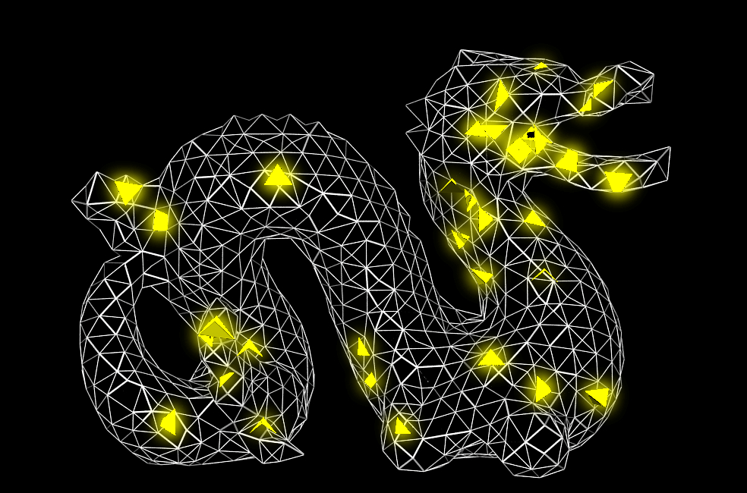
The Cubature Approach
Notes:
The key insight was that you could instead evaluate the function at a small number of cubature points, and get a very good approximation to the non-linear function.

Slide 30
The Cubature Approach
Notes:
Just like is classic quadrature, each point gets a weight

Slide 31
The Cubature Approach
Notes:
And when you sum them together, you get a good approximation of the non-linear function

Slide 32
The Cubature Approach
Notes:
This approach is actually fairly general.
You can do it for any arbitrary non-linear function you want, as long as it supports points sampling. No special tensor representation is required.

Slide 33
The Cubature Approach
Notes:
So, can we do it for some advection operator?

Slide 34
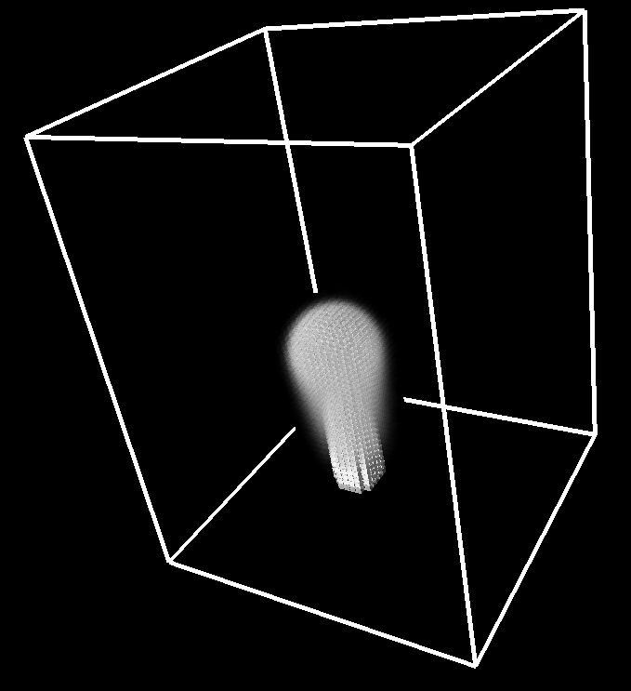
The Cubature Approach
64 x 48 x 64
Notes:
Well, in order to answer that question, we tried to compute an actual cubature fit.
This means we have to find a good, sparse set of points, and compute weights for them. We adapted the approach from the 2008 paper to fluids, and ran it on a very low-resolution fluid, 64 x 48 x 64.

Slide 35
The Cubature Approach
64 x 48 x 64
Six days!
Notes:
It did find a fit, but it took 6 days!
This is clearly not an acceptable running time. Where is the algorithm spending all of its time?

Slide 36
The Greedy Algorithm
Notes:
To understand this, let’s take a closer look at the greedy strategy that the 2008 paper uses.
Say we’re just doing a 2D simulation,
Let’s say you have an existing cubature set, but it doesn’t approximate the action of an advection operator very well.

Slide 37
The Greedy Algorithm
Notes:
And we’re in the middle of computing a cubature set for advection, but it’s not doing a very good job.

Slide 38
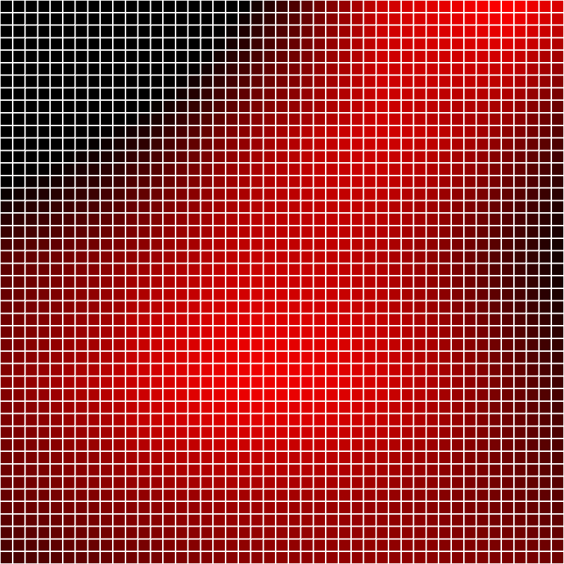
The Greedy Algorithm
Notes:
We can get an idea of where the fit is bad by looking at the residual. (show residual rendering)

Slide 39
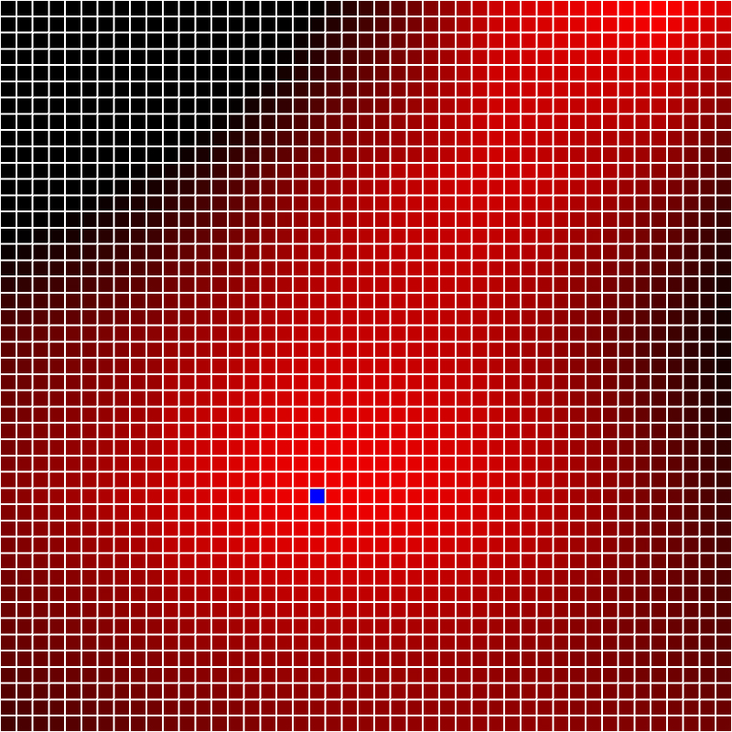
The Greedy Algorithm
Notes:
If the fit isn’t good enough, we’ll pick the point with the largest positive projection onto the residual (show in blue), since that one will probably kill off a good portion of the error. (show a peak)

Slide 40
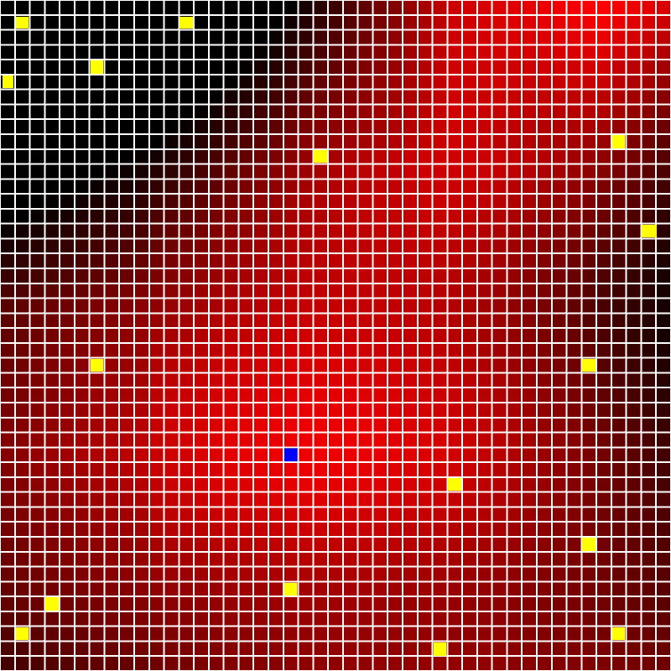
The Greedy Algorithm
Notes:
So you add this cell to your cubature set

Slide 41
Non-Negative Least Squares
Notes:
then you run a NNLS solve to see what the new weights should be. We go into why it’s an NNLS solve and not LS in the paper.

Slide 42
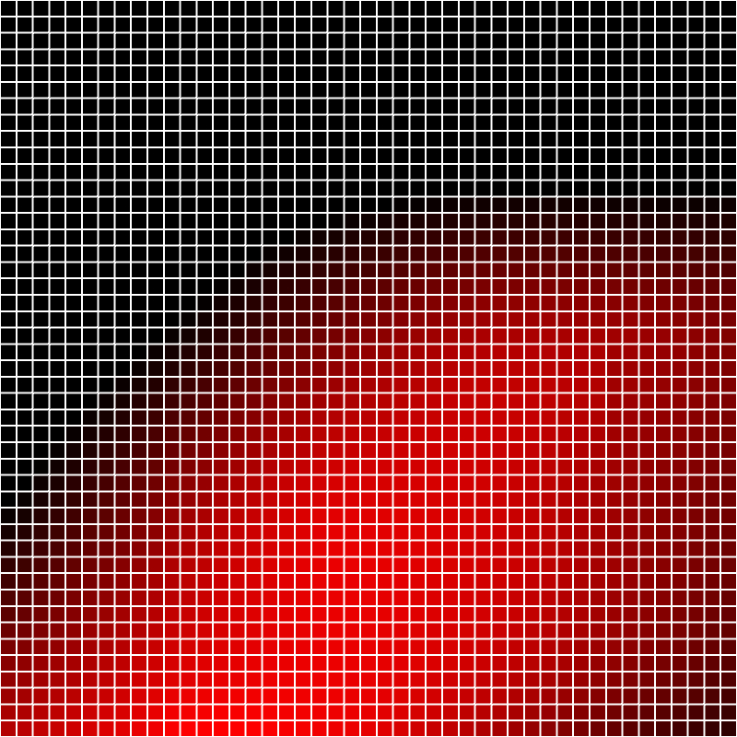
The Greedy Algorithm
Notes:
Hopefully your residual improved, so you look at it again.
If things still aren’t good enough, go through this whole process again. Add another point to the set.

Slide 43
Lawson-Hanson NNLS solve:
Greedy search for P cubature points:
Notes:
A single NNLS solve takes cubic time, and we do it once for every new cubature point. So the final running time is quartic in the number of cubature points. That’s where it’s spending all its time. Can we do better?
We tried a lot of things here, and they led us down a path to a better algorithm

Slide 44
Notes:
One thing we noticed is that a lot of the picks are duds, because the weights get solved to zero.
This would happen when a point was useful early on in the fit, but got supercededd later on.
This is a good thing though – this means we can detect duds. (show gems, with some set to zero.)

Slide 45
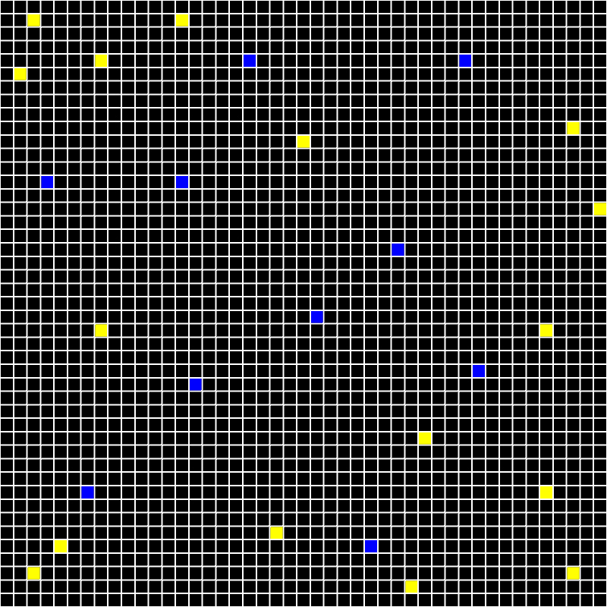
Notes:
What this tells us is, we don’t have to add one point at a time to the cubature set. We can blast down tons of points, and run a single fit to get weights for all of them.
Maybe we’ll find a bunch of good points all at once, and if we don’t, we can see the duds and remove them. (show a bunch go to zero, remove them)

Slide 46
Notes:
We’ll find a bunch of good points with non-zero weights

Slide 47
Notes:
And probably a bunch of bad ones as well.

Slide 48
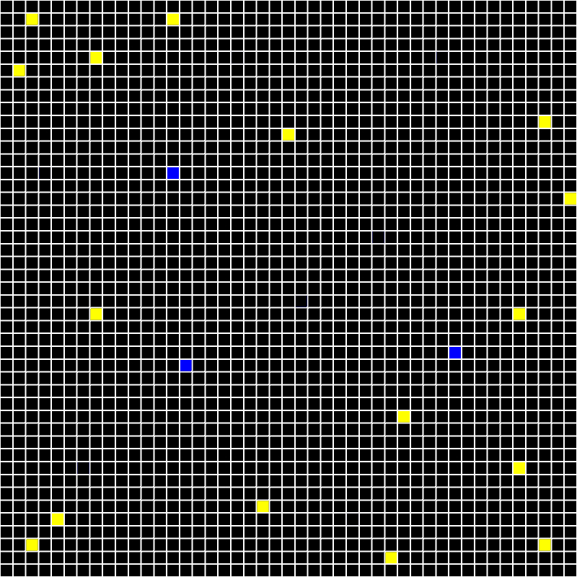
Notes:
That’s okay though, we can just cull the zero ones.
So this was a good idea, but in the end it actually didn’t speed the fitting algorithm up that much.

Slide 49
[Cook 1986] [Pharr and Humphreys 2010]
… many others
[Cook 1986]
… many others
Notes:
At this point what we were doing started to feel an awful lot like Monte Carlo sampling. So we refreshed ourselves on that literature. Maybe we can take a page from them?

Slide 50
Importance Sampling
Notes:
Really what we’re trying to do is approximate an integral using a small number of sample points.
That’s the same philosophy as importance sampling!

Slide 51
Importance Sampling
Notes:
Practically speaking, we have this residual function in hand

Slide 52
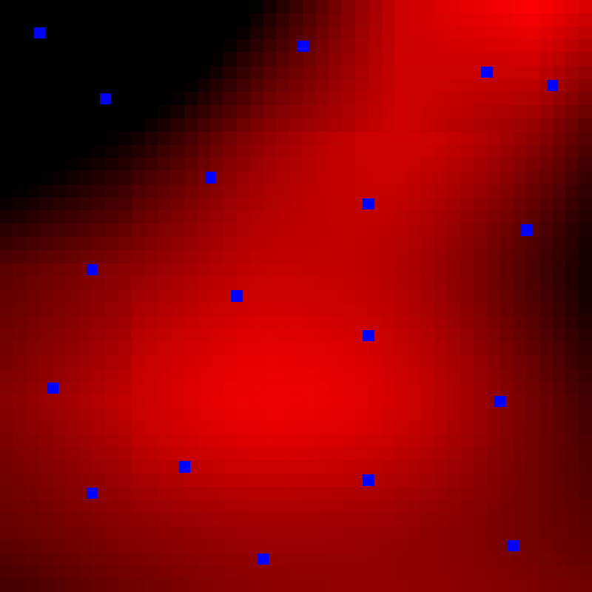
Importance Sampling
Notes:
We could throw down a bunch of points as potential cubature points and hope that some end up getting non-zero weights.

Slide 53
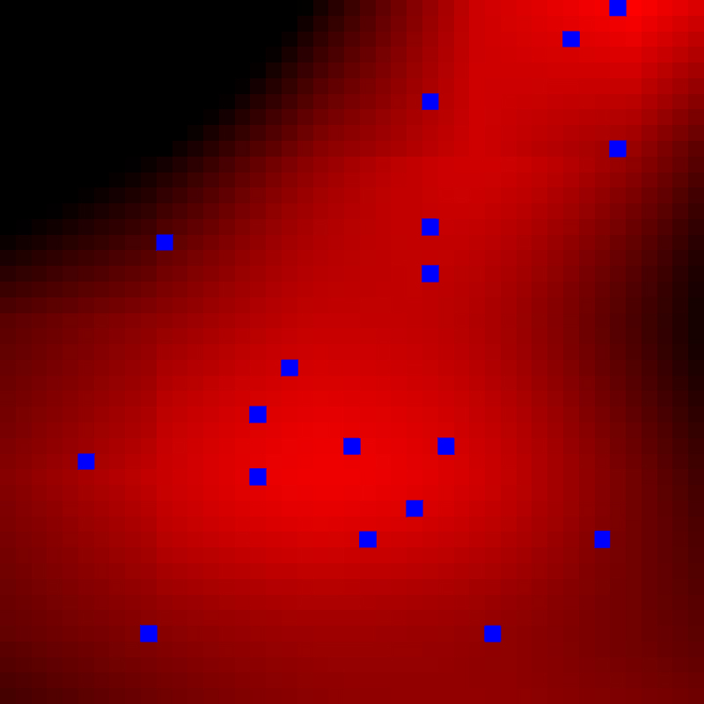
Importance Sampling
Notes:
But doesn’t it make sense to cluster the sample points in promising regions? Such as those with a high residual?

Slide 54
Notes:
Here’s the importance sampling function we used, but I won’t go into more detail here and just leave it for the paper.
It’s actually very close to the greedy selection criteria.

Slide 55
Six days
30 minutes
Notes:
The running times speak for themselves. That 6 day example before can now run in less than half an hour.

Slide 56
 | Example 1 | Example 2 | Example 3 | Example 4
L₂ error, Iteration 1 | 0.0428803 | 0.0592719 | 0.0409149 | 0.0330917
L₂ error, Iteration 2 | 0.0148716 | 0.0184463 | 0.0145316 | 0.0118481
L₂ error, Iteration 3 | 0.0107379 | 0.0112989 | 0.0106133 | 0.00650847
L₂ error, Iteration 4 | 0.00866083 | 0.00865156 | 0.00871744 | converged
Total Time | 01h 18m 07s | 03h 05m 58s | 09h 28m 29s | 05h 29m 02s
Notes:
Other more complex examples take longer of course, as you can see here.
It’s safe to say that it would be totally impractical to compute these using the greedy method.
We found that all our examples converge in 4 iterations or less.

Slide 57
Greedy search for P cubature points:
Importance sampled cubature:
Notes:
We thus argue that empirically, our algorithm appears to run on cubic time, though we don’t have a rigorous proof for it yet.

Slide 58
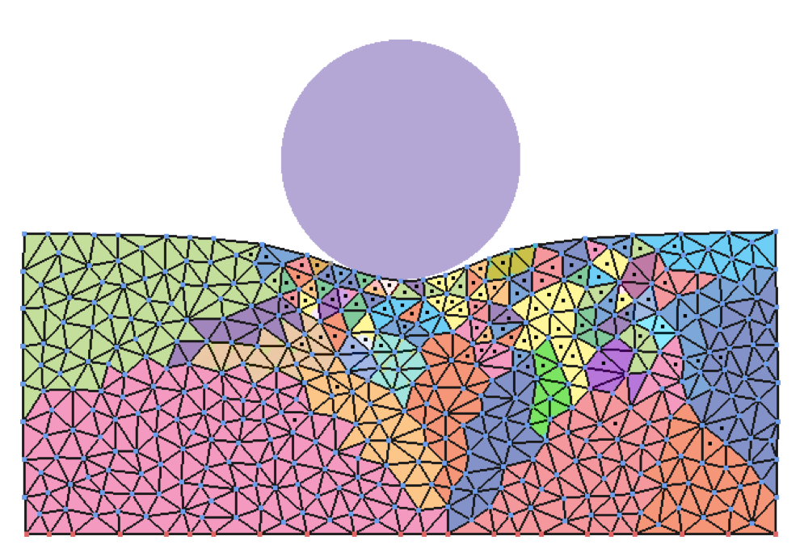
[Harmon and Zorin 2013]
Notes:
It looks like this idea was waiting to be born, as there’s another paper at SIGGRAPH this year that also uses importance sampling for cubature training, the Harmon and Zorin paper.
So, if you’re interested in this topic, I would give that one a read as well.

Slide 59
Outline
Previous Work
Subspace Basics
The Cubature Approach
Other Features
Results
Discussion and Conclusions
Notes:
There are a bunch of other features we mention in the paper that I won’t go into too much detail in here.

Slide 60
Fast Diffusion-Projection
Notes:
The other stages of Stable fluids are just linear operations, so we can write them as matrices and project them.

Slide 61
Fast Diffusion-Projection
Diffusion
Projection
Notes:
The top bit here is the diffusion stage, and the bottom is the pressure projection

Slide 62
Fast Diffusion-Projection
Notes:
The top bit here is the diffusion stage, and the bottom is the pressure projection

Slide 63
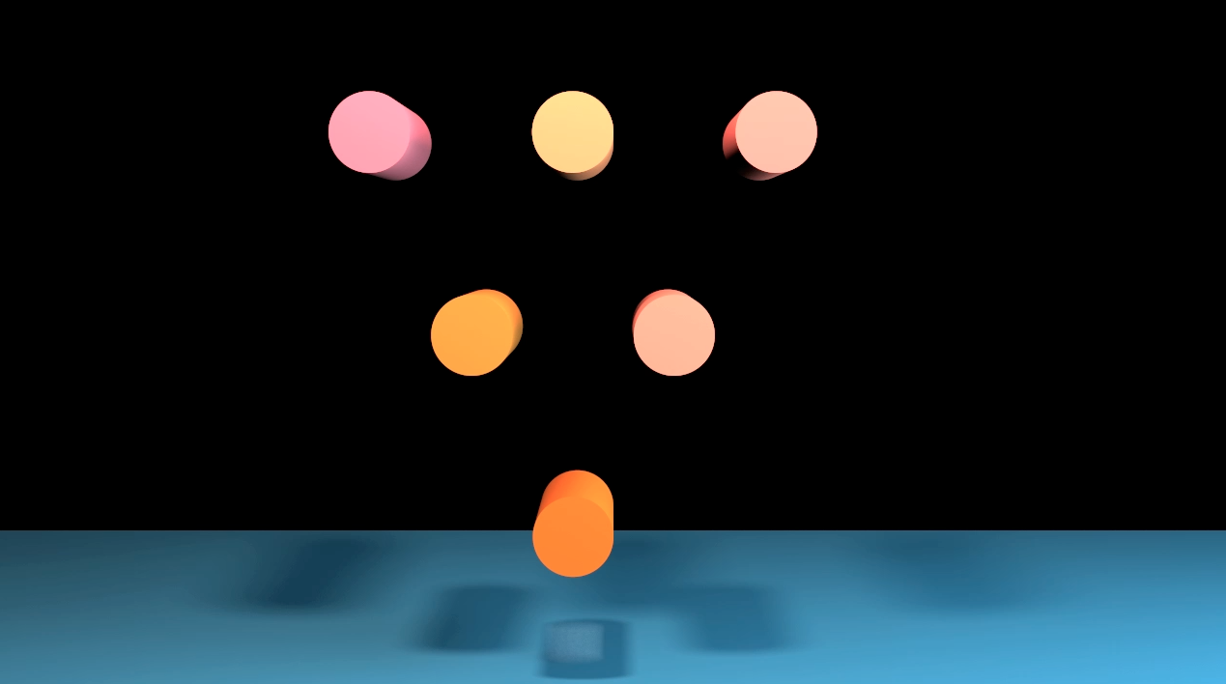
Internal Obstacles
Notes:
Of course, no fluid simulation method is complete unless it can handle internal obstacles.

Slide 64
Iterated Orthogonal Projection
[Molemaker et al. 2008]
Notes:
Again, while going into very little detail, we found that the IOP method from Molemaker et al’s 2008 paper plays very nicely with a subspace simulation.

Slide 65
Iterated Orthogonal Projection
[Molemaker et al. 2008]
Notes:
Here’s that diffusion-projection matrix I just showed you

Slide 66
Iterated Orthogonal Projection
[Molemaker et al. 2008]
Notes:
All you have to do to incorporate obstacles is insert a new IOP matrix in the middle right here. It works beautifully.

Slide 67
Outline
Previous Work
Subspace Basics
The Cubature Approach
Other Features
Results
Discussion and Conclusions
Notes:
Finally, let’s get to some results.

Slide 68
Stam Plume, 200×266×200
06h 57m 30s
Notes:
Here’s a plume computed using standard semi-Largraigna advection. It’s pretty high res, so it takes a while to compute.

Slide 69
Notes:
You can perturb a bunch of parameters once you have this model in hand.

Slide 70
Stam Plume example
Solver Only: 18ms 9326x faster
With Vel. Recon.: 4.2s 39x faster
Total preprocessing: 09h 50m 23s
12-core, 2.66 Ghz Mac Pro
Notes:
Here’s the running time of the solver. If we time only the solver times, our solver is a lot faster, almost 10 thousand times faster.
Some components live outside of the subspace though, like density advection and vorticity confinement. So, if we do an end-to-end timing, our solver is 39x faster, which still a pretty good number.

Slide 71
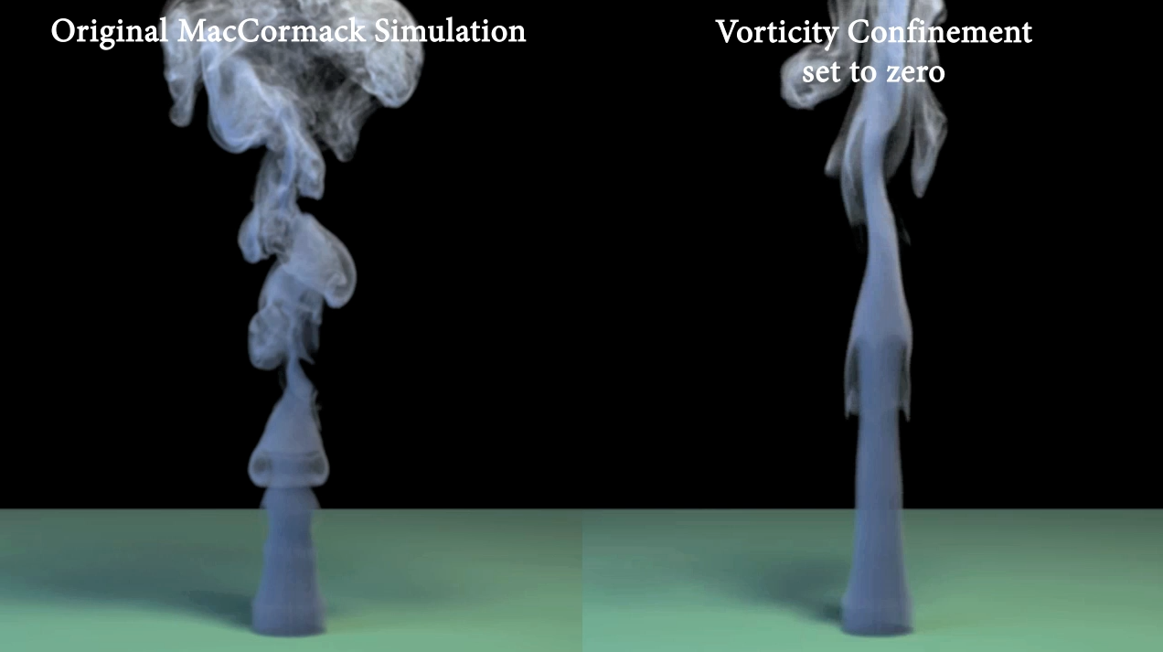

Slide 72
MacCormack example
Solver Only: 96ms 1764x faster
With Vel. Recon.: 5.6s 30x faster
Total preprocessing: 09h 27m 16s
Notes:
We still get a nice speedup out of cubature, but it’s slower. The reason for this is that MacCormack advection is more non-linear so you need more cubature points to capture it.

Slide 73
Dirichlet obstacles, 276 x 276 x 138
03h 35m 00s

Slide 75
Dirichlet example
Solver Only: 130ms 661x faster
With Vel. Recon.: 5.1s 17x faster
Total preprocessing: 19h 00m 58s
Notes:
We still get a nice speedup out of cubature, but it’s slower. The reason for this is that MacCormack advection is more non-linear so you need more cubature points to capture it.

Slide 76
Neumann obstacles, 175 x 175 x 350
03h 27m 30s

Slide 77
Vorticity confinement = 20, originally 1.5

Slide 78
Neumann example
Solver Only: 34ms 2435x faster
With Vel. Recon.: 5.7s 14x faster
Total preprocessing: 18h 53m 55s

Slide 79
Outline
Previous Work
Subspace Basics
The Cubature Approach
Other Features
Results
Discussion and Conclusions
Notes:
Okay, let’s wrap up.

Slide 80
Contributions
Fast re-simulation of an existing simulation
A cubature approach to subspace advection
Practical cubature training via importance sampling
Internal obstacles via subspace iterated orthogonal projection
Notes:
We’ve presented a new method for efficiently re-simuating an existing simulation.
This is possible because we use the cubature approach to subspace advection. In order to make cuabture training feasible though, we invented a new importance sampling method.
Finally, there is a very slick and efficient way to incorporate internal obstacles using a subspace version of IOP.

Slide 81
Limitations
Memory intensive (Mac Pro had 96 GB)
Time-consuming pre-process
How well does it generalize?
Notes:
The limitations are similar to those of other subspace methods, so there’s no silver bullet here.
The basis can grow very large, so it takes a lot of memory. Our system had 96 GB of RAM, and we found it was actually really easy to bump up against this limit.
The pre-process can take a long time, though there are lots of low hanging fruit. We didn’t split the SVD across different machines, and we only did the easist parallelizations.
Finally, how well does it generalize? We studied this a little in the paper, but more work needs to be done.

Slide 82
Future Work
Basis enrichment (XFEM?)
Better basis compression
(HSS?)
Liquid re-simulation?
[Richardson et al. 2011]
[Seo et al. 2011]

Slide 83
Acknowledgements
NSF CAREER award (IIS-1253948)
UCSB Center for Scientific Computing
NSF MRSEC (DMR-1121053)
Hewlett-Packard
NSF CNS-0960316

Slide 84
Thank you

Slide 85
w
Thank you
Notes:
Good morning everybody, and thank you for coming to my talk. I’m Theodore Kim from the University of California, Santa Barbara, and I’ll be talking about subspace fluid re-simulation.

