Slide 1
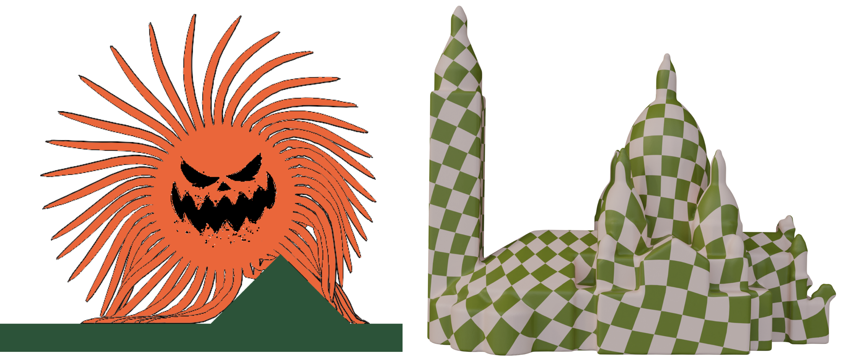
Spatial Eigenanalysis of 2D Deformation Energies
Haomiao Wu, Kui Wu, Theodore Kim
July 2026
Notes:
Hi everyone, today I’m going to present our paper,

Slide 2

Notes:
2D elasticity can be seen in many different applications such as dynamic simulation

Slide 3
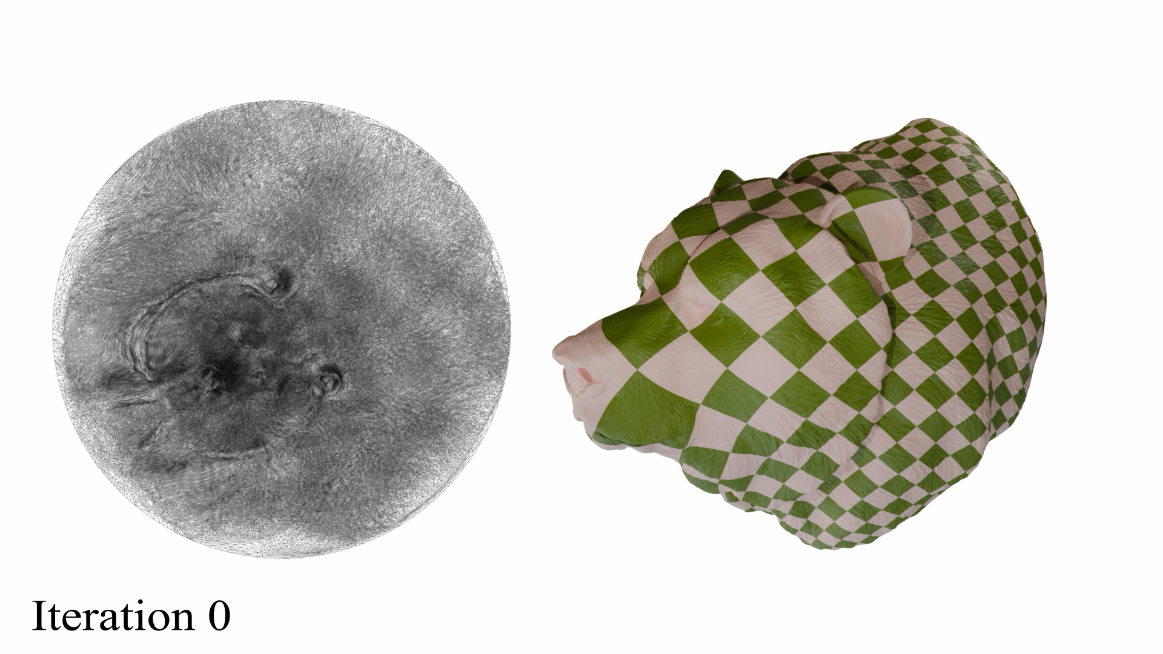
Notes:
we can do surface parameterization where we minimize 2d deformation energies

Slide 4

Notes:
We will look at finite element methods with triangle meshes for solving these problems. The main thing governing elastic behaviors is the elastic energies, Psi. and x is the spatial position vector describing the shape, such as vertex positions

Slide 5

Notes:
Take static problems for example, the internal and external forces should balance out subject to constraints. Bacause the elastic forces usually depend nonlinearly on vertex position, one way to solve the nonlinear equation is to use Newton’s method, and the linearized equation per newton step is given here.

Slide 6
Notes:
Where H is the energy Hessian.

Slide 7

$$H(x)=\frac{∂^{2}Ψ}{∂x^{2}}$$
Notes:
it is the second derivative of elastic energies with respect to the vertex position x.

Slide 8
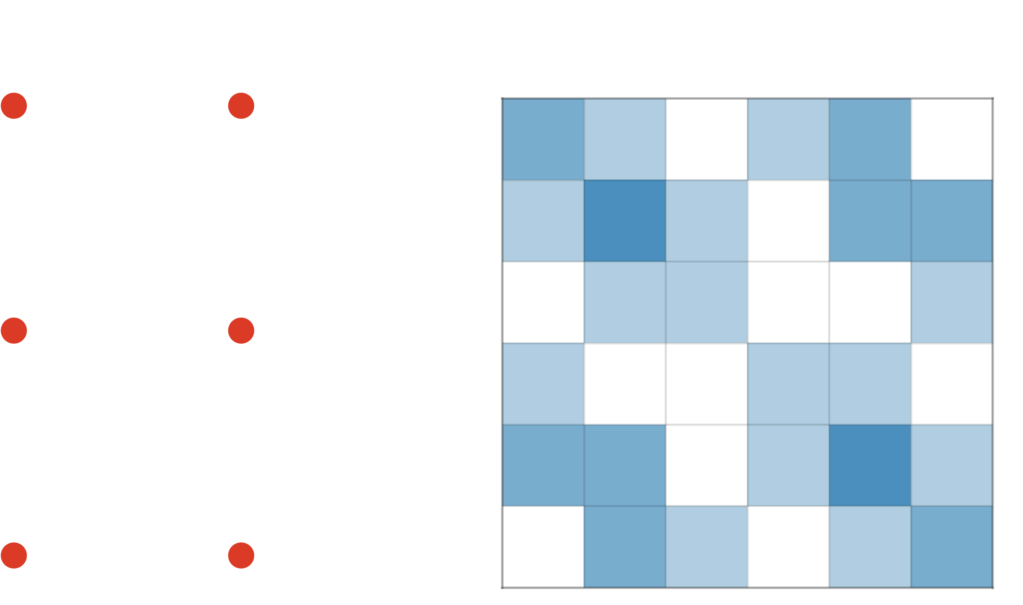
Notes:
If we look at this example of a simple triangle mesh, we can imagine that as the number of elements increases, Hx becomes a large sparse matrix, but often not semi positive definite, which makes it challenging to converge when solved with linear solver such as Preconditioned conjugate gradient, or PCG.
So an SPD projection is crucial for stably solving the system. Because directly projecting the whole global H is usually not feasible, previous works find ways to simplify the SPD problem

Slide 9


$$H_{i}(x)$$
Notes:
First, instead of looking at the big global hessian, people start by examining the local hessian Hi,

Slide 10
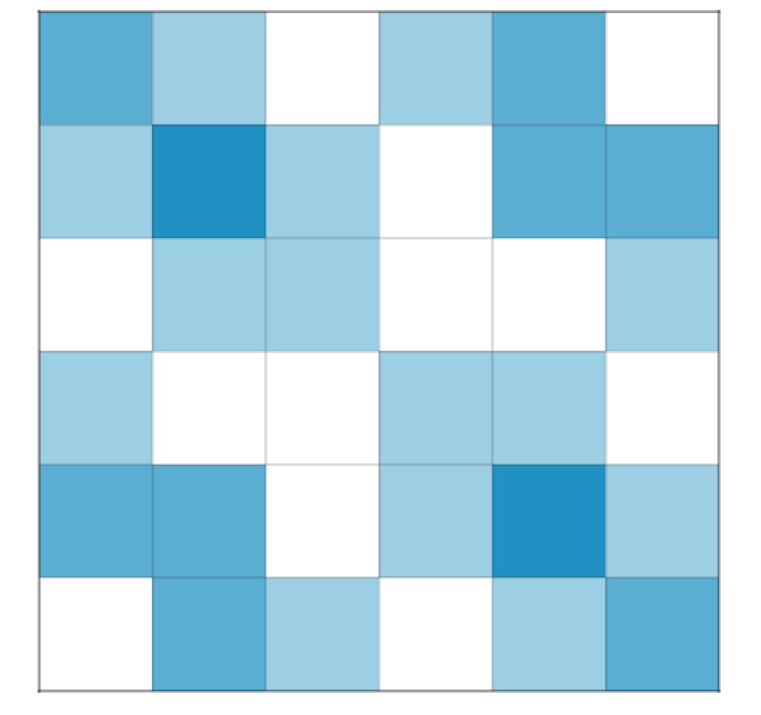

$$H_{i}(x)$$
$$H(x)$$
Notes:
They are distributed into the global DoF, and summed up to get the global H

Slide 11
$$H_{i}(x)$$
$$H(x)$$
Notes:
Because a sum of SPD Hessians must also be SPD, a convenient method is to do SPD projection per element.

Slide 12

$$\frac{∂^{2}Ψ}{∂x^{2}}={\left(\frac{∂Ψ}{∂F}\right)}^{⊤}\frac{∂^{2}F}{∂x^{2}}+{\left(\frac{∂F}{∂x}\right)}^{⊤}\frac{∂^{2}Ψ}{∂F^{2}}\left(\frac{∂F}{∂x}\right)$$
Notes:
Beside that, since the position-based Hessian can be written in terms of the deformation gradient F, using a chain rule, previous work only study the highlighted term, which is the deformation-gradient based hessian for an analytical eigensystem.

Slide 13
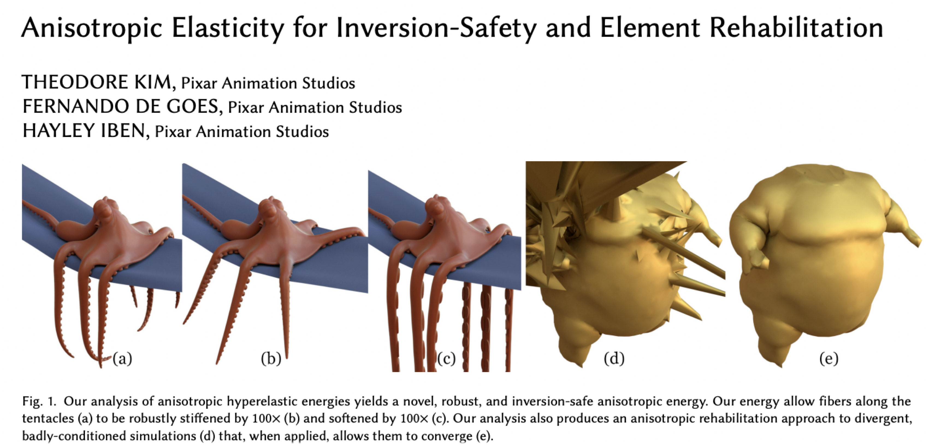
Notes:
Examples include volume energies

Slide 14
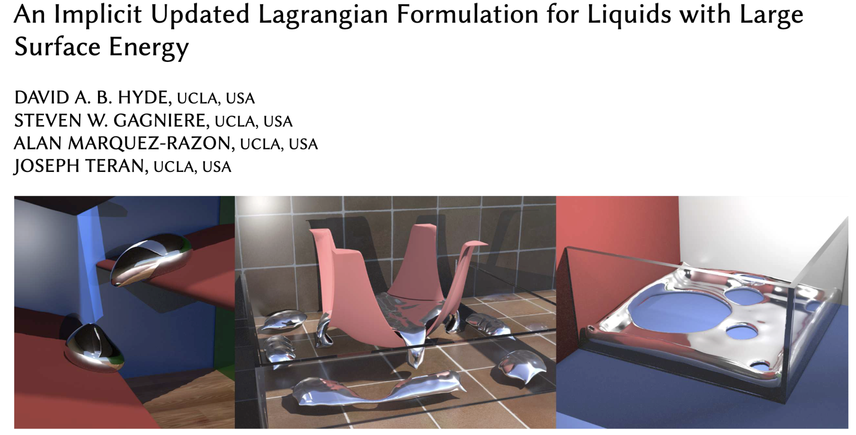
Notes:
And surface tension energies

Slide 15

$$\frac{∂^{2}Ψ}{∂x^{2}}={\left(\frac{∂Ψ}{∂F}\right)}^{⊤}\frac{∂^{2}F}{∂x^{2}}+{\left(\frac{∂F}{∂x}\right)}^{⊤}\frac{∂^{2}Ψ}{∂F^{2}}\left(\frac{∂F}{∂x}\right)$$
$$G$$
Notes:
However, because in order to get the final position based hessian, we need to multiply the middle term with partial F partial x, which is not orthonormal, this makes the spectrum of x-based and F-based hessian completely different. The x-based eigensystem might provide a more direct projection, but getting it analytically is not trivial

Slide 16
$$\frac{∂^{2}Ψ}{∂x^{2}}={\left(\frac{∂Ψ}{∂F}\right)}^{⊤}\frac{∂^{2}F}{∂x^{2}}+{\left(\frac{∂F}{∂x}\right)}^{⊤}\frac{∂^{2}Ψ}{∂F^{2}}\left(\frac{∂F}{∂x}\right)$$
Notes:
So our goal, for this paper, is to derive the analytical eigenanalysis directly of the whole term.

Slide 17
Smith, B., F. D. Goes, and T. Kim Analytic eigensystems for isotropic distortion energies (2019)
Notes:
To solve the x-based eigensystem, We will Start by looking at invariants computed from S, which is the symmetric part of the polar decomposition of the deformation gradient.

Slide 18
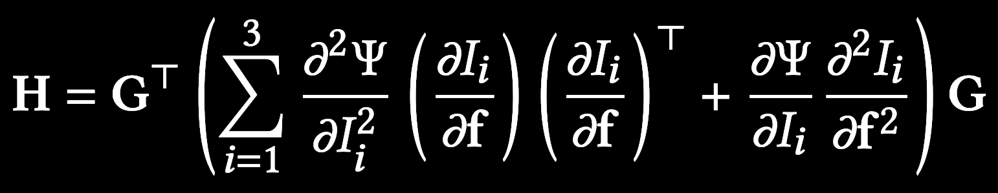
Notes:
Most elastic energies can be defined using these scalars, and the hessian can be computed by chain rule in terms of the invariants. For the eigenanalysis, We will look at the final result of H, including all terms, not just doing Spd projection of each terms separately and then summing them up, here, f is the vectorized deformation gradient.

Slide 19
Notes:
Here G is partial F partial x, and it is 6 by 4 in 2D, a two dimensional null space represents the translations. So H would also have that 2D null space

Slide 20
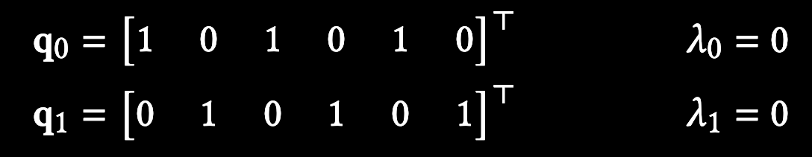
Notes:
We can easily get the first two eigenvectors, with 0 eigenvalue, that encodes the translation modes, without any deformation

Slide 21
Notes:
We can easily get the first two eigenvectors, with 0 eigenvalue, that encodes the translation modes, without any deformation

Slide 22
Notes:
If we only look at the f-based hessian of the invariants, all three invariant hessians have eigensystems that align with each other. But affter applying G, the spectrums get blended up. So we can not longer analyze the hessian of each invariant and then sum them up. We Need to exploit properties of different energies

Slide 23


$$Ψ_{\text{ARAP}}(F)=μ\left(I_{2}−2I_{1}+3\right)$$
$$Ψ_{\text{SNH}}(F)=\frac{μ}{2}(I_{2}−3)+\frac{λ}{2}{\left(I_{3}−1−\frac{μ}{λ}\right)}^{2}$$
Notes:
We will start by looking at two popular elastic energies. If we observe the expressions of these energies, we can notice that they only depend on two of the three invariants,

Slide 24


$$Ψ_{\text{ARAP}}(F)=μ\left(I_{2}−2I_{1}+3\right)$$
$$Ψ_{\text{SNH}}(F)=\frac{μ}{2}(I_{2}−3)+\frac{λ}{2}{\left(I_{3}−1−\frac{μ}{λ}\right)}^{2}$$
Notes:
and they are linear wrt I2. This is true for some other energies as well

Slide 25


$$Ψ\left(I_{1},I_{2}\right)$$
$$Ψ\left(I_{2},I_{3}\right)$$
Notes:
So we will derive the eigensystem under two different scenarios, one for they energy that only depend on I1 and I2,

Slide 26
$$Ψ\left(I_{1},I_{2}\right)$$
$$Ψ\left(I_{2},I_{3}\right)$$
Shape distortion energy
Notes:
which we call shape distortion energies,

Slide 27
$$Ψ\left(I_{1},I_{2}\right)$$
$$Ψ\left(I_{2},I_{3}\right)$$
Shape distortion energy
Volume preserving energy
Notes:
and the other for volume preserving energies energies that depend on I2 and I3.

Slide 28
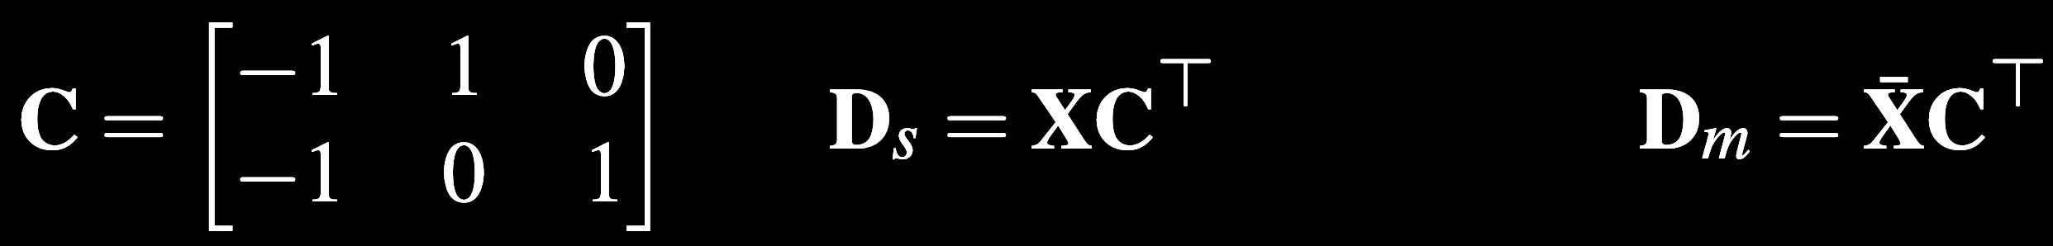
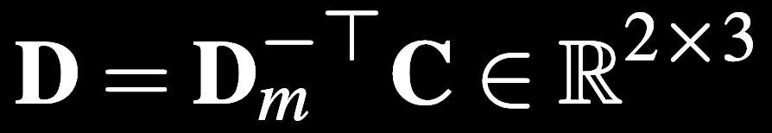
Notes:
Now we will start the derivation. To compute the G matrix, we first define Dm computed from the rest vertex positions, then we define a 2 by 3 matriD computed from Dm.

Slide 29

$$G=D⊗I_{2}$$
Notes:
the G matrix can be written as the k product of a 2 by 3 matrix D and the identity matrix, Kronecker product is good because it allows structure being revealed in terms of a lower dimensional level.

Slide 30



$$G=D⊗I_{2}$$
$$F=UΣV^{⊤}$$
$$D=U_{D}Σ_{D}V_{D}^{⊤}$$
Notes:
To prepare for the next step, we also define the SVD of F and D.

Slide 31
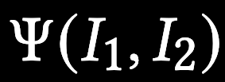

Notes:
In order to review the structure of H, we rotate it into a convenient frame, computed using the svds.

Slide 32
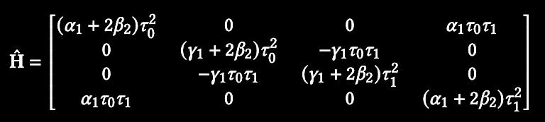
Notes:
After that, H becomes sparse, and even block diagonal, up to permutation. Alpha and betas are the scalars representing the derivatives of psi w.r.t. the invariants. Taus are the singular values of D. we can now easily solve it by solving two 2 by 2 eigenproblems

Slide 33
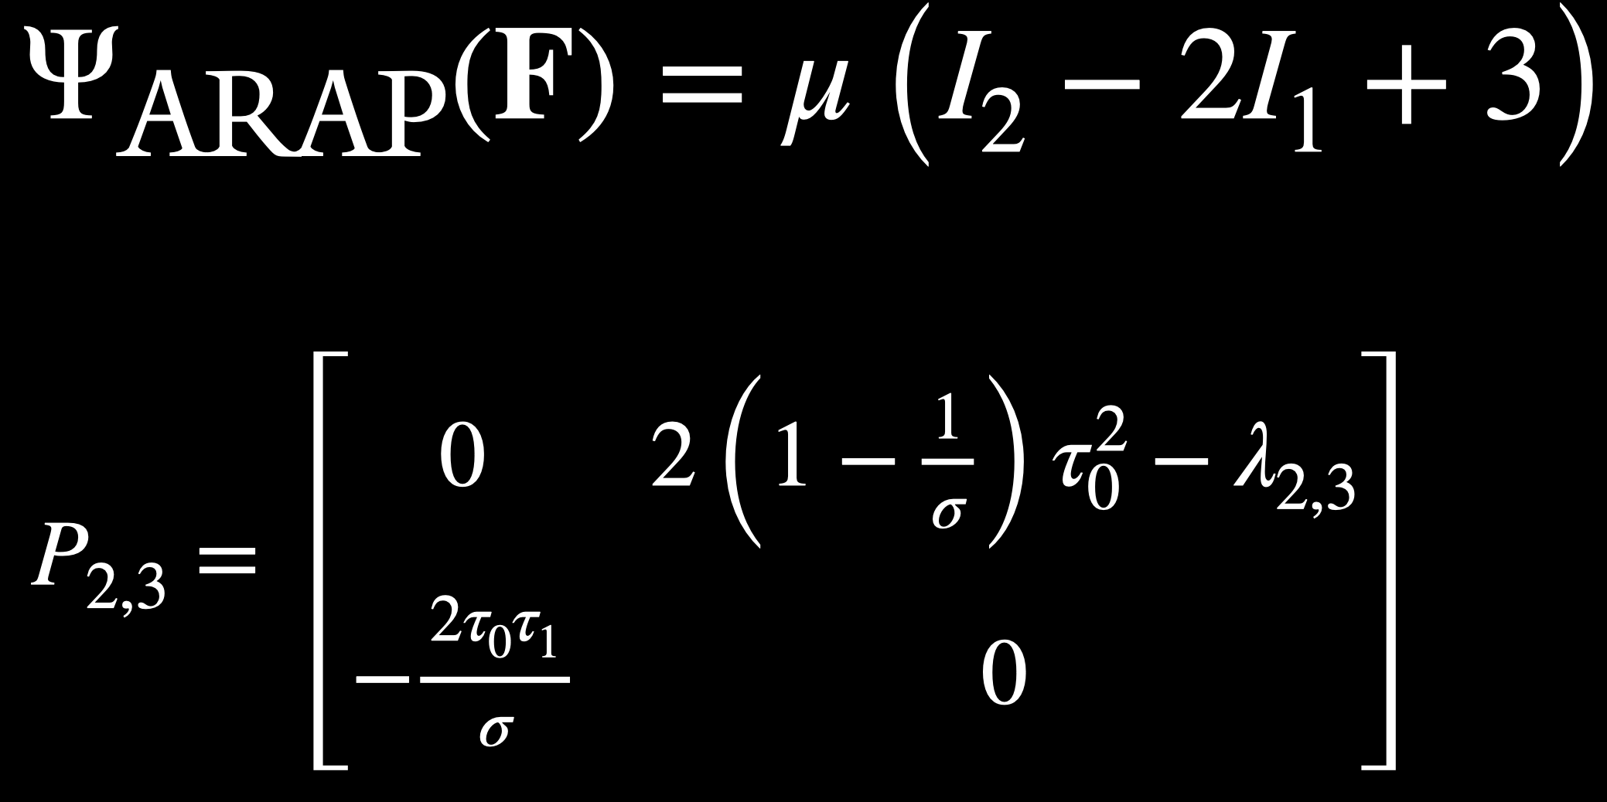
Notes:
To show the result, we take arap as an example. We write the eigenvector as 2 by 2 matrices. Two of the four eigen vectors only has offdiagonal nonzero entries, which represent a rotation mode.

Slide 34
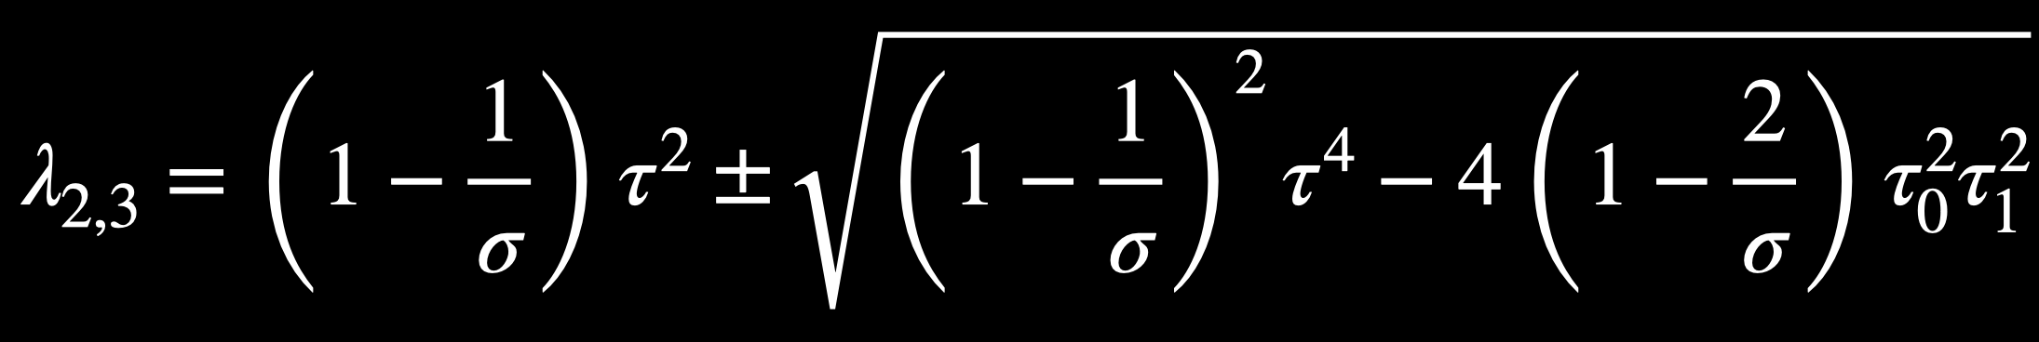
Notes:
The eigenvalues for those two is given by this equation

Slide 35



$$P_{4}=\left[\begin{matrix}1 & 0 \\ 0 & 0\end{matrix}\right]λ_{4}=2τ_{0}^{2}$$
$$P_{5}=\left[\begin{matrix}0 & 0 \\ 0 & 1\end{matrix}\right]λ_{5}=2τ_{1}^{2}$$
Notes:
The other two eigenvectors are the scaling modes in two directions, we can see that in our rotated frame the eigenvectors are very clean and has a clear physical meaning, such as scaling and rotation.

Slide 36
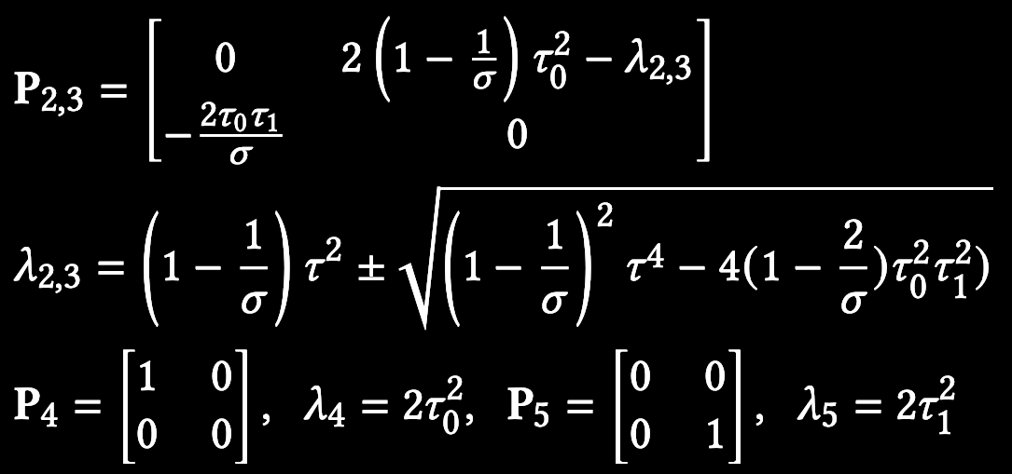
Notes:
Putting all four together, plus the tw0 translation modes, we have the 6 eigen vectors of arap, we can also apply it to other shape-distortion based energies.

Slide 37

Notes:
We can do the similar analysis with the volume preserving energies, it is a bit more complicated and more details can be found in the paper.

Slide 38
Applications
Notes:
With the position-based analytical eigensystems, we now can have some nice applications to improve the performance of numerical solvers.

Slide 39
A Spectral Preconditioner for PCG
A Unified Projected Newton
Notes:
We will show how to apply our analysis to construct

Slide 40
A Spectral Preconditioner for PCG
A Unified Projected Newton
Notes:
For the first application, we want to assemble a preconditioner that improves the convergence of PCG that solves the linear system at each newton step.

Slide 41

A Spectral Preconditioner for PCG
$$Ax=b$$
Notes:
One type of preconditioner that is very related to our analysis is spectral preconditions, to solve a linear system Ax = b，we can have a preconditioner matrix B,

Slide 42
A Spectral Preconditioner for PCG
$$Ax=b$$
Notes:
A spectral preconditioner is a low range update on a base preconditioner b0, which can be something like block jacobi. Most of the time it behaves like the base preconditioner

Slide 43
A Spectral Preconditioner for PCG
$$Ax=b$$
Notes:
In the subspace spanned by the eigenvectors with the lowest eigenvalues, it behaves like a precomputed low dimensional inverse. Here, Z is the bases consisting of the low eigenvalues global eigenvectors. But getting Z is tricky, since our global system matrix A is very high dimensional

Slide 44
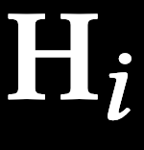

$$H(x)$$
Notes:
And we have always been solving the eigensystems of the local hessian hi analytically, we still don’t know how to get the eigenvectors of the big H, which is a sum of the local hessians

Slide 45

$$q_{j}$$
Notes:
But now we have the position based eigenvectors qj,

Slide 46




$$q_{i}$$
$$J_{i}q_{j}$$
$$J_{i}$$
Notes:
And its entries are directly corresponded with global dofs, by the scattering matrix J.

Slide 47

$$q_{i}$$
$$J_{i}q_{j}$$
$$J_{i}$$
$$z=\overset{m}{\underset{i=1}{∑}}\overset{6}{\underset{j=i}{∑}}ω_{ij}J_{i}q_{j}^{i}$$
Notes:
An intuitive way to compute the global eigenvector would be to construct them from the local ones. For example, by using a weighted sum of the local qs.

Slide 48

$$z=\overset{m}{\underset{i=1}{∑}}\overset{6}{\underset{j=i}{∑}}ω_{ij}J_{i}q_{j}^{i}$$
Fitted once at the start of the Newton iterations
Notes:
that’s not how the eigenvectors of a sum of matrices work. But we are trying to construct a preconditioner, so we are allowed to approximate the global eigenvectors using this simple weighted sum. And the weights can be fitted from exactly numerically computed global eigenvectors once at the start of the first newton step, and at later steps we will reuse the omegas and assemble z from the local eigenvectors using this equation, which is just a fast matrix multiplications.

Slide 49
A Spectral Preconditioner for PCG
$$Ax=b$$
Notes:
So we have a way of efficiently estimating Z and assemble the spectral preconditioner. To test the performance, we apply our preconditioned to solve for a surface parameterization problem, that minimize the arap energy of texture coordinates

Slide 50
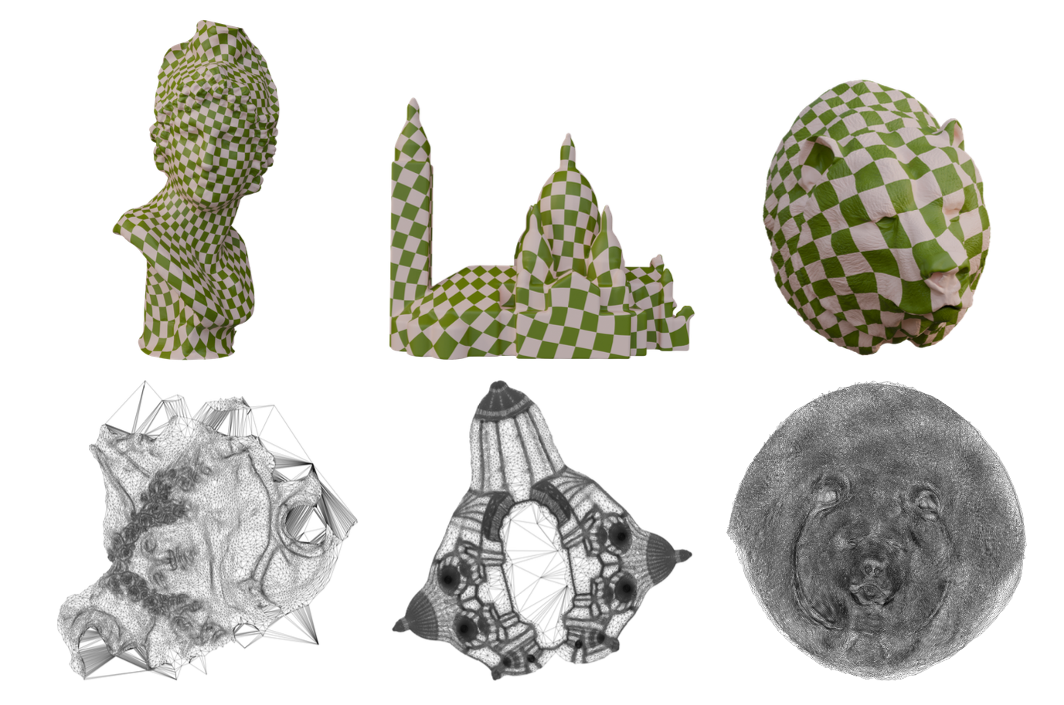
Notes:
Here are the results one three examples, the checkerboard texture distribute uniformly on these objects

Slide 51

Notes:
Here is a video showing how the parameterization converges throughout the newton steps.

Slide 52
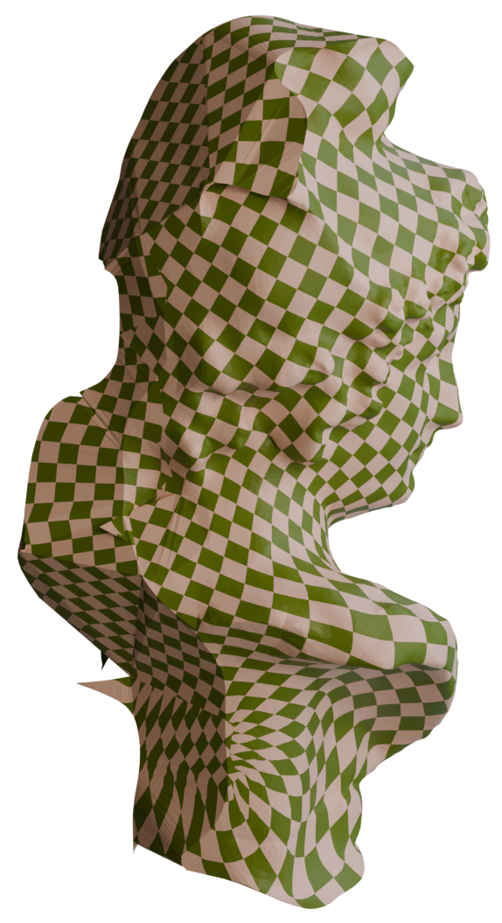
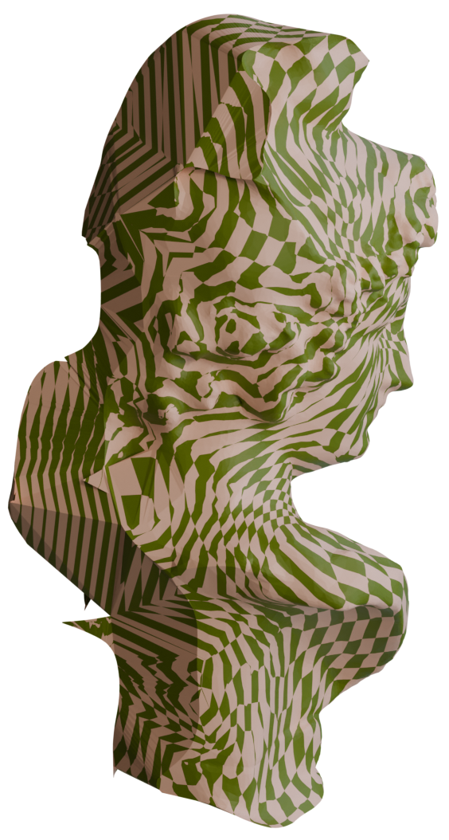
Ours
Local-Global
Notes:
The minimization of arap energy can also be solve through the popular local-global solvers. But compared with a directly doing a global high dimensional newton solve that we use on the left, the local global solvers fails to converge.

Slide 53
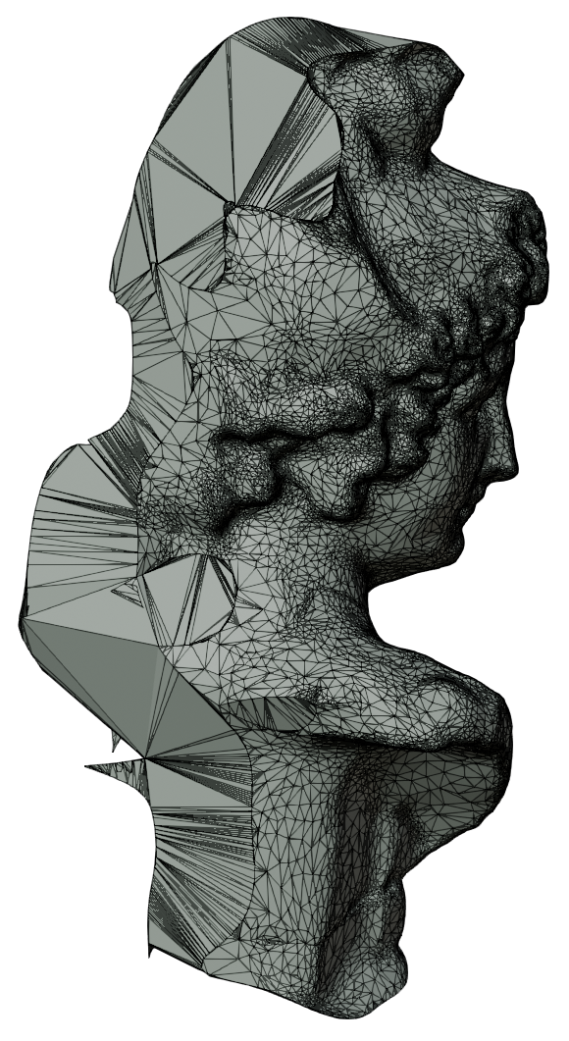
Wire Frame
Ours
Local-Global
Notes:
From the mesh condition we can see that local global method are bad at handling ill conditioned elements and inversions, and our method is more robust

Slide 54
 | Precomp. | Construct | Total
Bust | 8.6% | 2.3% | 11.5s
Building | 6.5% | 1.9% | 47.9s
Bear | 5.4% | 1.5% | 390.0s
Notes:
In terms of timing, here we show a breakdown of our method, numerically solving the exact global eigenvectors with low eigenvalues has a little overhead, but we only need to do it once for the first newton step

Slide 55
 | Precomp. | Construct | Total
Bust | 8.6% | 2.3% | 11.5s
Building | 6.5% | 1.9% | 47.9s
Bear | 5.4% | 1.5% | 390.0s
Notes:
In later newton steps the global eigenvectors are constructed from the analytical local ones, which only takes a small portion of total runtime

Slide 56
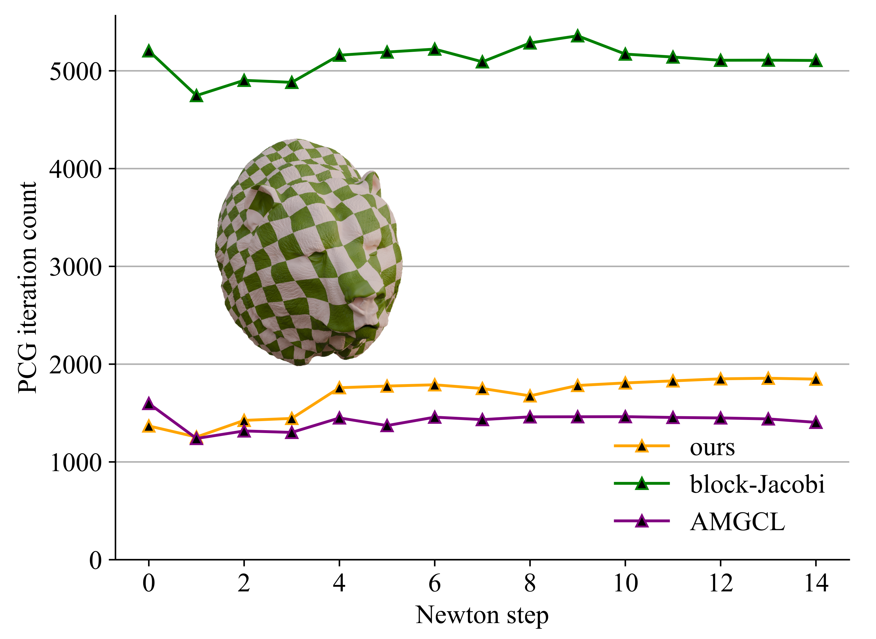
Notes:
Here we plot the number of PCG iterations it takes to converge at each newton step. Ours takes significantly fewer iterations compared to the base preconditioner block jacobi. We also compare with modern preconditioners such as algebraic multigrid, theirs has similar iteration count than ours

Slide 57
 | Ours |  |  | Block-Jacobi
 | Precomp. | Construct | Total | Time (s) | Ours Speedup
Bust | 8.6% | 2.3% | 11.5s | 24.7 | 2.15×
Building | 6.5% | 1.9% | 47.9s | 152.2 | 3.18×
Bear | 5.4% | 1.5% | 390.0s | 870.2 | 2.23×
Notes:
But if we look at the total runtime ours is 2-3times faster than block jacobi

Slide 58
 | Ours |  |  | AMGCL
 | Precomp. | Construct | Total | Time (s) | Ours Speedup
Bust | 8.6% | 2.3% | 11.5s | 34.3 | 2.98×
Building | 6.5% | 1.9% | 47.9s | 181.2 | 3.78×
Bear | 5.4% | 1.5% | 390.0s | 1023.9 | 2.63×
Notes:
And our wins AMG with even more speedup, because of the overhead of applying the mutlgrid preconditioner .

Slide 59
A Spectral Preconditioner for PCG
A Unified Projected Newton
Notes:
We have shown that our position based eigenanalysis is useful for PCG solves, we then show that it can also speedup the whole newton solve

Slide 60

$$\left(H(x)+\frac{1}{Δt^{2}}M+\frac{1}{Δt}C\right)Δx=−∇Ψ_{}(x^{(k)})$$
Notes:
Looking back at the system matrix, the energy hessian is not the only term contributing to it.

Slide 61

$$\left(H(x)+\frac{1}{Δt^{2}}M+\frac{1}{Δt}C\right)Δx=−∇Ψ_{}(x^{(k)})$$
Notes:
There are also the mass and damping term. Because the mass matrix is positive and diagonal, it can offset some negative eigenvalues from H, making it unnecessary to filter all the negative eigenvalues. Our position-based eigensystems can also directly correspond to entries in the mass and damping matrix,

Slide 62
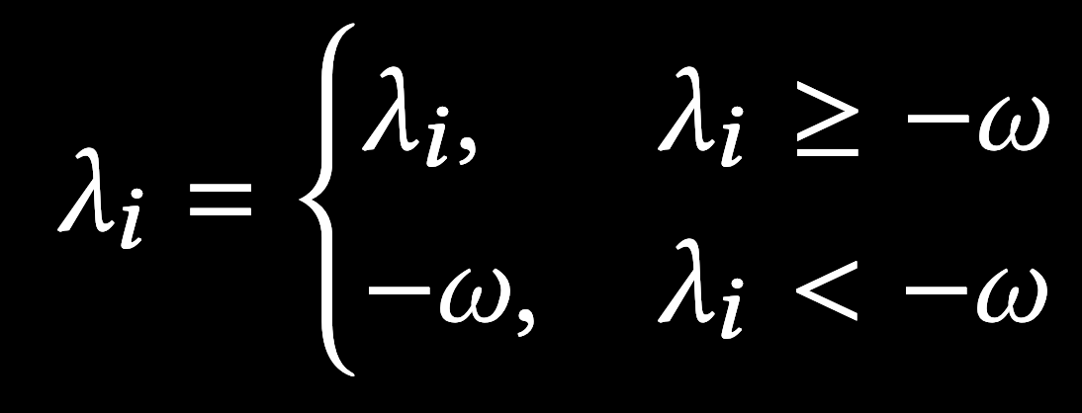
Notes:
and we are able to come up with a more conservative filtering strategy by jointly looking at all three terms in the system matrix. Now we only filter eigenvalues that are lower than a negative threshold per element. This way our projected system matrix can be closer to the original matrix while still guaranteeing positive semi definiteness this means that the system matrix can be more consistent across each newton step, and the descending direction of newtons method is better guaranteed. And we can expect a faster newton convergence

Slide 63

ARAP
Notes:
We test our new projection strategy on 2D simulations. We provide two scenes with both arap and sth energy

Slide 64

ARAP
Notes:
We test our new projection strategy on 2D simulations. We provide two scenes with both arap and sth energy

Slide 65

SNH
Notes:
We test our new projection strategy on 2D simulations. We provide two scenes with both arap and sth energy

Slide 66
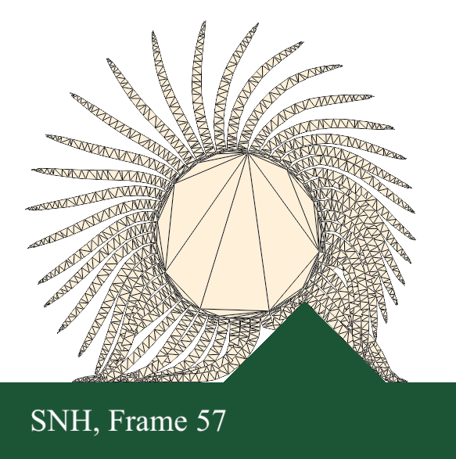
Notes:
Now we take the hairy ball with sth as an example and show the performance curves

Slide 67
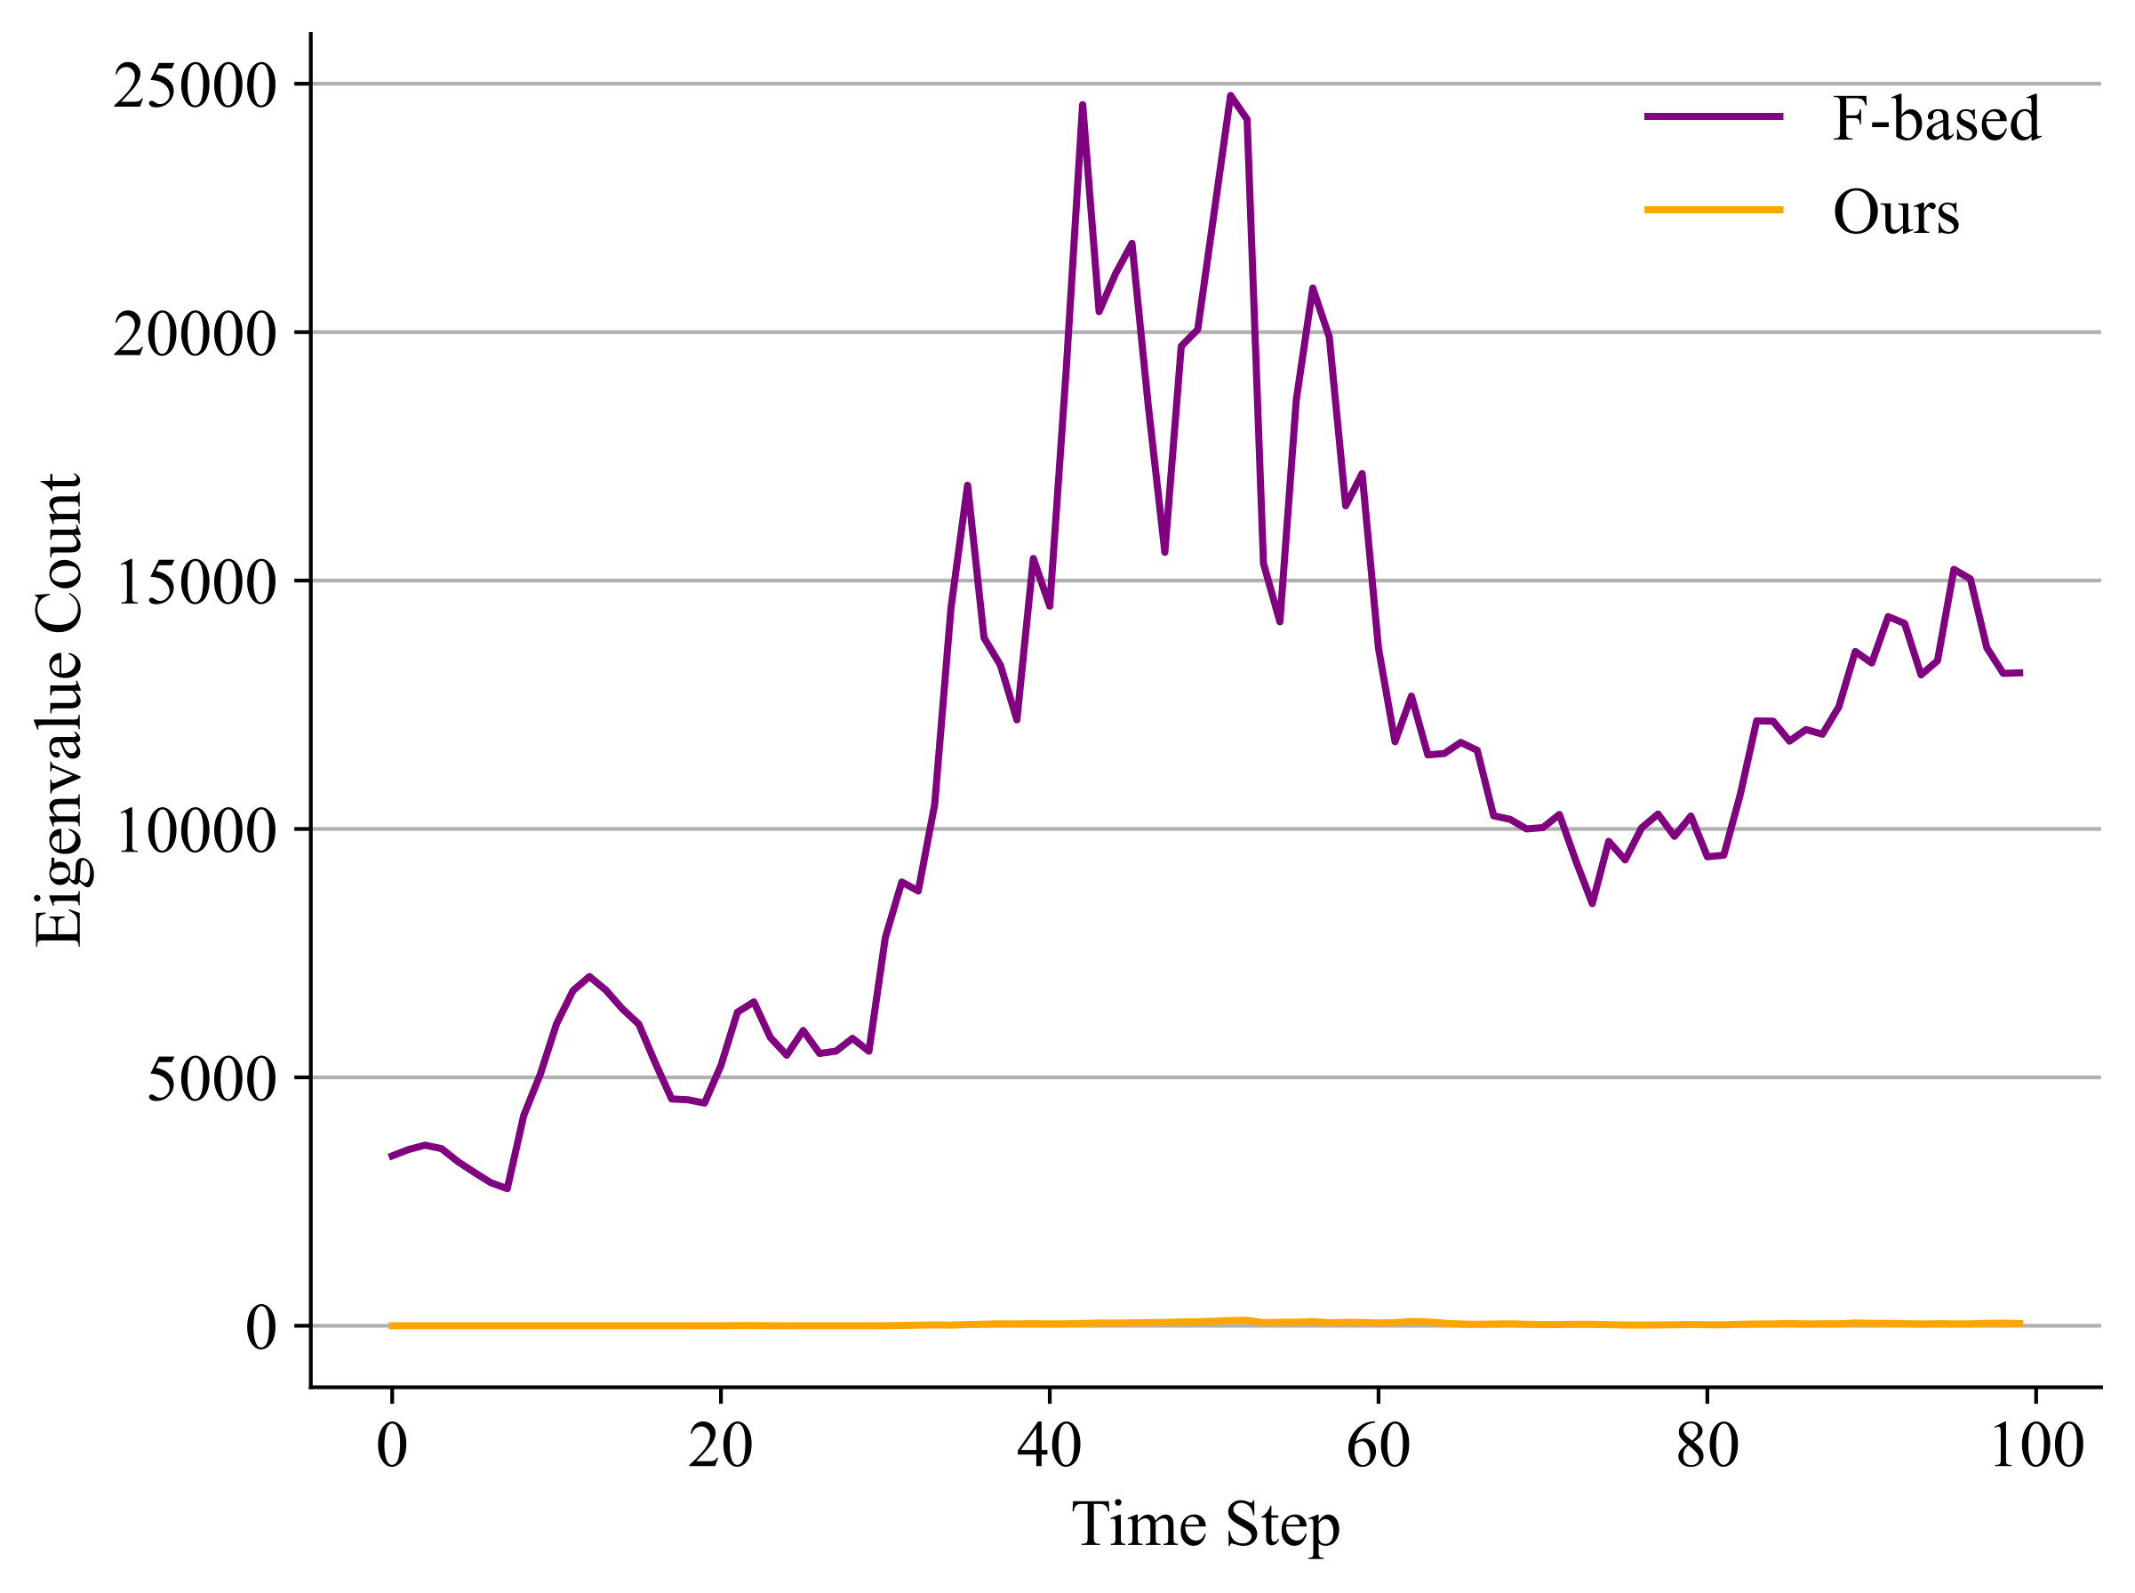
Notes:
We count the number of eigenvalues that are filtered using our method, compared to using F-based eigendecomposition, you can see that very few eigenvector actually needs to be clamped if we use our superior strategy that unifies all three terms of the system matrix.

Slide 68
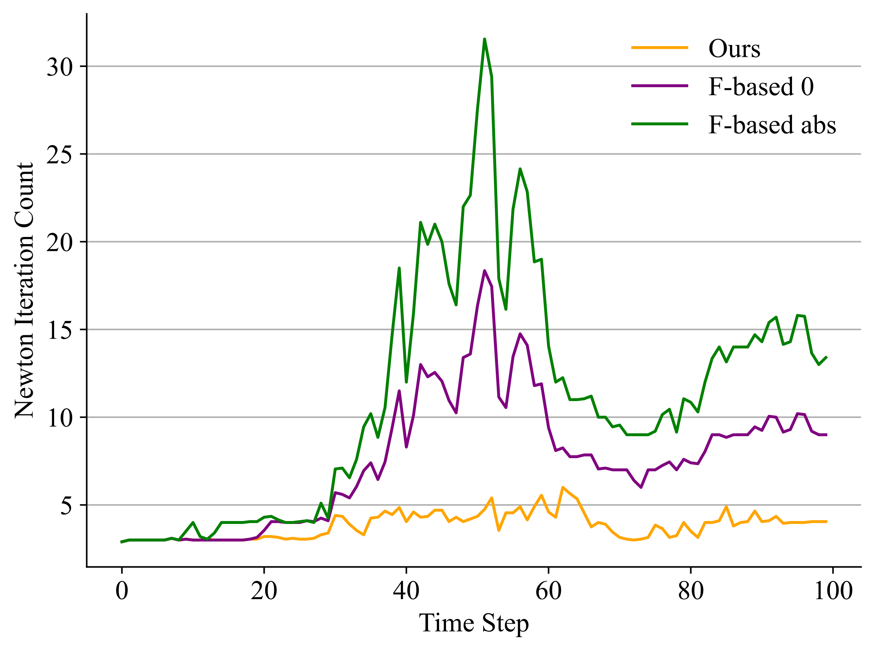
Notes:
We also compare the number of newton steps required for convergence at each simulation time step. We show the results of two types of F-based filtering, clamping negative eigenvalues to 0 or taking the absolute value. Both converges much slower than ours.

Slide 69
Energy |  | Clamp Reduction
Hairy | ARAP | 30.42×
 | SNH | 20.0×
Notes:
In terms of statistics, ours actually only filters up to 30 times fewer eigenvalues

Slide 70
 |  | Our Speedup over
Energy |  | F-based 0 | F-based Abs.
Hairy | ARAP | 1.83× | 2.64×
 | SNH | 2.03× | 2.84×
Notes:
And we achieve 2 - 3 times speedup of simulating the whole animation.

Slide 71
Future Work
3D spatial eigenanalysis
Different base preconditioners
Notes:
That’s all about the theory and application of our paper. In terms of future work, a direct follow up would be to derive spatial eigenanalysis for 3D. For our preconditioner, we can also try different combinations of base preconditioners and have even better performance.

Slide 72
Thank you!
Notes:
Next, we will take a look at how you can do eigenanalysis without intermediate variables in 2D

