Slide 1
The Racial Character of Computer Graphics Research
Theodore Kim, Alexa Schor, Julian Posada, Alka V. Menon
Yale University
June 25, 2026
Notes:
Good morning everybody. Today I’m going to talk about computer graphics research, the algorithms used to make CGI effects in movies and 3D video games. By research I mean the academic journals and conferences that publish and disseminate these algorithms.
We are going to ask two very simple questions.

Slide 2
What does “skin” mean in computer graphics?
Notes:
First: What does the word “skin” mean in computer graphics research?

Slide 3
What does “hair” mean in computer graphics?
Notes:
Second: what does the word“hair” mean in computer graphics research?
Researching being done by people like me. I don’t usually publish here at FAccT, I’ve been publishing in computer graphics for over 20 years.

Slide 4



Notes:
Our flagship conference is SIGGRAPH, the Special Interest Group on Graphics and our flagship journal is ACM Transactions on Graphics (“TOG”).
In terms of conference attendance and journal impact factor, no other venue is even close. If you want to understand the graphics research community, you should look there.

Slide 5

Notes:
So we did. We got the raw text of every article ever published at this journal and conference through 2024.

Slide 6
Search for “skin”
Notes:
Here’s what we saw when looked up the word “skin”.

Slide 7
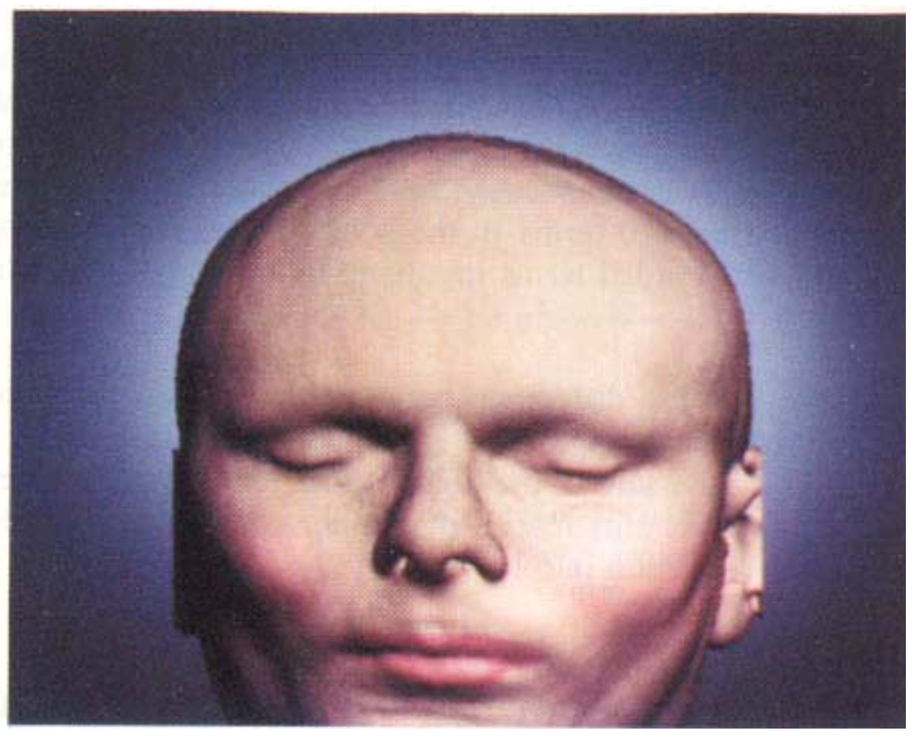
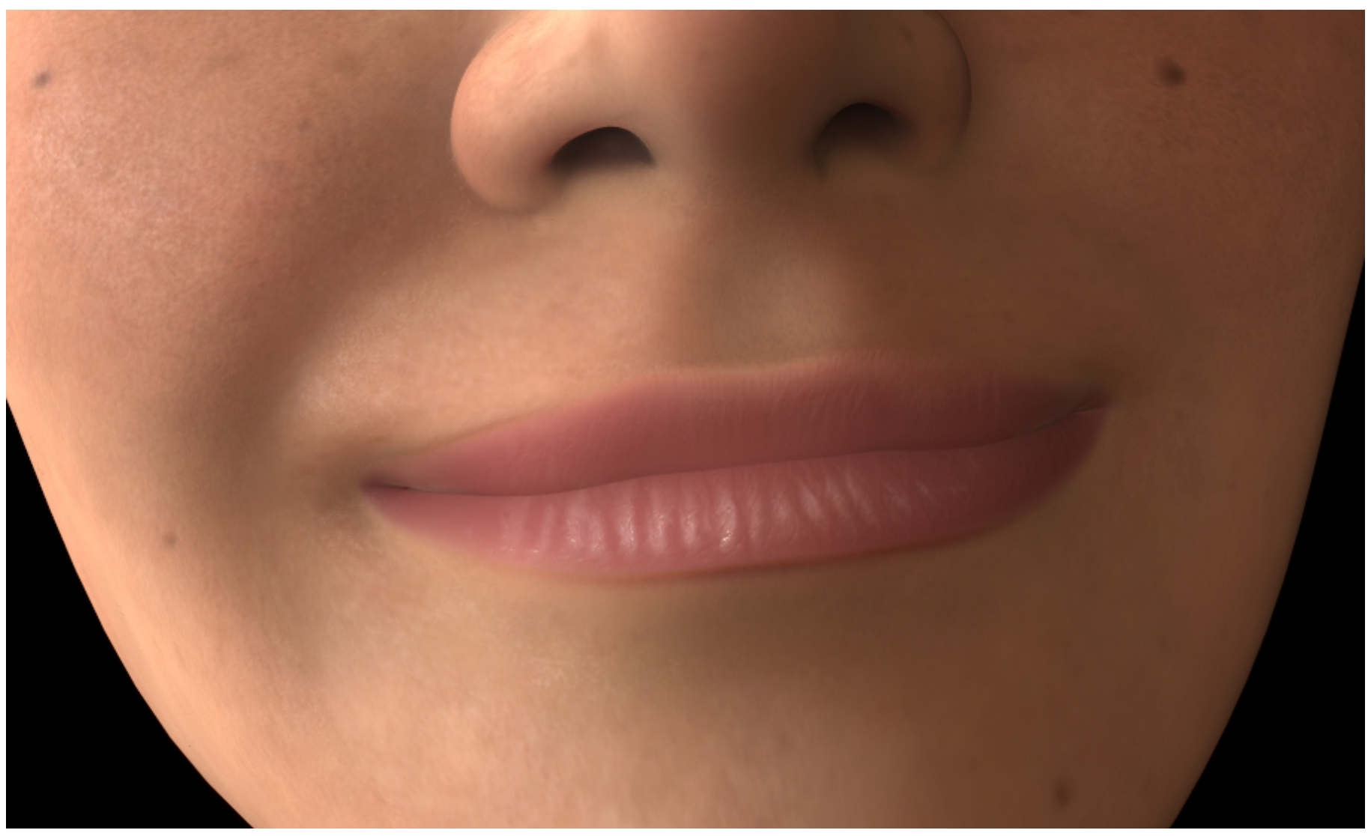
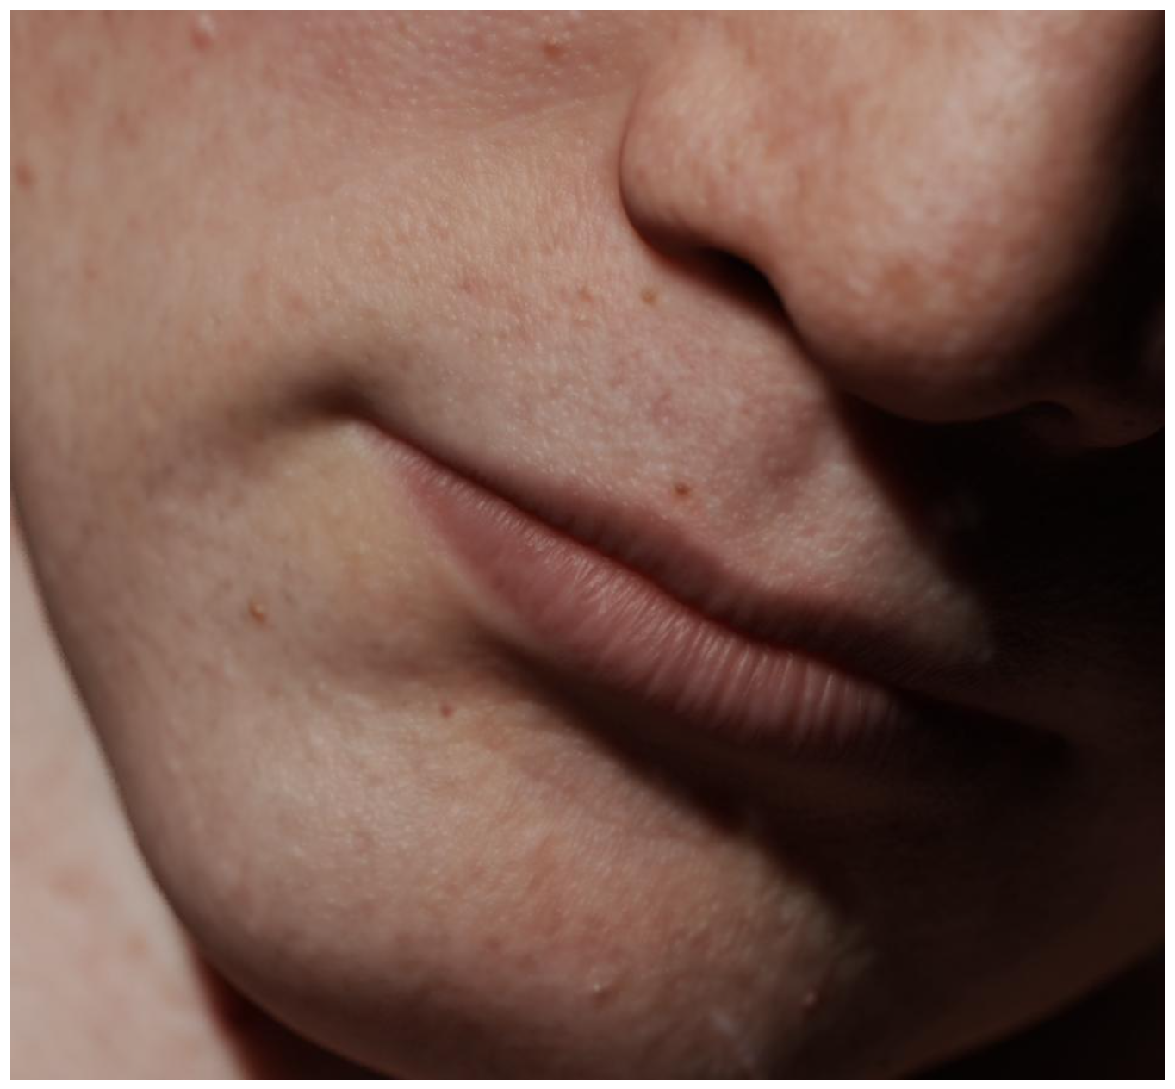
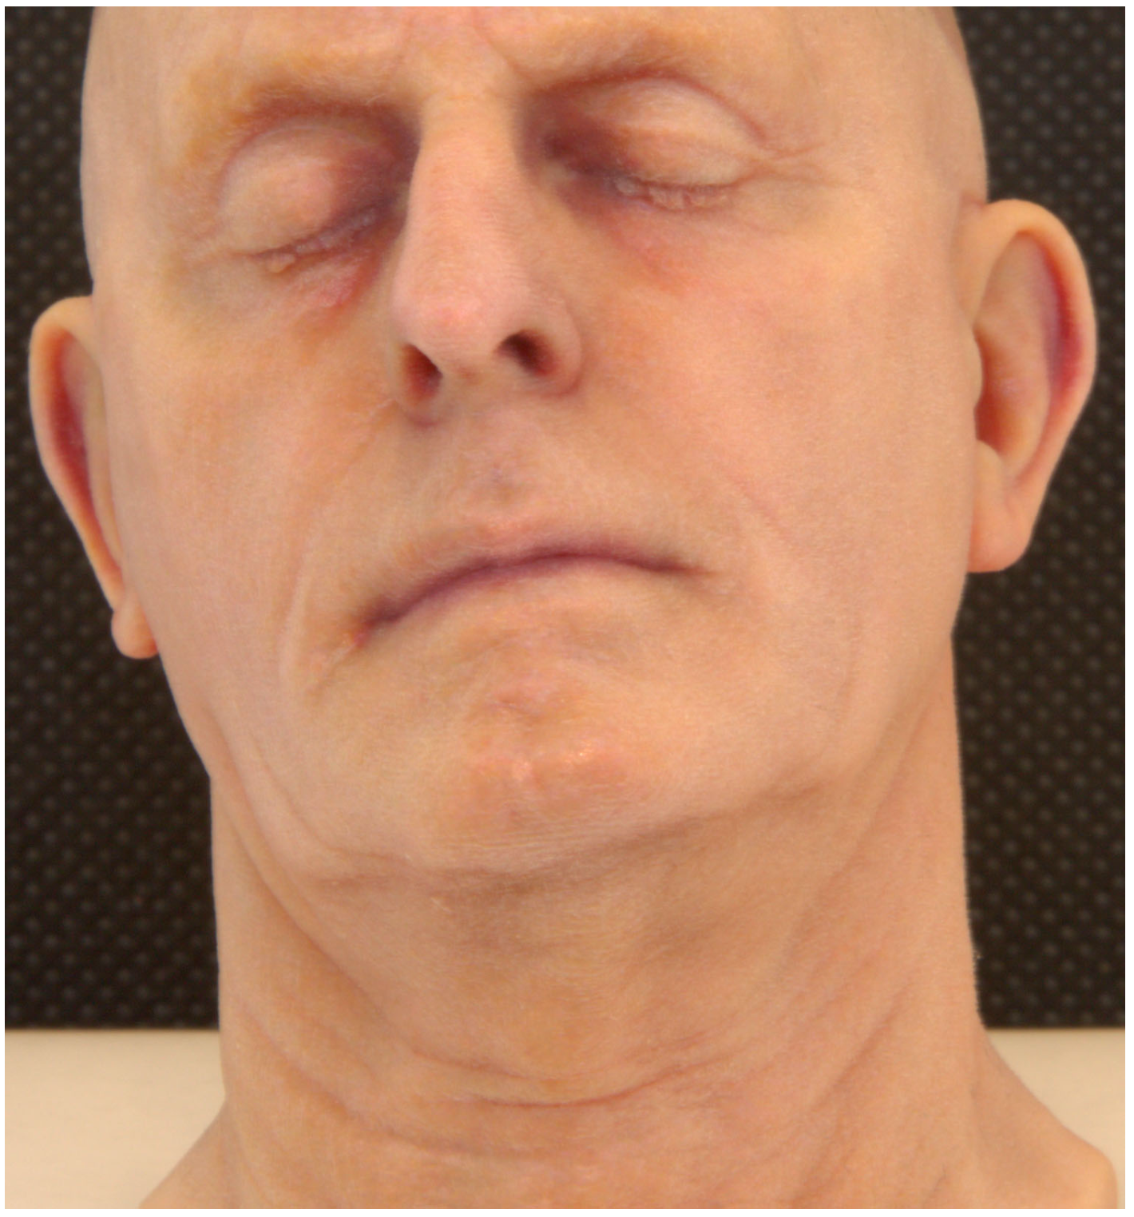
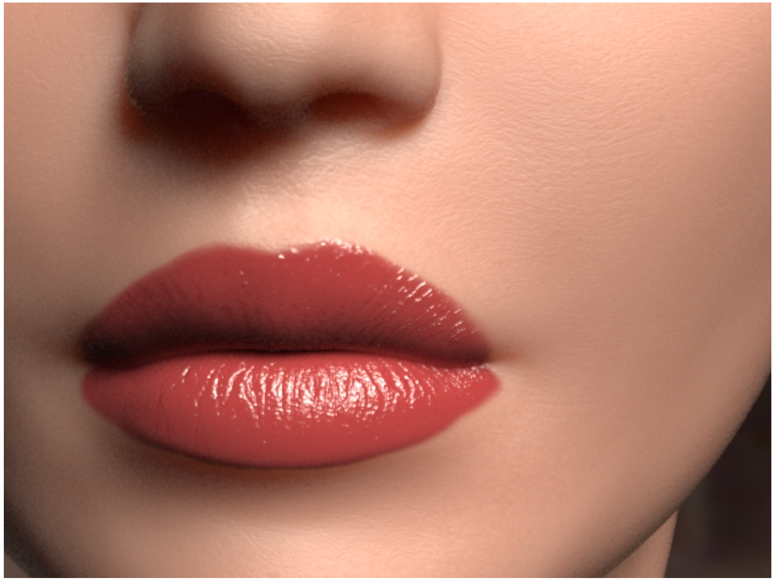
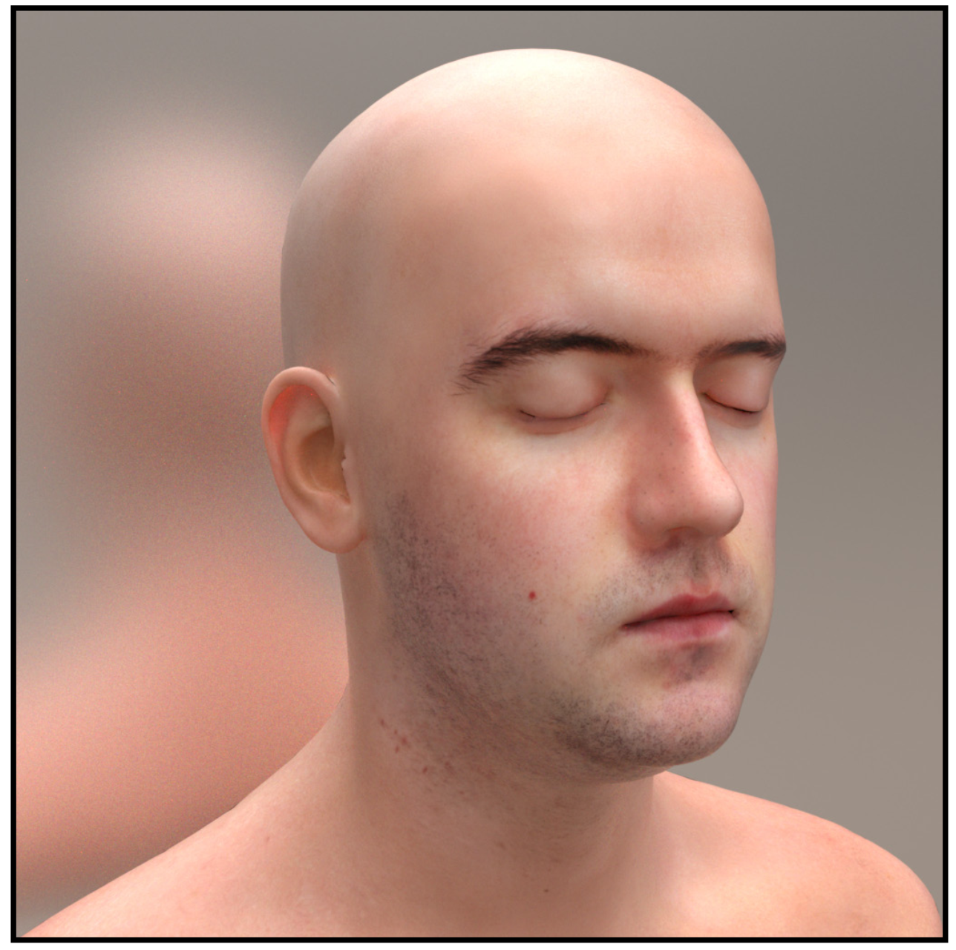
“Skin” as optical substrate
Notes:
Some papers investigate “skin” on the most basic physical and optical level. These all investigate white skin.

Slide 8
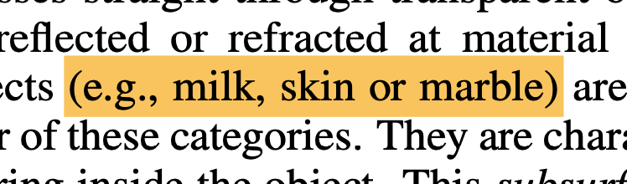
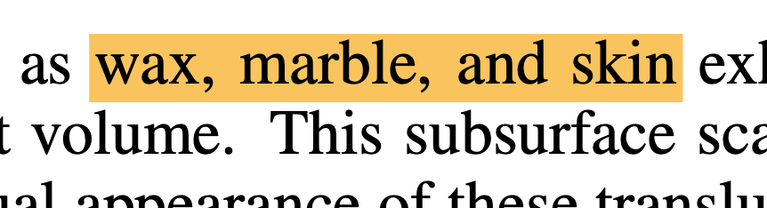
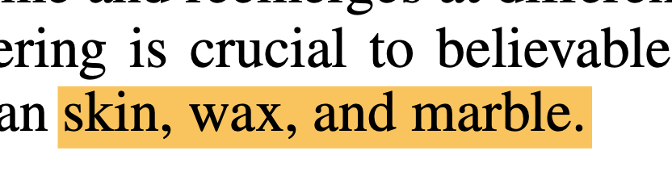
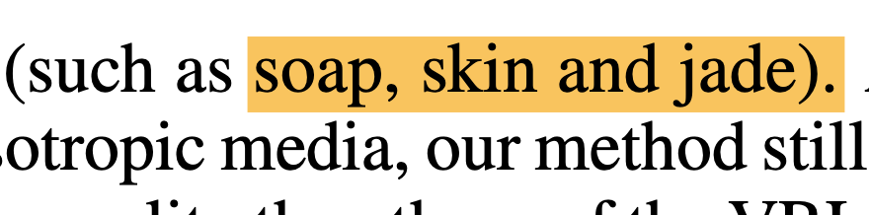
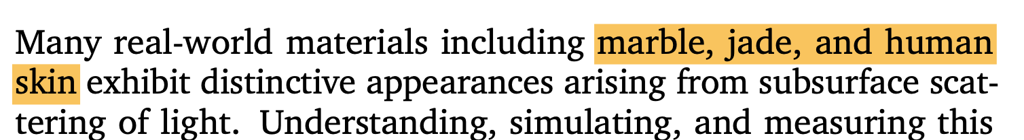
“Skin” as optical substrate
Notes:
In these papers, skin is imagined as a “pale translucent material” like milk, marble, wax, and soap.
The language is consistent across decades and research groups

Slide 9

Rendering Translucent Materials Using Photon Diffusion, Donner and Jensen 2007
Notes:
They all simulate subsurface scattering: how light spreads out in a highly diffusive medium. How light makes white skin glow.

Slide 10


Sinners (2025)
Notes:
Black skin never appears in these papers. Skin like that appeared in last year’s movie Sinners.

Slide 11
“materials like chocolate, onyx, and skin”
Sinners (2025)
Notes:
There are no papers that analogize “chocolate, onyx, and skin”. Nobody has written that paper.

Slide 12
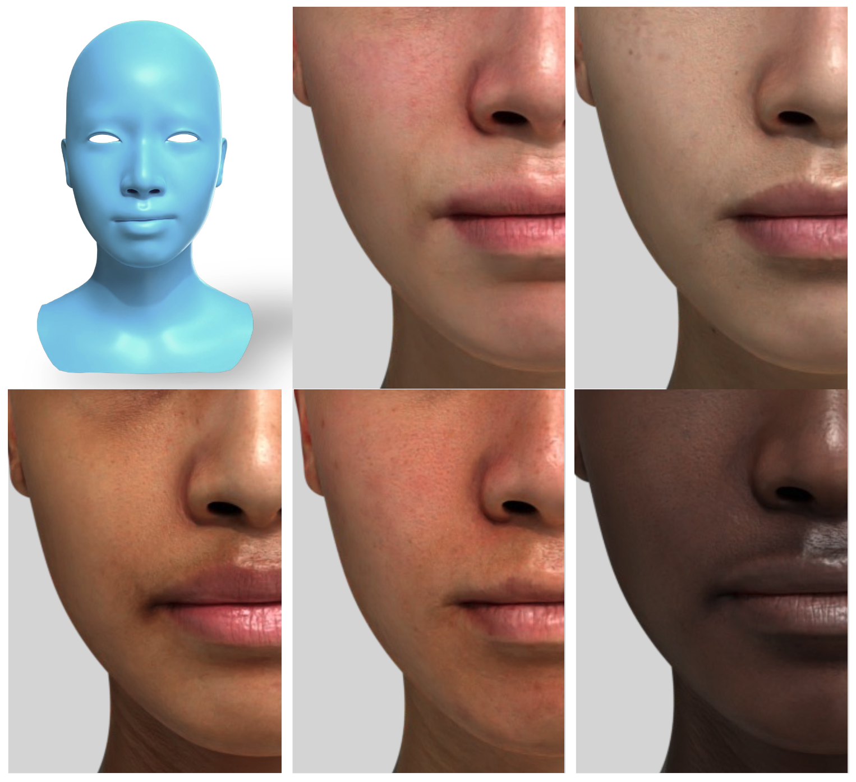
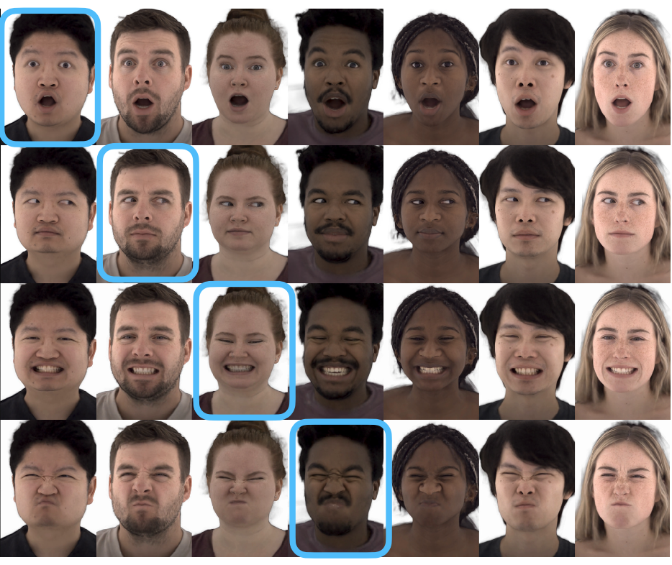
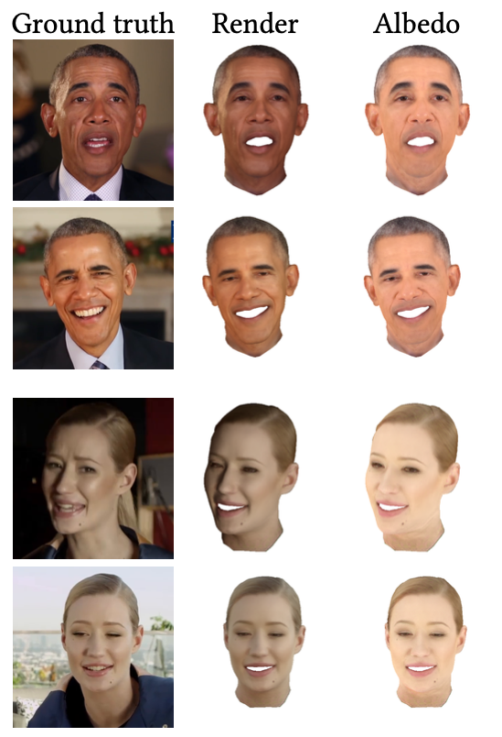
“Skin” as a full human face
Notes:
We found other kinds of “skin” papers in graphics, including what we called “human face” papers. These are avatar creation papers like for Mark Zuckerberg’s Metaverse.
These papers primarily feature white skin, but do have Black skin examples. Those Black skin renders all use the white skin algorithms.

Slide 13
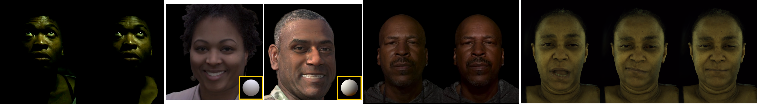
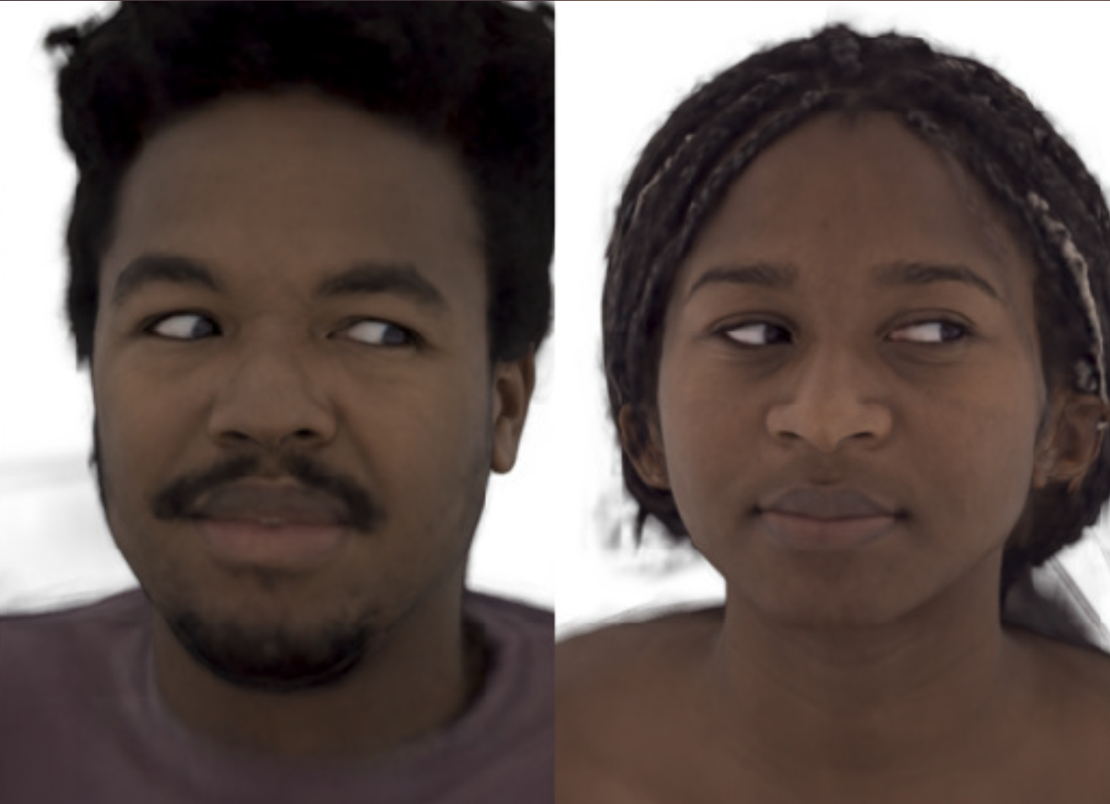
Notes:
The lighting capture setups used are clearly calibrated for white skin.
Here are a few examples from the papers, and what is going on? Are these people locked in a basement?

Slide 14
Rendering Translucent Materials Using Photon Diffusion, Donner and Jensen 2007
Notes:
It is known among cinematographers that “skin glow” is not as important a visual feature for Black skin.

Slide 15
Sinners (2025)
Notes:
Instead, it is known to be the “shine”. Look at the highlights on Wunmi Mosaku and Delroy Lindo’s forehead and cheekbones.

Slide 16
Notes:
Those highlights have been deleted in the facial capture papers.
This is the aesthetics of white skin applied to Black skin.
Even these underwhelming Black examples only started appearing around 2020,

Slide 17
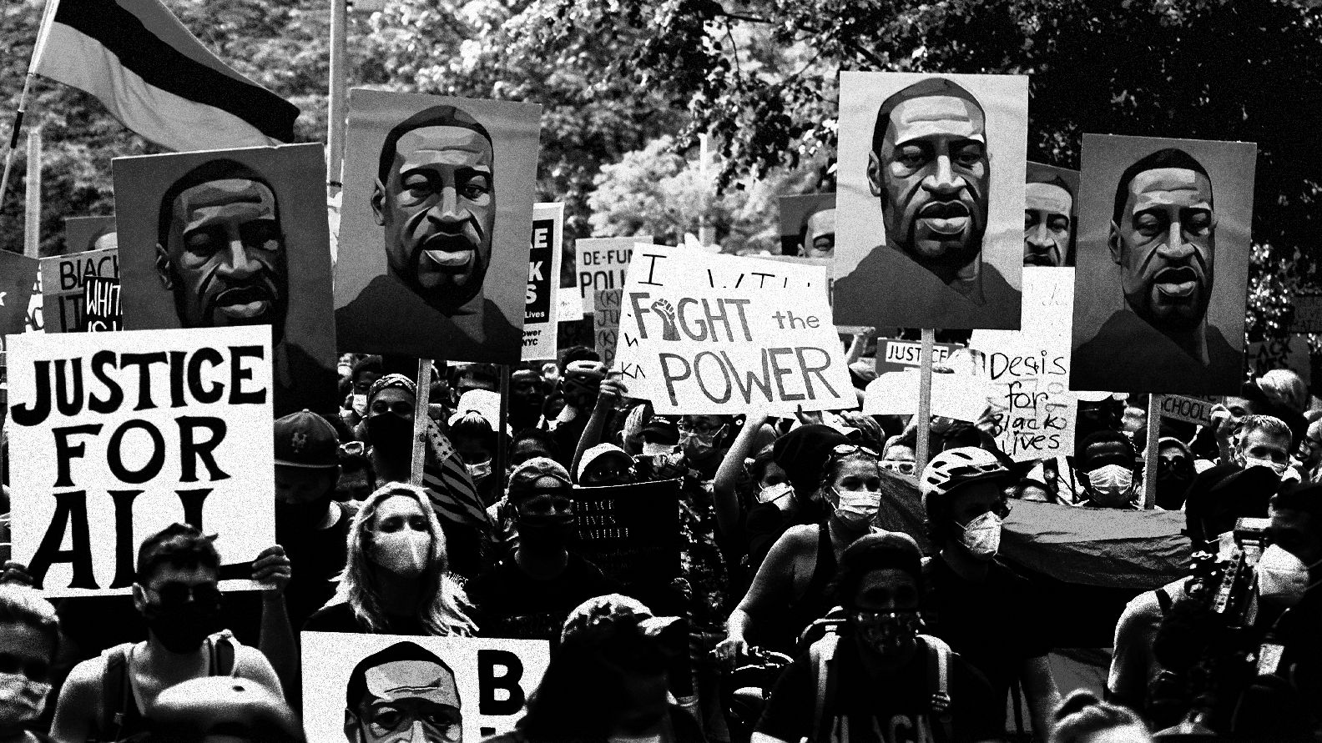
Notes:
After the murder of George Floyd. This was after significant advocacy by critics within the graphics community.

Slide 18
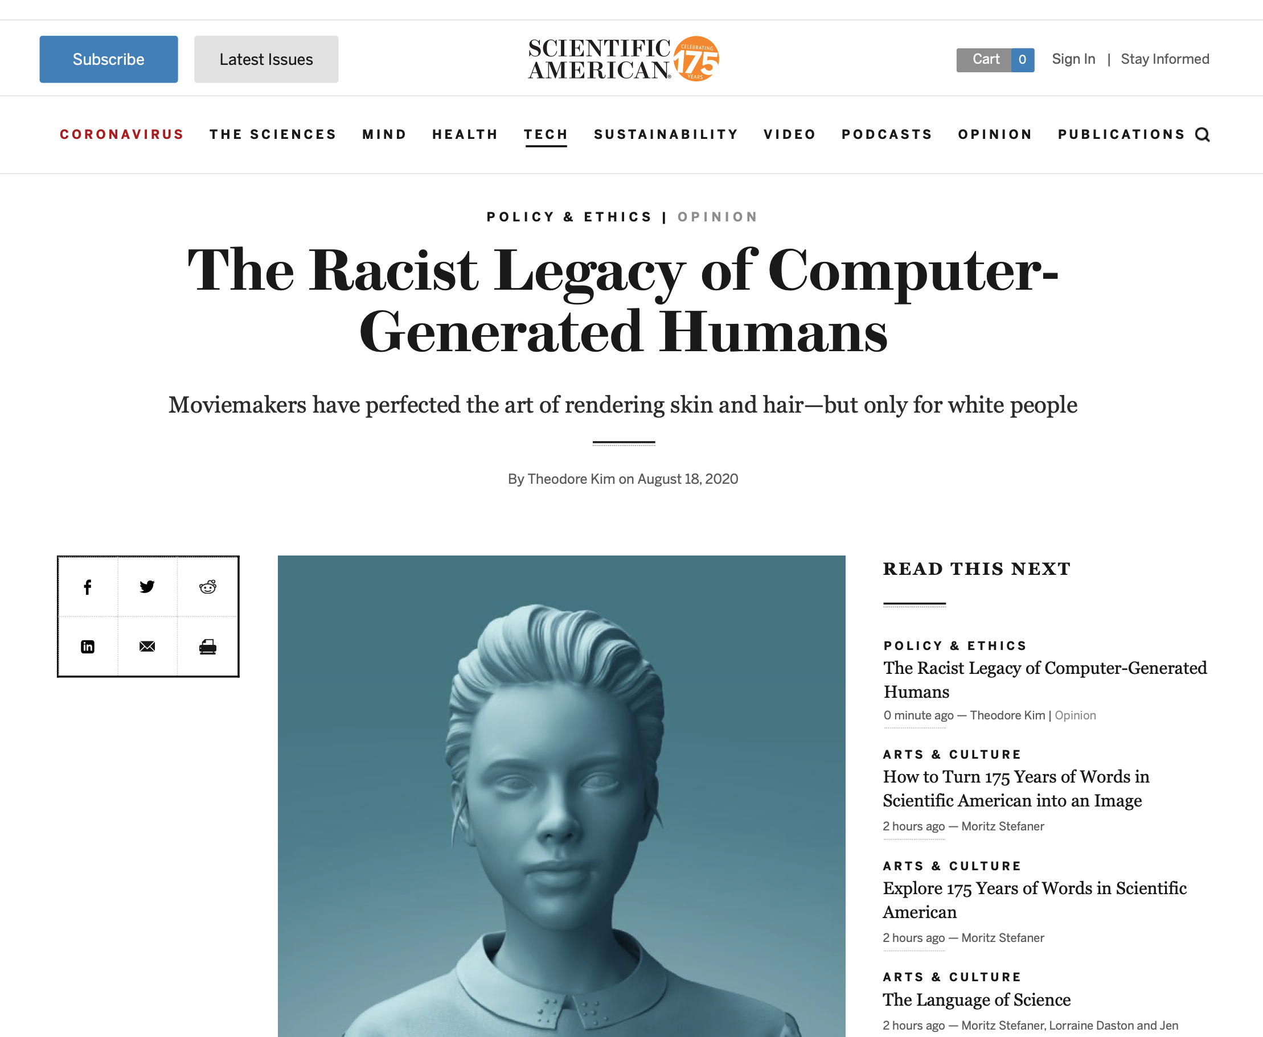
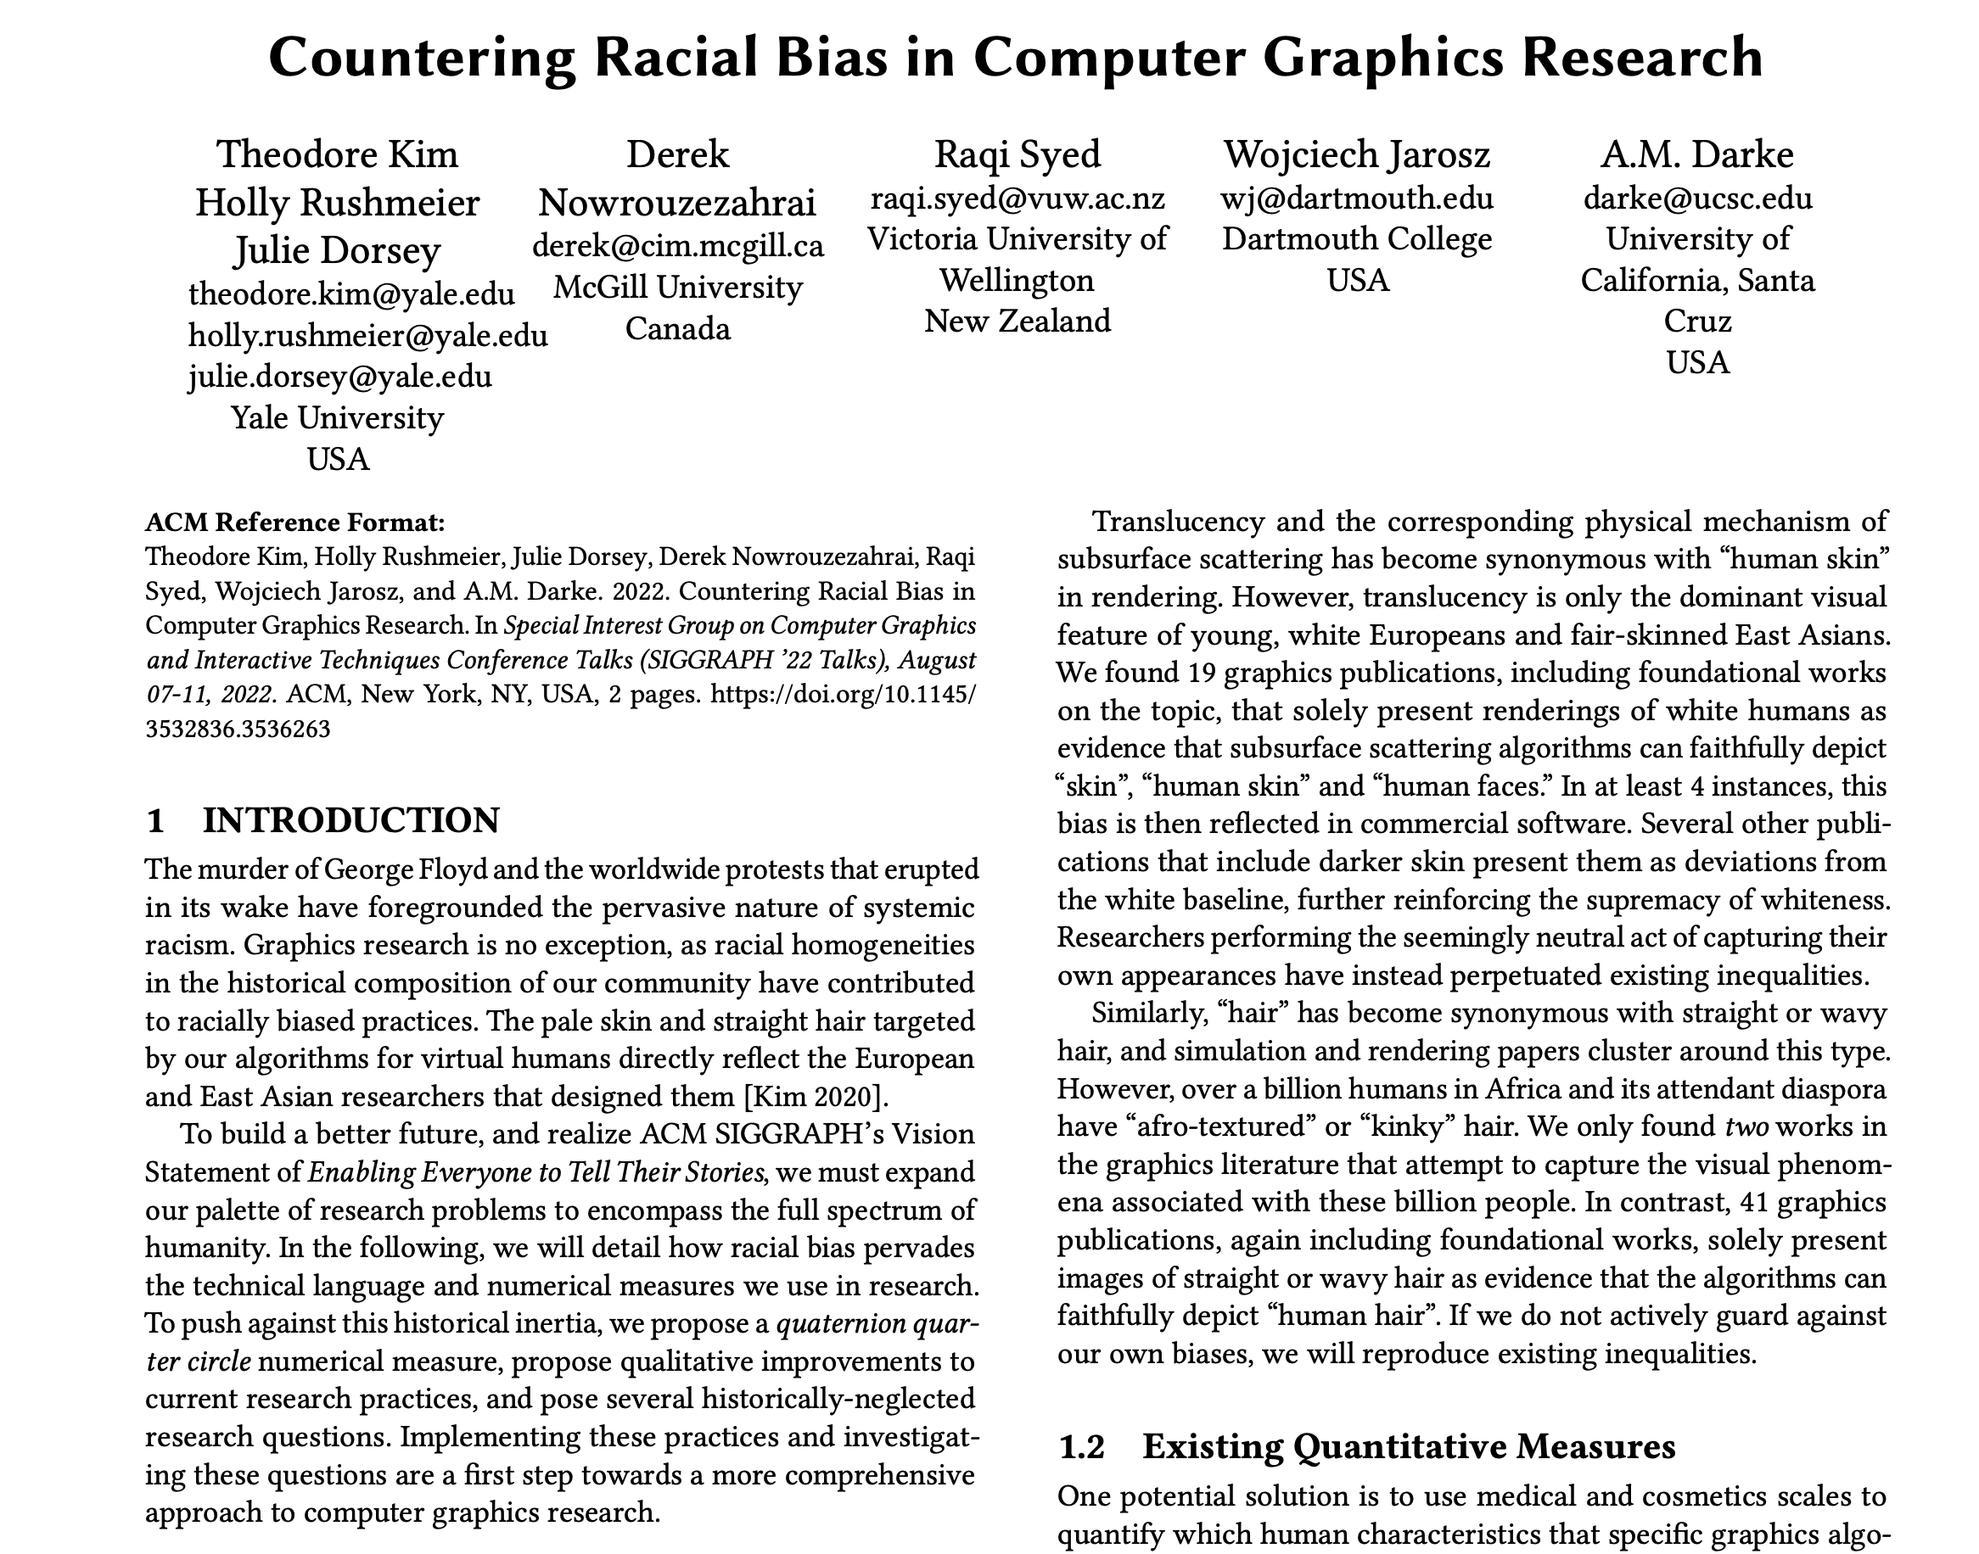
Notes:
And by critics, I mean me and my colleagues

Slide 19
“Skin” means “white skin” in computer graphics
Notes:
To summarize, in graphics, “skin” means white skin.
Papers have only grudgingly included crappy examples of Black skin since 2020.

Slide 20
Search for “hair”
Notes:
Let’s move on to “hair”. We did a search over all SIGGRAPH and TOG papers for “hair”.

Slide 21
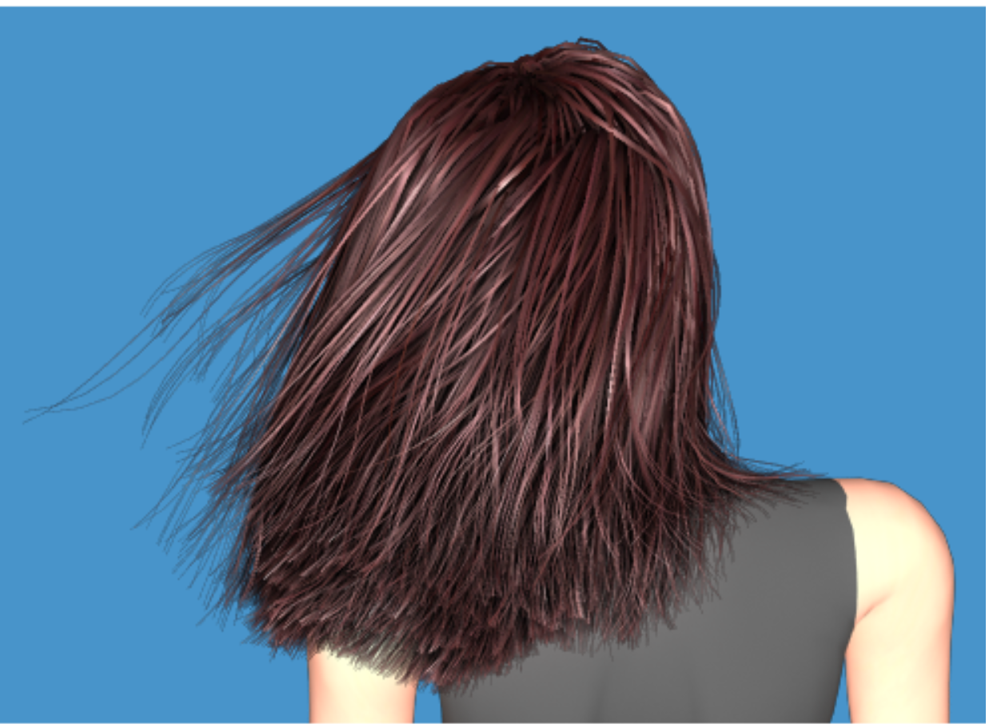
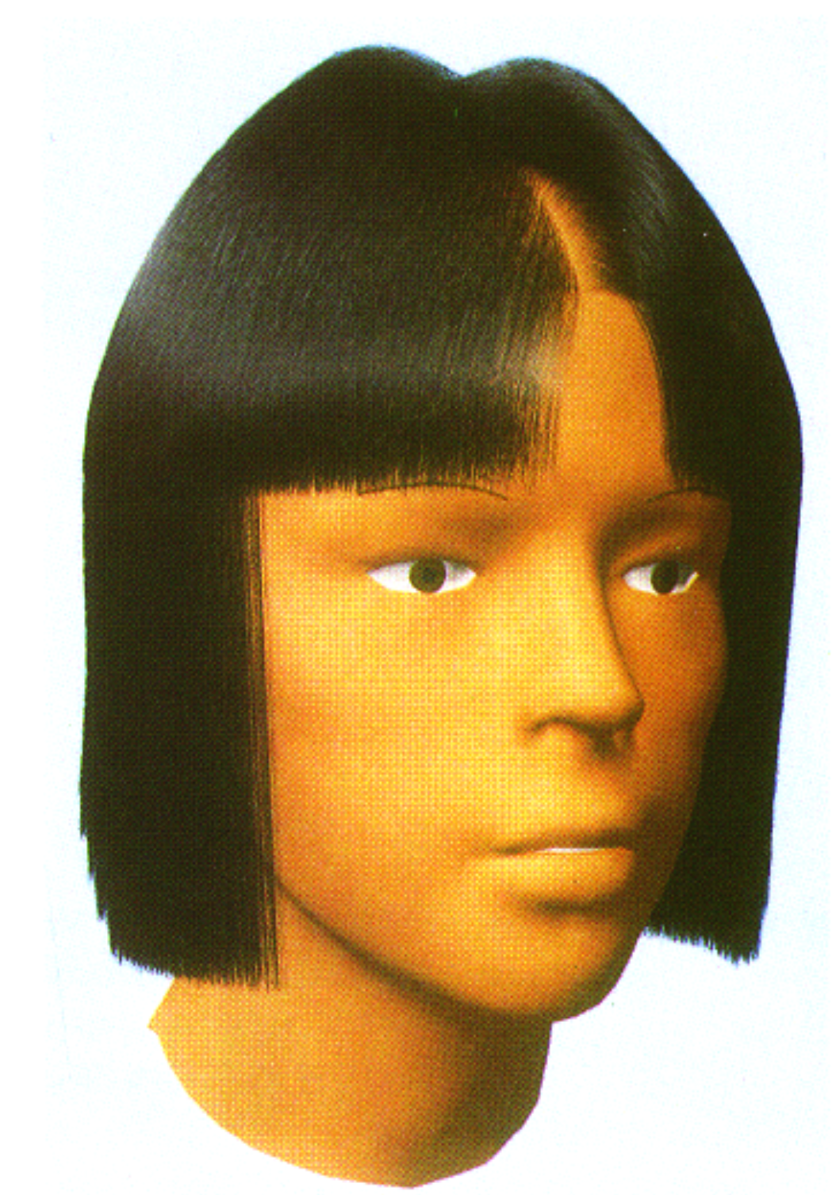
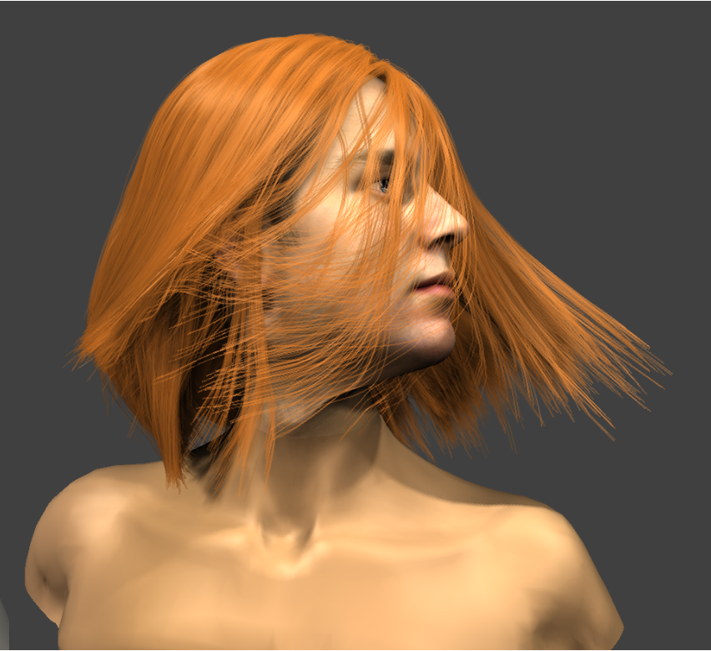
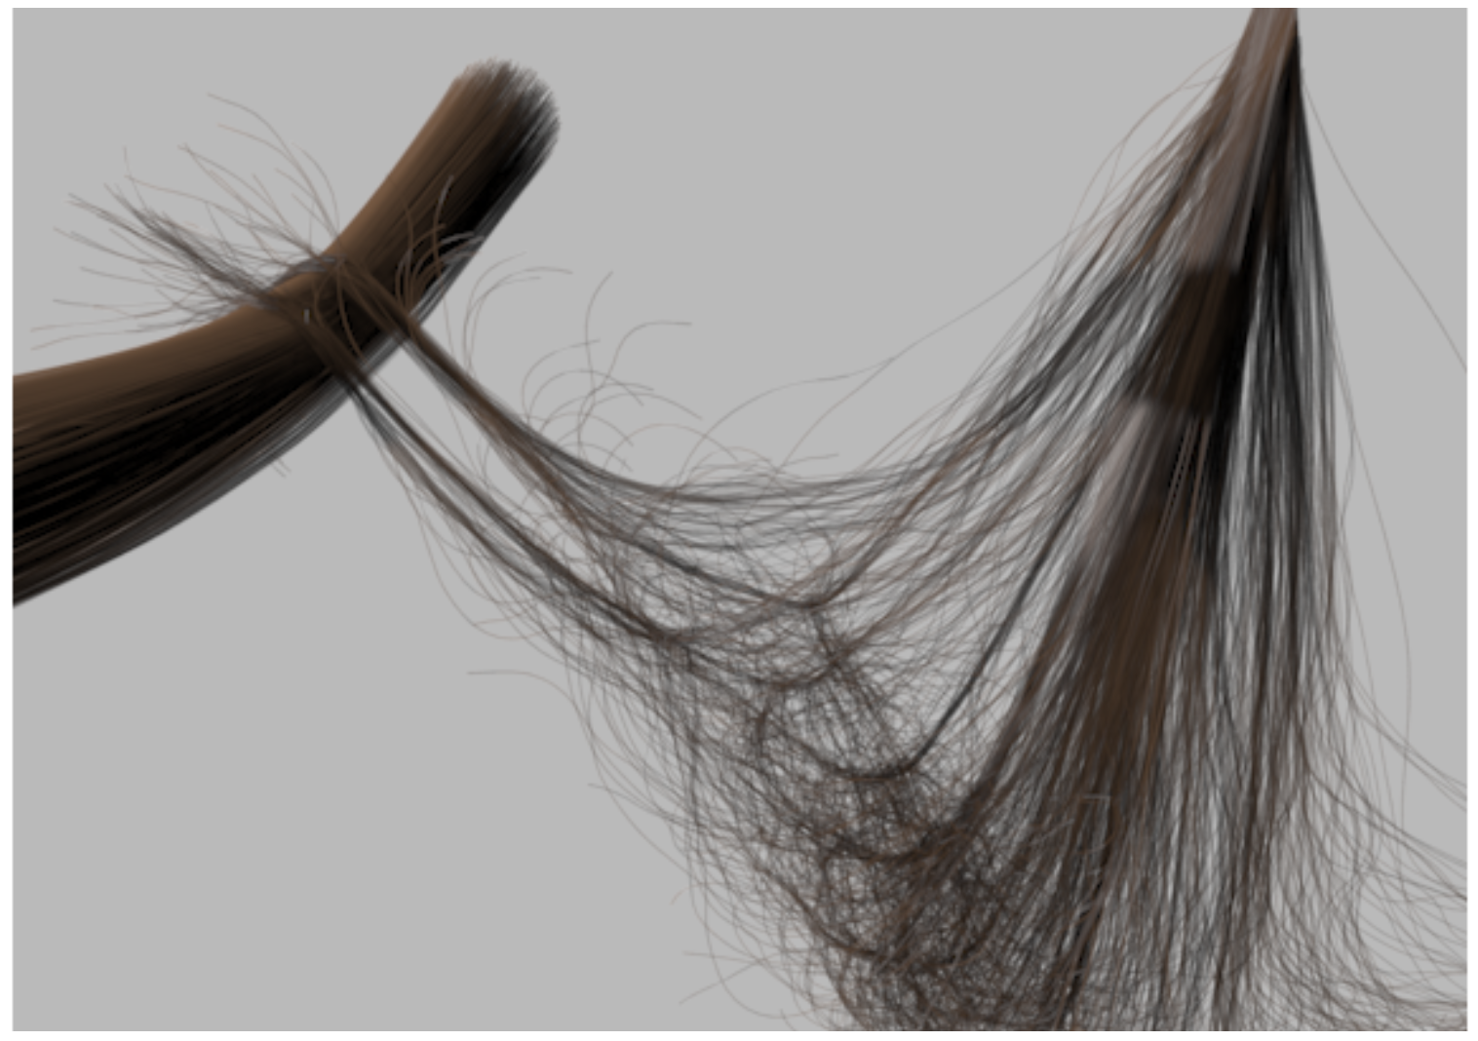
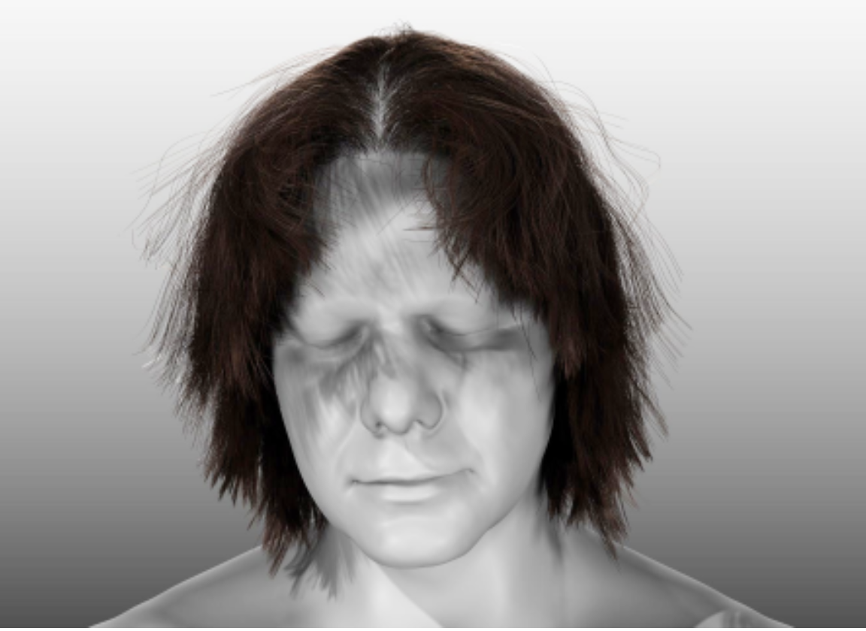
Notes:
Hair almost always means straight hair. Like, REALLY straight hair. Graphics papers on hair show straight hair, and often ONLY straight hair.

Slide 22
Significant binarization
Notes:
Here we found binarization. Everything that is not straight hair got lumped into “curly.” Everything from lightly wavy to highly coiled hair.

Slide 23
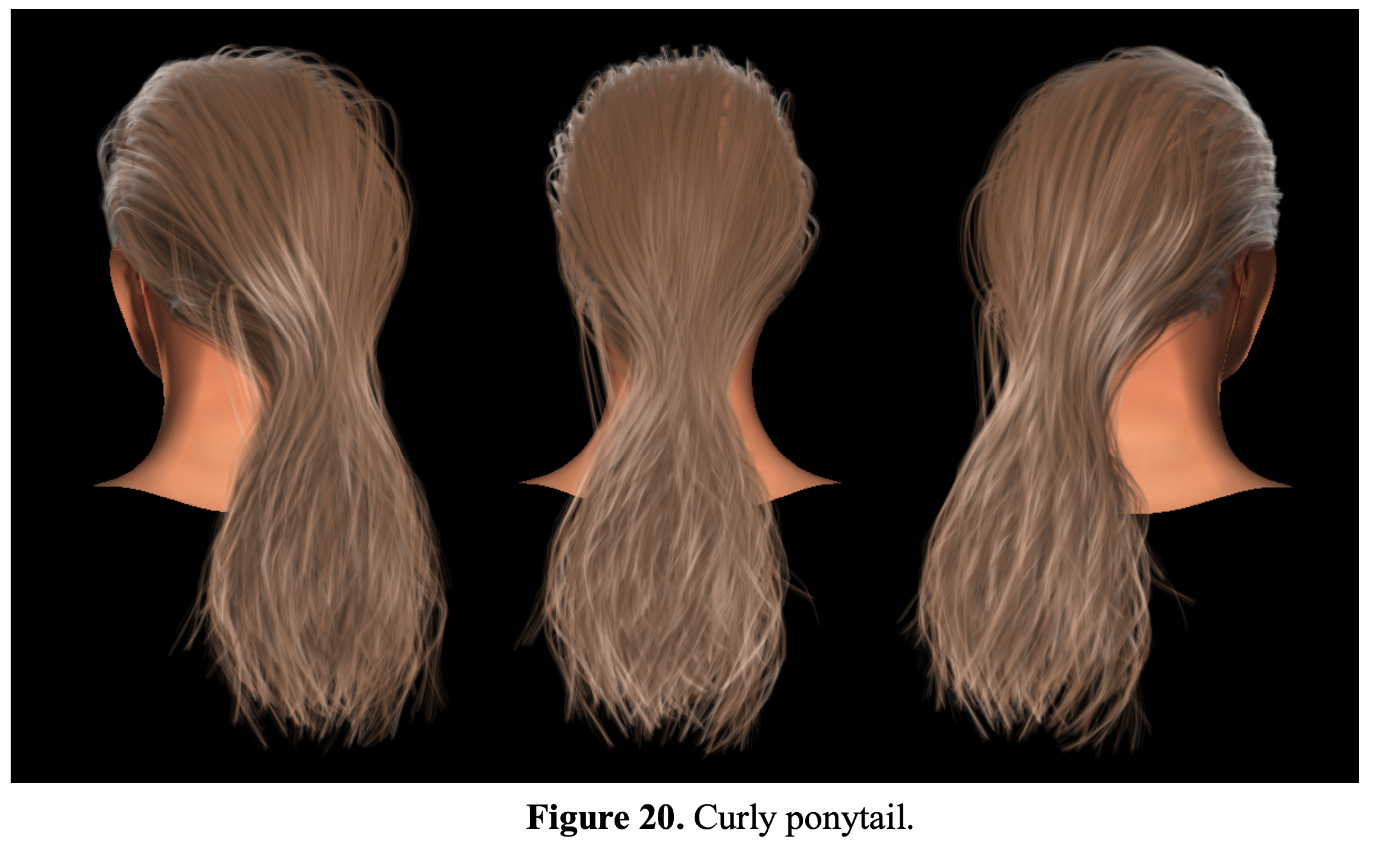
Notes:
Curly hair often means this. Slightly wavy hair. It’s a proxy term for “not straight” hair.

Slide 24
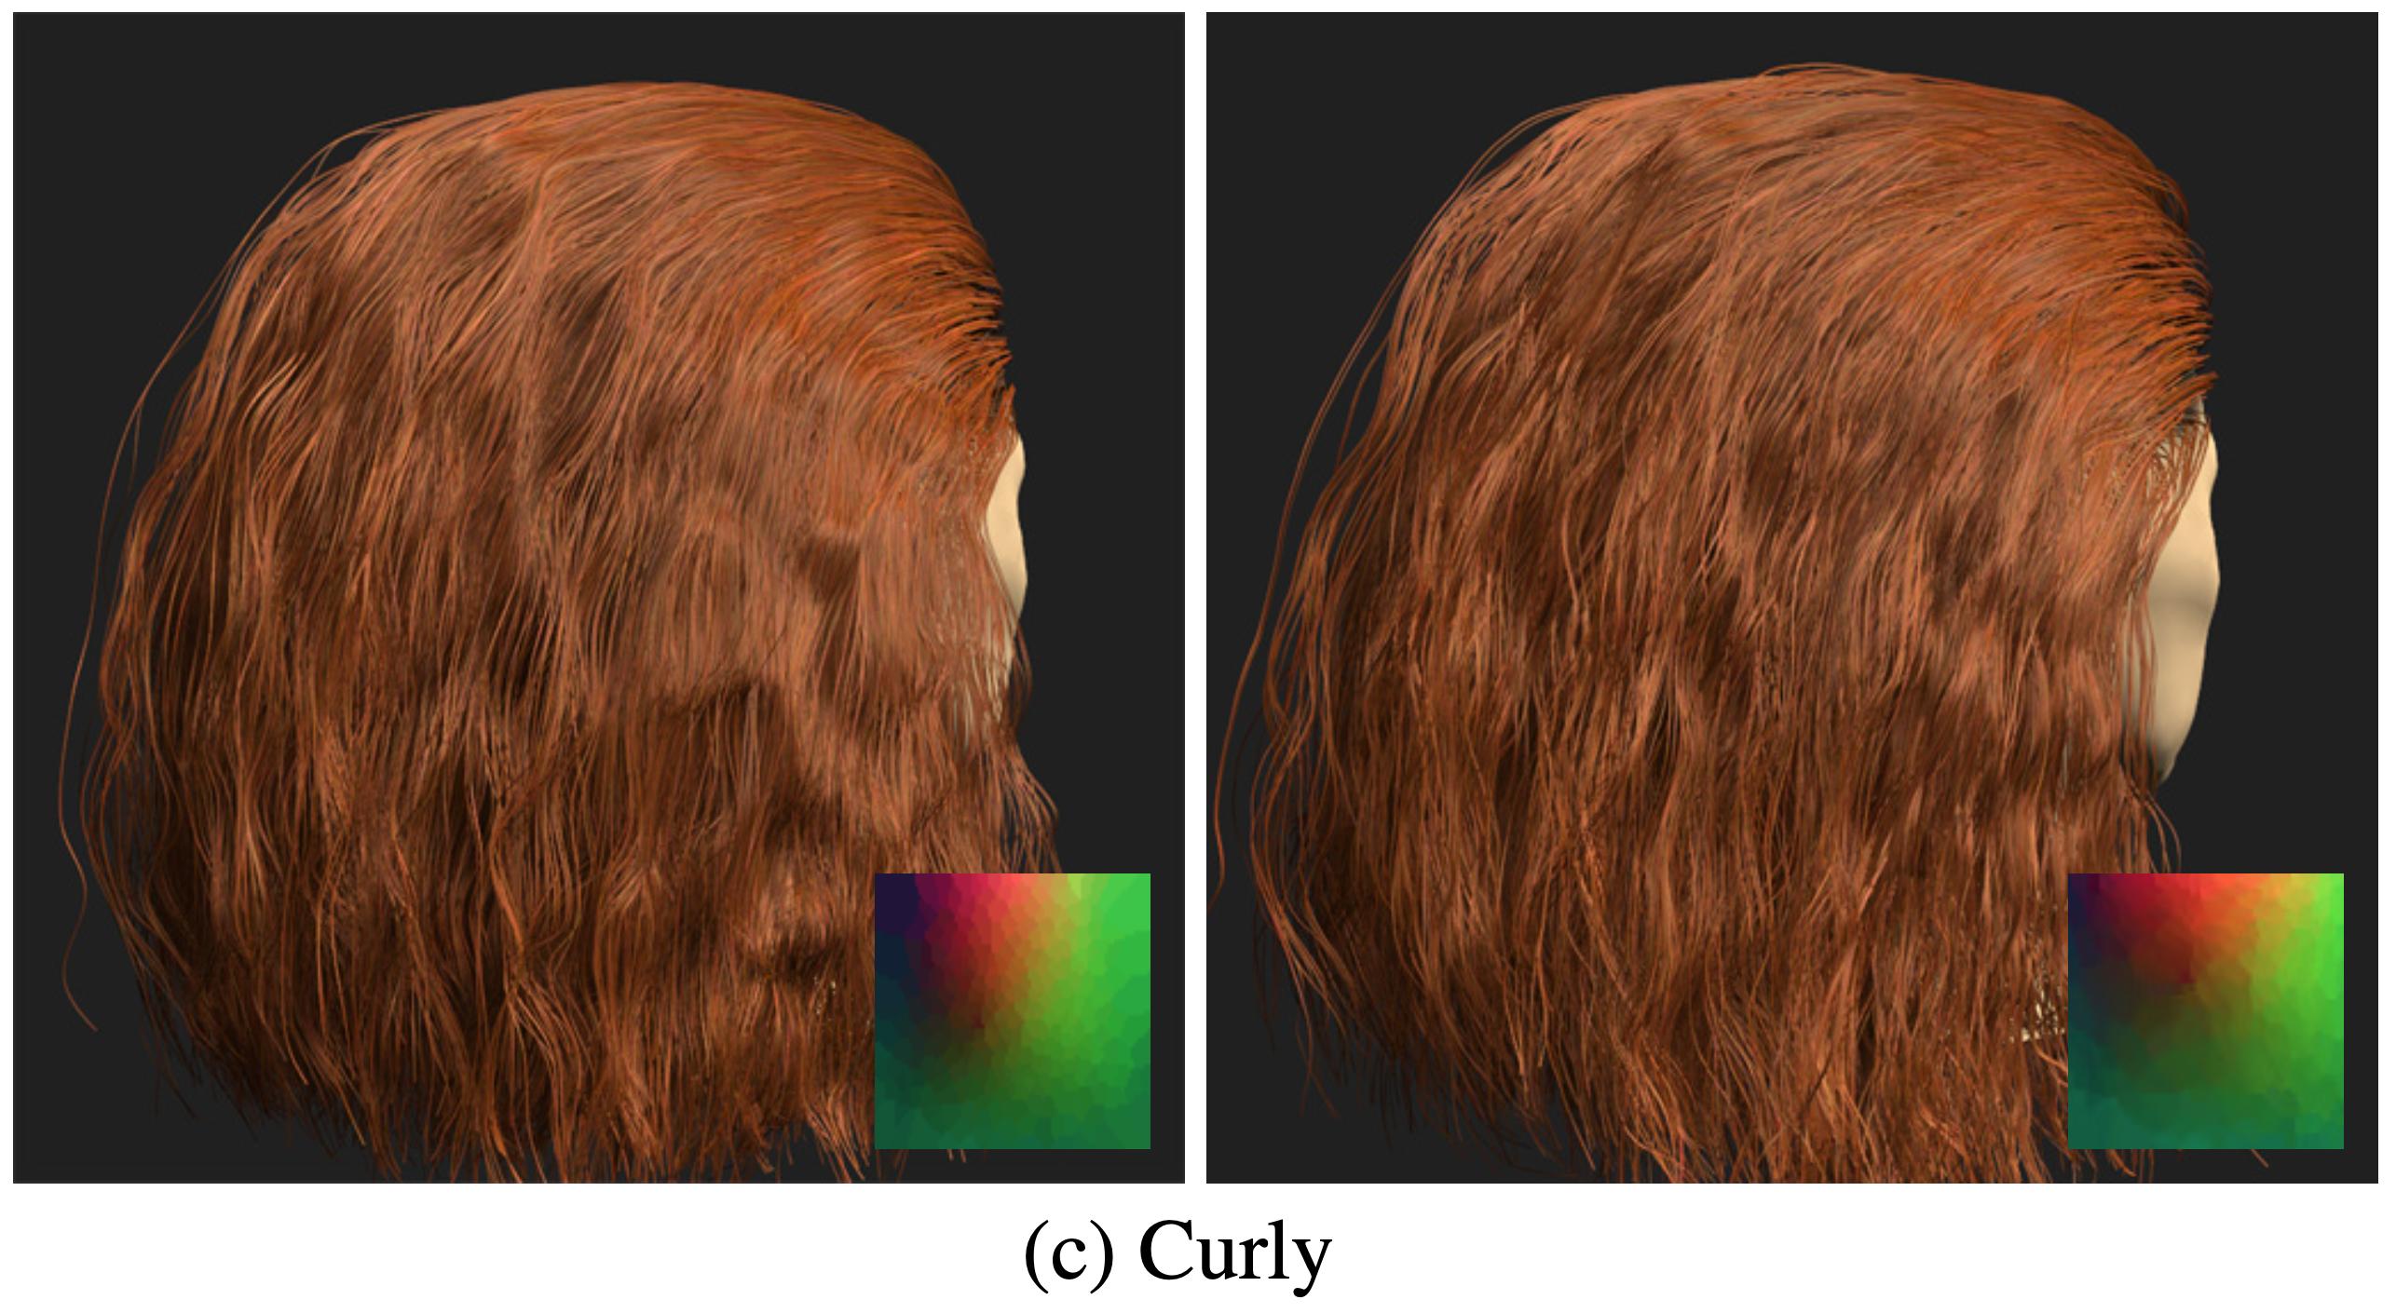
Notes:
Here’s another instance of curly hair

Slide 25
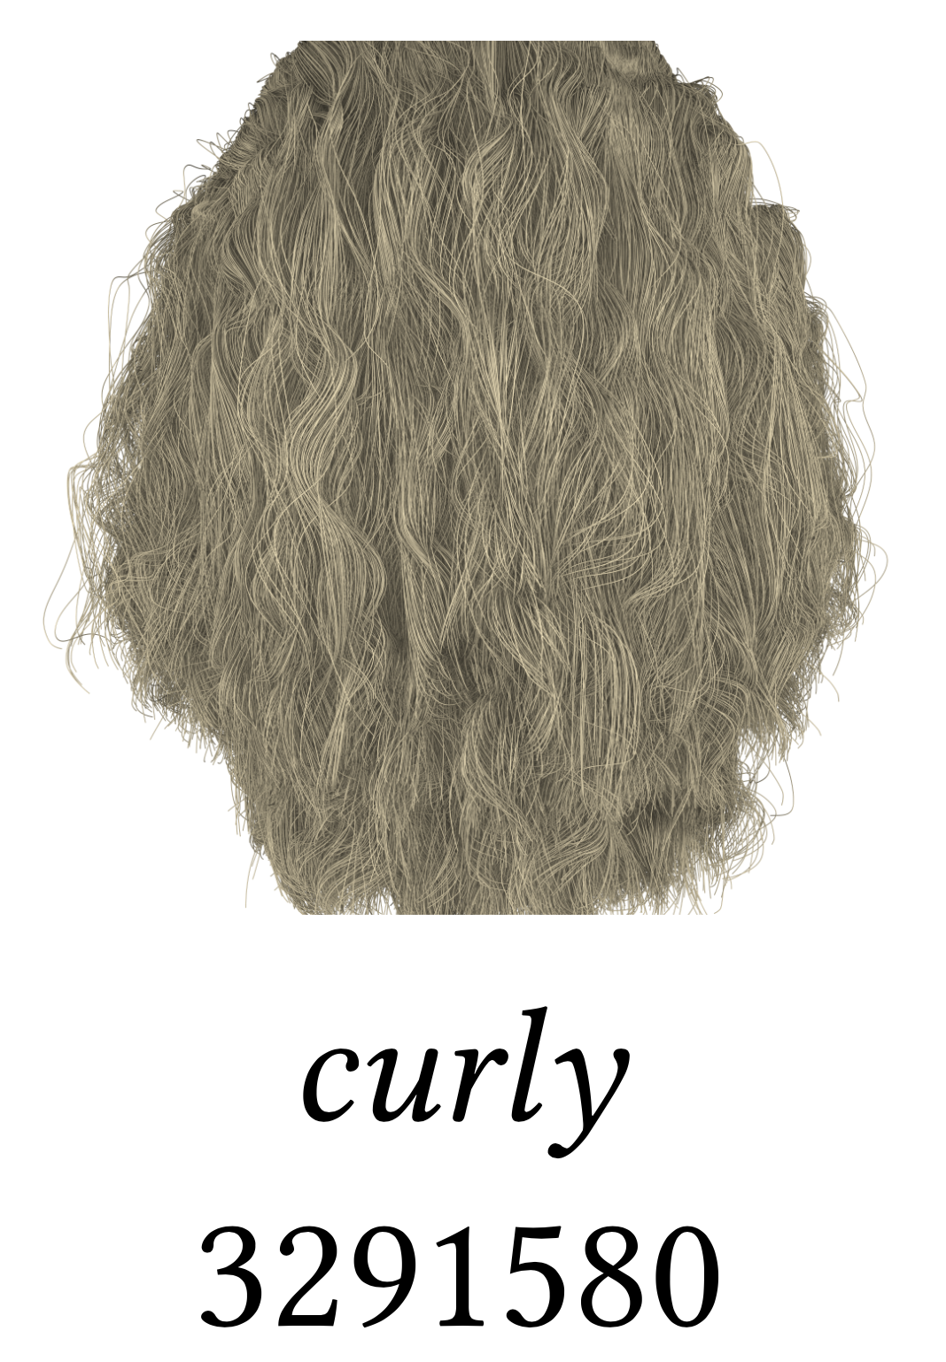
Notes:
Here’s another one. Algorithms are evaluated on straight hair and curly hair, and if it works on both, authors say it works for all hair.

Slide 26
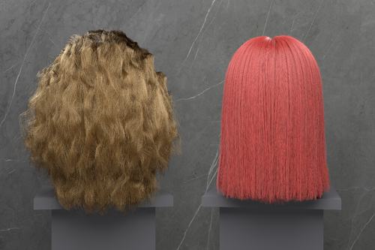
Notes:
Algorithms are evaluated on straight hair and curly hair, and if it works on both, authors say it works for all hair.

Slide 27
Notes:
Again, after me and my colleagues publicly criticized this practice after the murder of George Floyd.

Slide 28
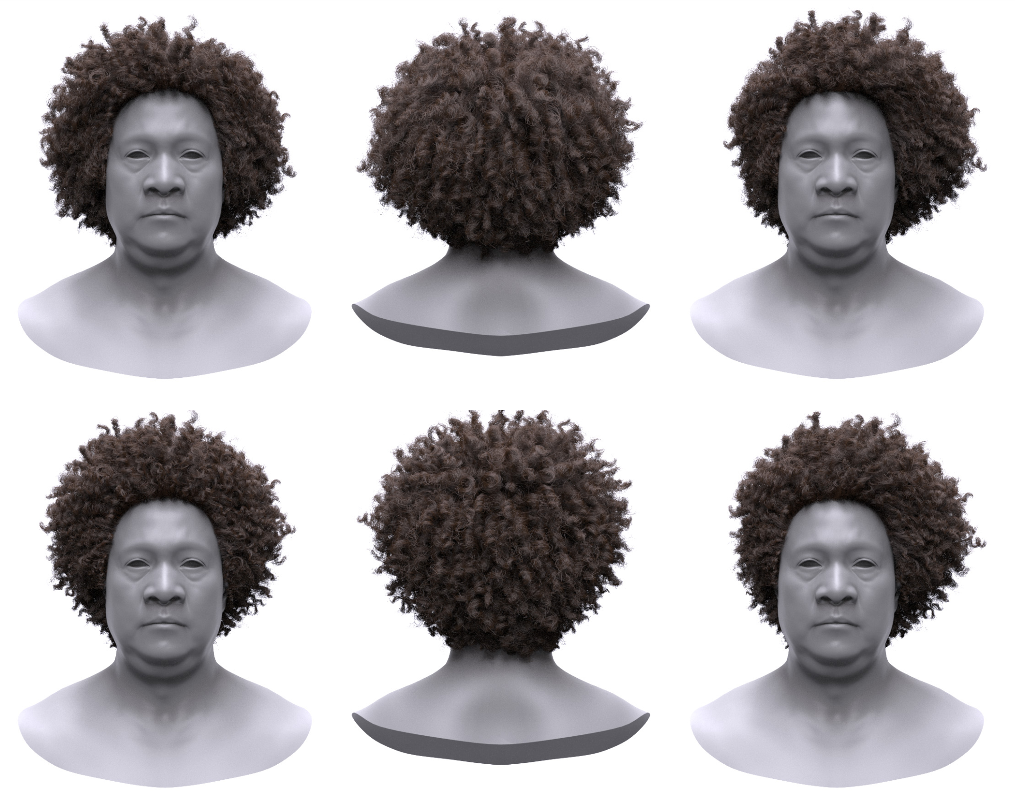
Sag-Free Initialization for Strand-Based Hybrid Hair Simulation, Hsu et al. 2023
Notes:
Some curlier examples started appearing in 2023.

Slide 29
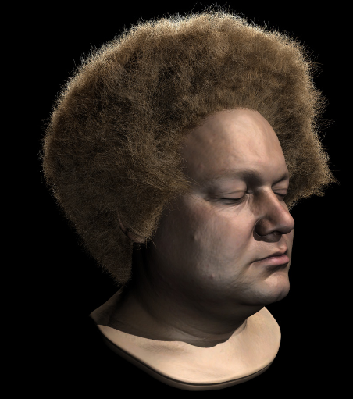
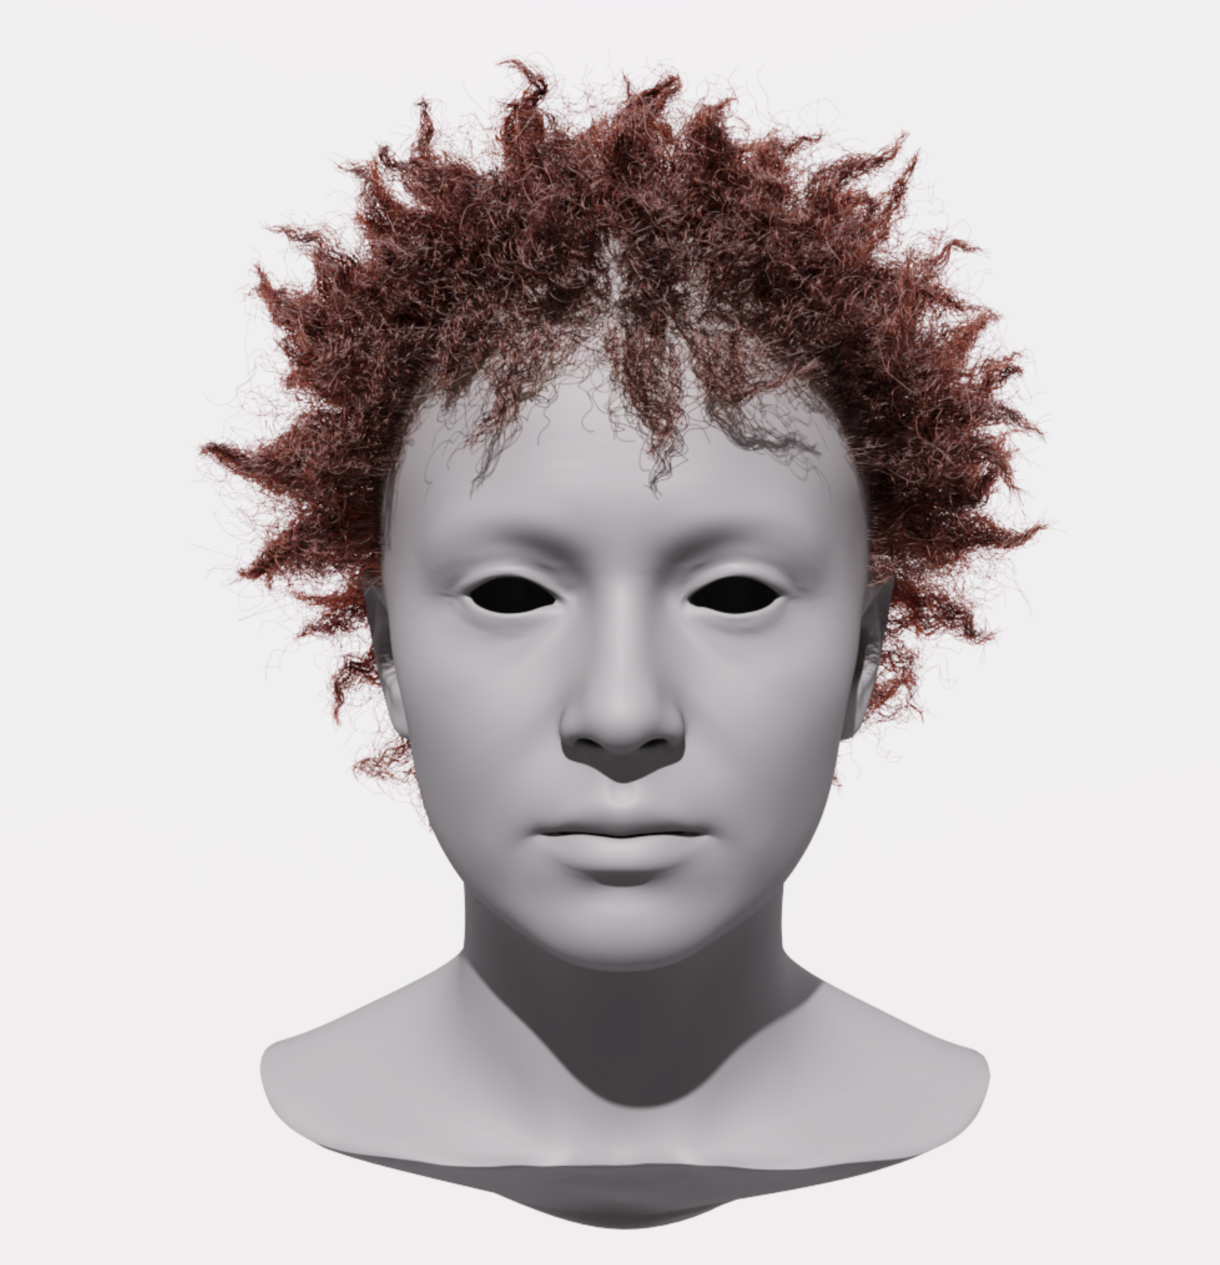
Notes:
The curly hair often looks awful, and gets tacked on at the end of the paper.

Slide 30
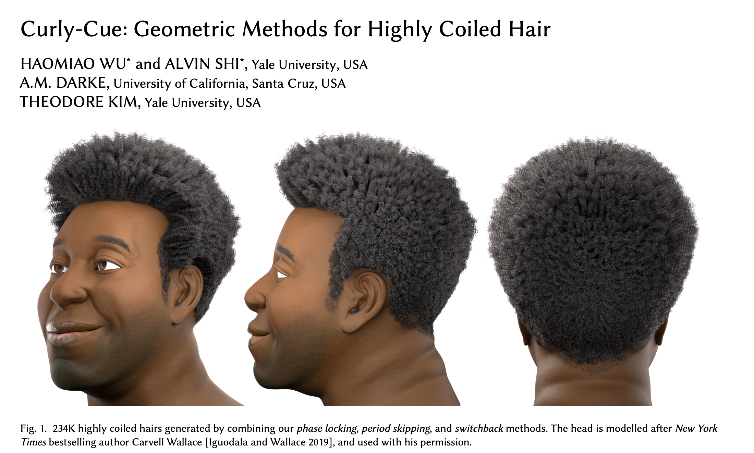
Notes:
The first SIGGRAPH paper that treated Black hair as a first class research problem was this one from 2024.
This was written by me and my colleagues.

Slide 31
“Hair” means “straight hair” in computer graphics
Notes:
In graphics, “hair” means straight hair.

Slide 32
“Hair” means “straight hair” in computer graphics
After 2020:
… plus one crappy Black example
Notes:
Starting it 2020, it also meant “plus one crappy Black example.”

Slide 33
New Terminology
Notes:
I will conclude with some new terminology.
Designing techniques for white skin and tacking a crappy example of Black skin at the end has been going on for a long time.

Slide 34

Notes:
This is Painting With Light, a standard film lighting manual from 1949 written by cinematographer John Alton

Slide 35
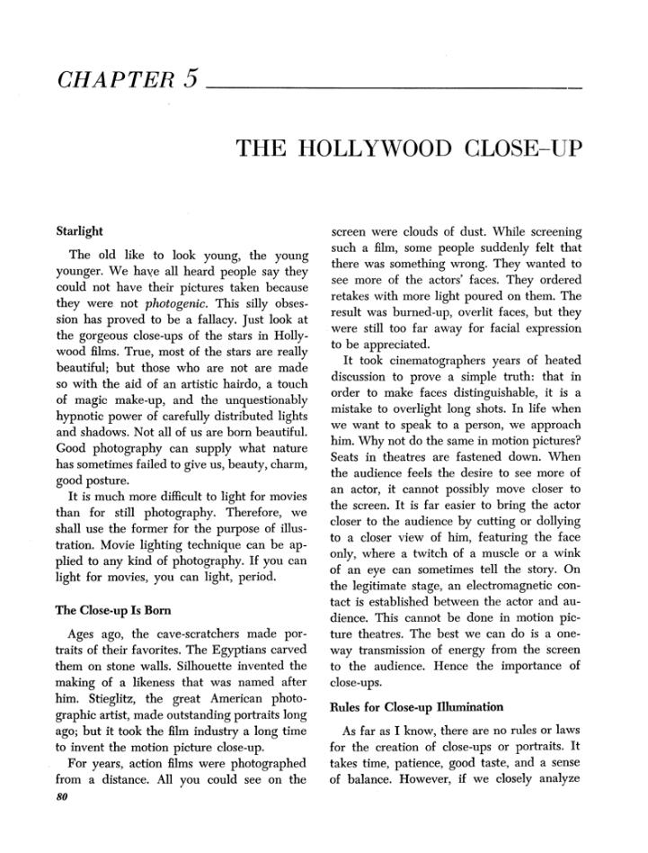
Notes:
Chapter 5 talks about lighting a human face

Slide 36
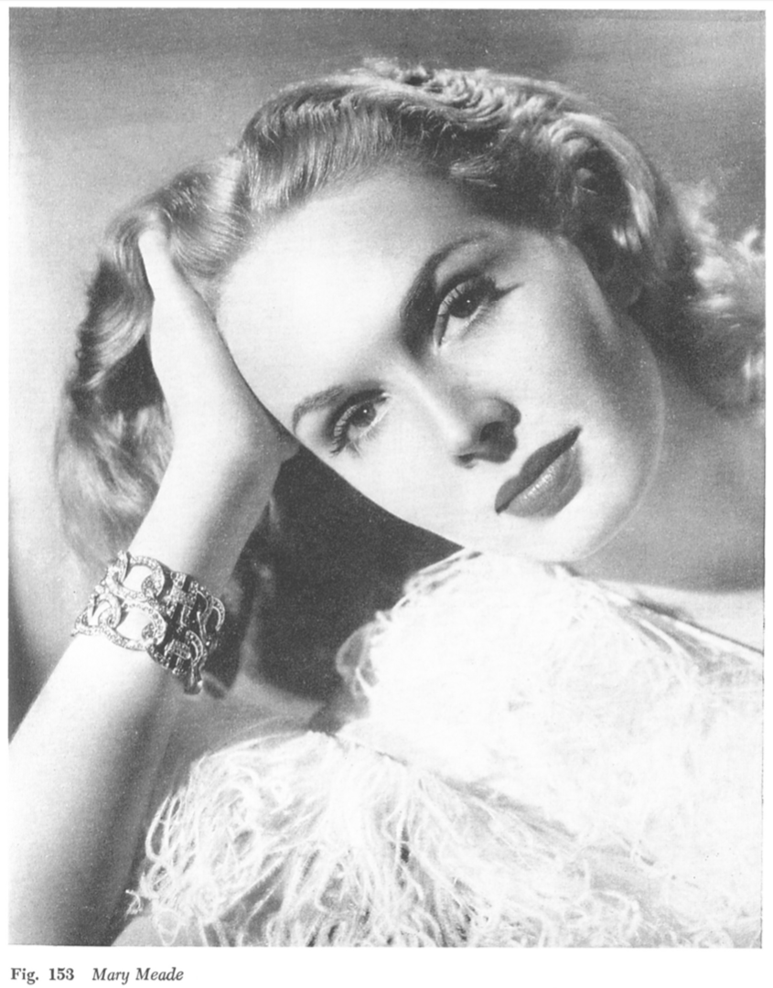
Notes:
By which he means a white face

Slide 37
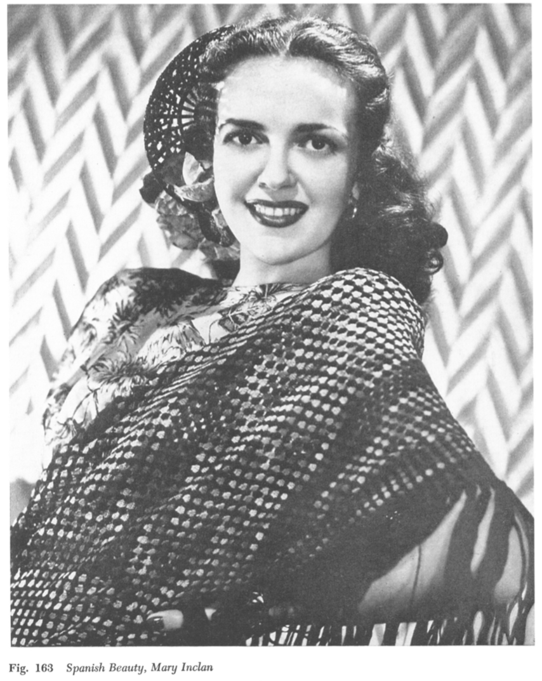
Notes:
a white face

Slide 38
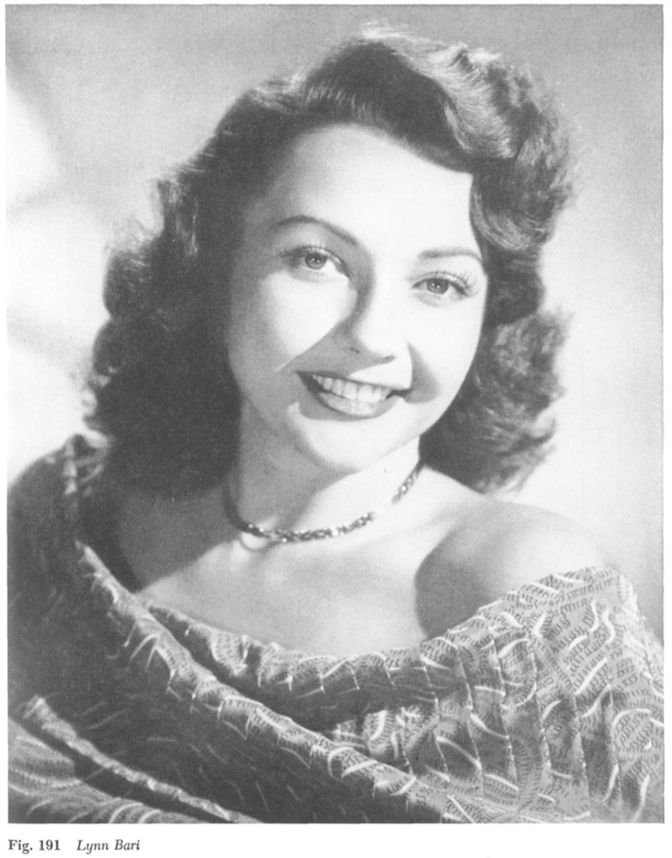
Notes:
a white face

Slide 39
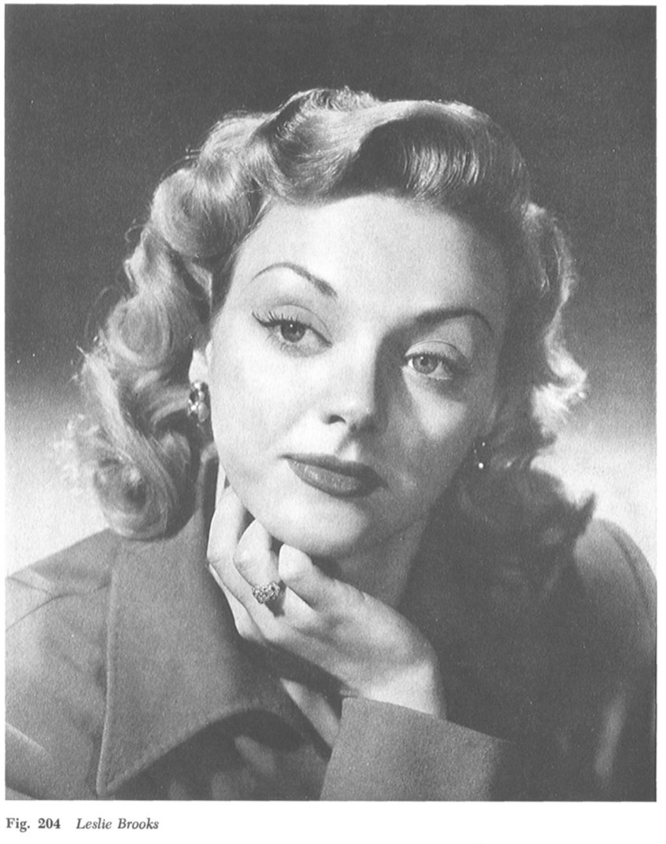
Notes:
a white face

Slide 40
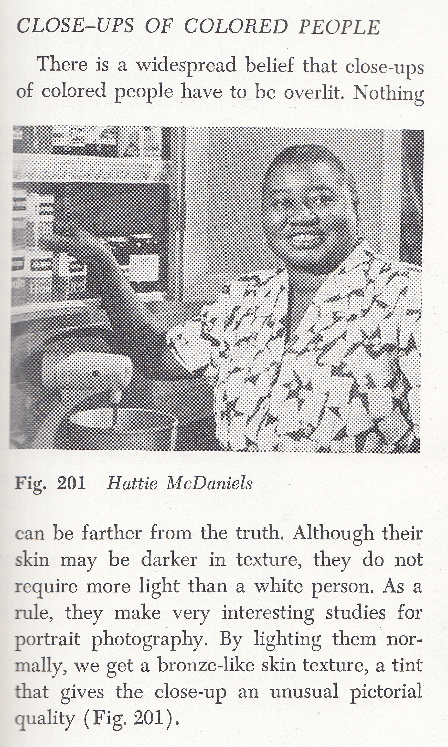
Notes:
It ends with one Black example, and says “Yeah, lighting Black skin is the same.”
As evidence of this, it includes a lit photo of Hattie McDaniel,

Slide 41
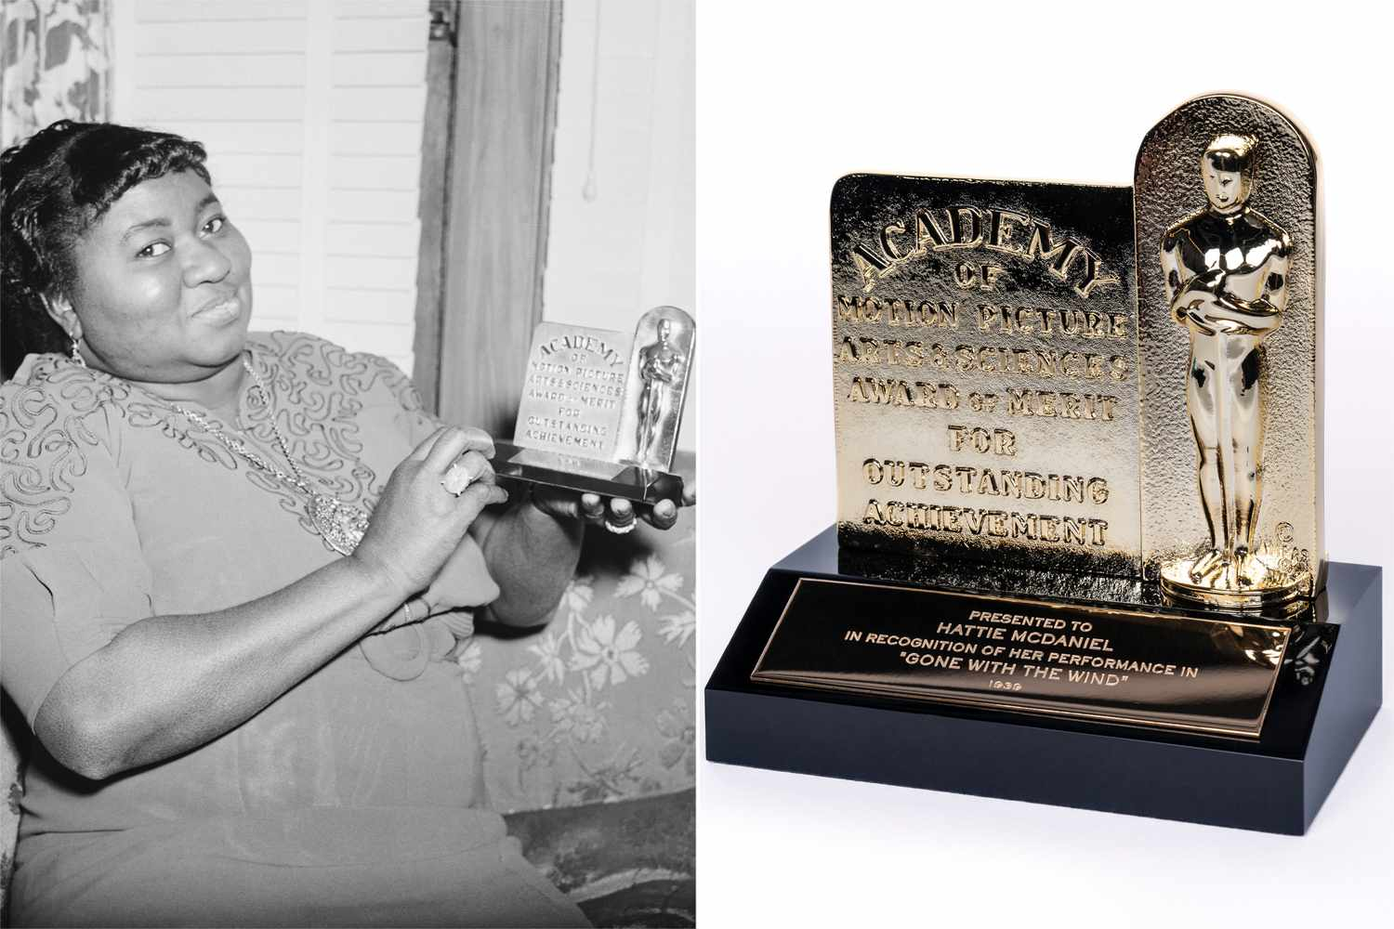
Notes:
the first person of color to ever win an Academy Award.

Slide 42
Notes:
And he misspells her name.
Her name is McDaniel, not McDaniels. There is no trailing “s”.

Slide 43
McDaniels Methods
Notes:
Thus, we propose the term McDaniels Method:

Slide 44
McDaniels Methods
Techniques exhaustively validated on white skin and straight hair, that relegate all other forms of skin and hair to a small set of flawed and underwhelming examples.
Notes:
techniques that are exhaustively validated on white skin and straight hair, and relegate all other forms of skin and hair to a small set of flawed and underwhelming examples

Slide 45
Notes:
In computer graphics research, there are currently lots of McDaniels Methods.

Slide 46
Durald Methods
Notes:
We also define the opposite, Durald Methods:

Slide 47
Durald Methods
Techniques developed in close collaboration with the people being depicted.
Notes:
techniques that were co-created in close collaboration with the people being depicted.

Slide 48

Durald Method
Techniques developed in close collaboration with the people being depicted.
Notes:
We name this after Autumn Durald Arkapaw, the first woman of color to ever win the best Cinematography Academy Award.

Slide 49
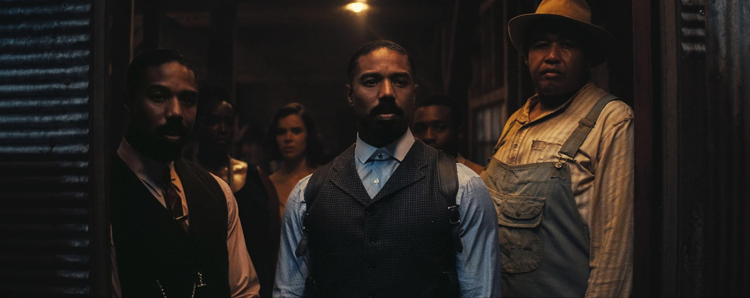


Sinners (2025)
Notes:
She won it this year. Just three months ago, for the movie Sinners.

Slide 50
Notes:
Our 2024 paper is a Durald Method.

Slide 51
Notes:
We wrote it in close collaboration with A.M. Darke, the top expert in the world on digital depictions of Black hair.

Slide 52
Is This a McDaniels Method or a Durald Method?
Notes:
So, next time you see a computer graphics paper on skin or hair, ask yourself:

Slide 53
Is This a McDaniels Method or a Durald Method?
Notes:
is this a McDaniels Method

Slide 54
Is This a McDaniels Method or a Durald Method?
Notes:
Or a Durald Method?
If it’s a McDaniels Method, call it out on its bullshit.
If it’s Durald Method, share it with your friends.
That is my ask of you.

Slide 55
Is This a McDaniels Method or a Durald Method?
Theodore Kim, Alexa Schor, Julian Posada, Alka V. Menon
Yale University
June 25, 2026
Notes:
Thank you for listening to our talk.

